Slide 1


Slide 2
Year 1 Team
Teachers:
1RC - Mrs Riddell and Miss Chang
1T - Mrs Thornton
Teaching Assistants:
– Mrs Baker
– Ms Edwards

Slide 3
School day - drop off and collection
Start of Day - Every morning (8.50 am) the teachers will collect the children from the playground by the Year 1 gate.
1RC stand on the yellow circle and 1T stand on the red circle.
End of Day - Collection is at 3.25pm. 1RC children will go out of Year 1’s main gate onto the middle playground. 1T will go out of our outdoor area onto the bottom playground.
Please feel free to come closer and we are always available to talk to you at this time, once all children have been collected.

Slide 4
Things to bring on the first day
Clear water bottle labelled with your child’s name, filled with water (to be brought in everyday)
Book Bag
Spare clothing
Your child’s book bag will come to school each day and we will send home reading books, spellings, letters, pictures etc.
No toys to be brought into school, except for Thursdays, where your child can participate in Pokemon Day. The children can bring in cards and swap them between the other children in school. This is monitored on the playground at Lunchtime.

Slide 5
First Week in Year 1
It is important that your children feel safe and happy in Year 1. As a class we will spend time:
Learning classroom routines
Learning classroom rules
Talking to the teachers and asking questions
English and maths lessons
Reading and practising handwriting
Discovery Time
Classroom Activities

Slide 6
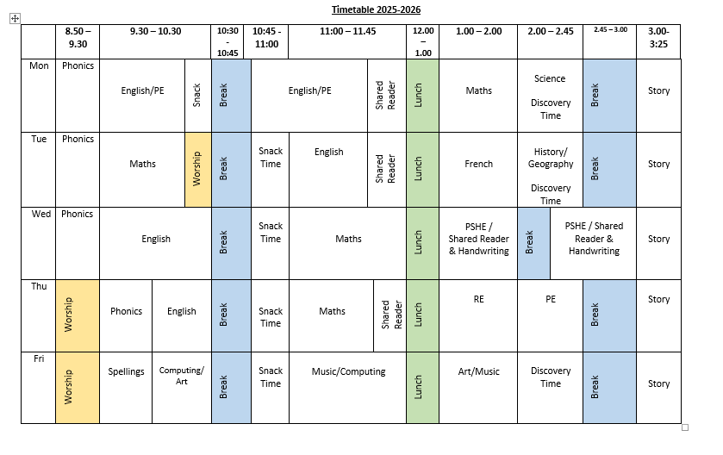
Timetable – Autumn Term

Slide 7
Reading & Reading books
In Year 1, we aim to listen to your child read in school at least once a week.
Some children may be added to a daily reading group to support their fluency and reading development.
One reading books matching your child’s phonic ability (according to our phonics scheme) and will be sent home on a Monday.
Alongside this, you will also have access to the phonics parent portal. Every Friday on the spelling sheet, you will be informed of the Shared Reading book for the following week. Please read this over the weekend, to support your child's lessons for the following week. This book can be quite challenging and should be read with an adult.
Please read at home as much as possible. You only need to spend 5-10 minutes a day. Please let us know how your child is doing by writing in the reading record book, we really enjoy reading your comments.

Slide 8
Spellings & Homework
Maths homework (Numbots) will be assigned on Wednesday and should be completed by the following Wednesday. Please let your children log on by themselves and complete the activities set by their class teacher.
Parent Portal Login: parents.fft.org.uk Passcode:k8q41b
There will also be weekly spellings, which we send out on a Friday.
Your child must practise these at home each week.

Slide 9
Phonics & Phonics Screening
Daily phonics will continue in Year 1.
The children take part in The National Phonic Screening Check in June.
Throughout the year, we will do lots of practice with your child. The children are unaware that they are taking part in an assessment, we make it as fun as possible! The check has “alien” words, which make it lots of fun for the children.

Slide 10

Working in Partnership
Curriculum Newsletter every half term
Reading Spine
Whole school weekly newsletter
Year 1 email address – year1@holytrinity.leeds.sch.uk

Slide 11

Trips
In Year 1 we will be going on 1 trip off site.
We will also have an experience day in school.
We rely on parental volunteers for our trips. If you are able to volunteer then please let us know by email year1@holytrinity.leeds.sch.uk

Slide 12
Admin
Communication – Please ensure school have the correct contact details for you, including email.
Milk –To access this, you must register with Cool Milk and they deliver the milk to us. If you still wish for your child to have milk at school in Year 1, payment is made through Cool Milk. We received updated milk lists from Cool Milk directly.
Additional – If you have any concerns or information which you think will support your child’s transition into Year 1, please share it with your child’s class teacher.

Slide 13

We hope you have a wonderful summer holiday and we look forward to meeting you all in September. If you have any further questions please email year1@holytrinity.leeds.sch.uk

