Slide 1
MATHS AND ART DAY
DRAWING CHALLENGE HOMEWORK

Slide 2
competition
If you would like to enter the competition, draw a portrait of poppy and bring it to school next week. The winner will be announced on Friday.

Slide 3
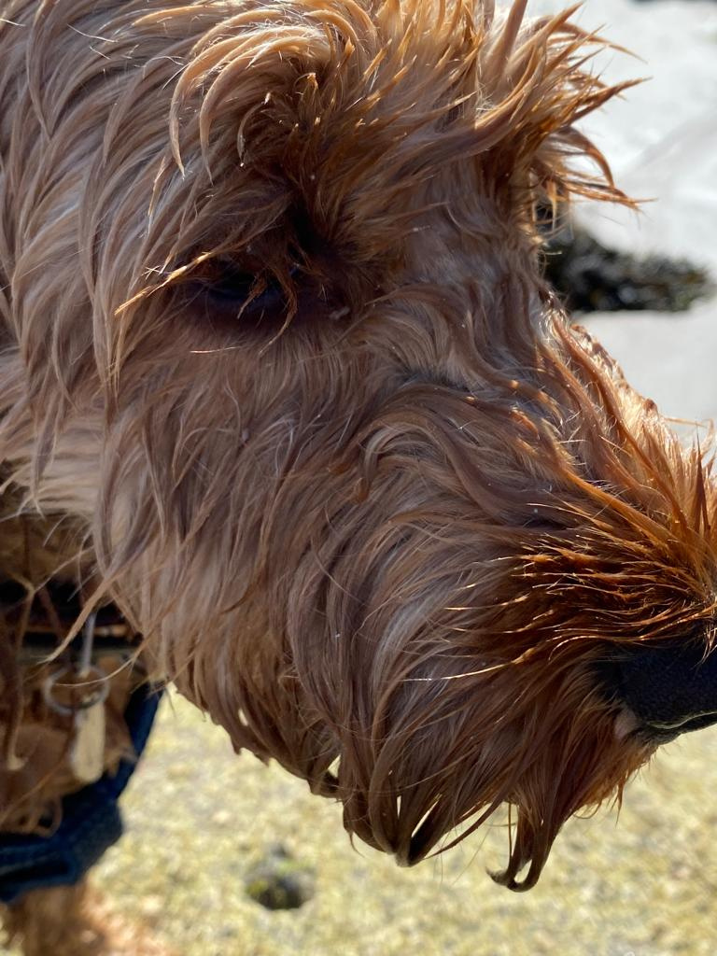
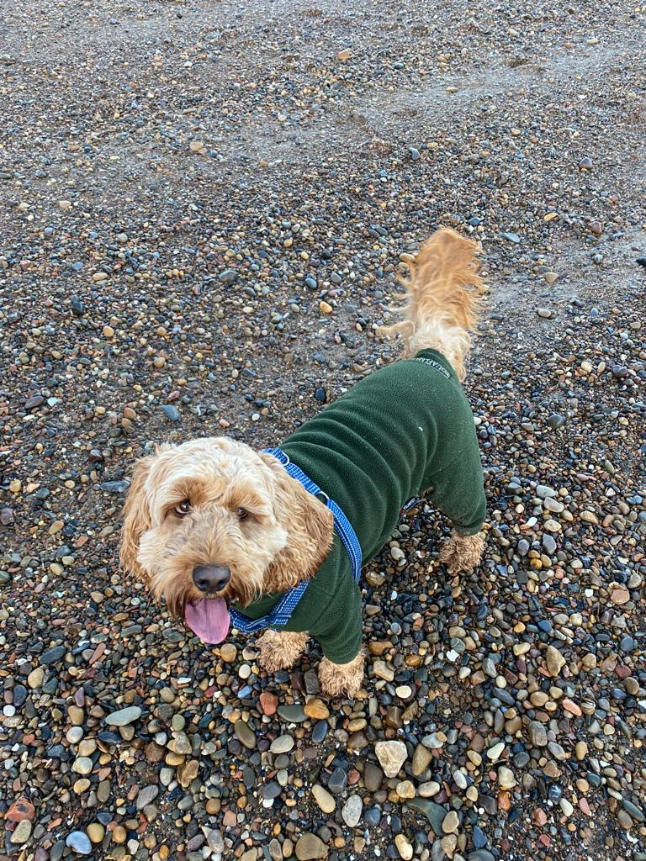

Slide 4
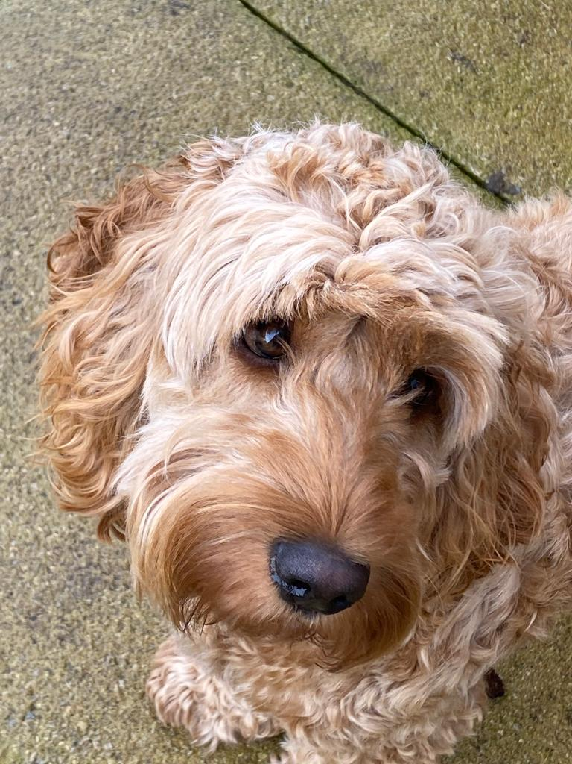
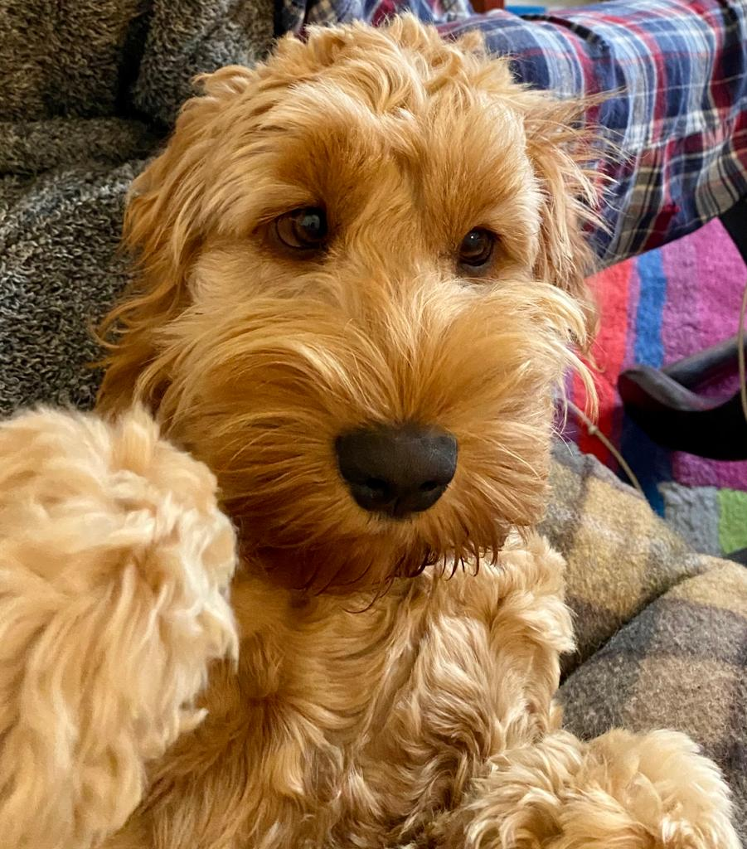

Slide 5
