Slide 1
14.7.2021
L.O. to identify and describe right angles in 2D shapes.
Success Criteria:
I understand that angles are formed where two straight lines meet at a point.
I can describe angles as the measure of the turn between the two lines.
I can identify right angles in 2D shapes, representing the angle using a small square.

Slide 2
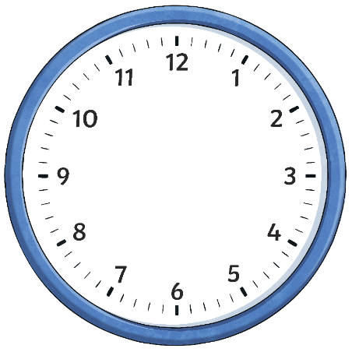
Which clocks show a quarter turn?
A and E
A
B
C
D
E
Can you explain why the other clocks do not show quarter turns?
B and D show a half turn which is two quarter turns. C shows a turn smaller than a quarter turn.

Slide 3
What Is an Angle?
We see angles when two straight lines meet at a point.
An angle is the measure of the turn between two lines.

Slide 4
What Is an Angle?
Here we can see the angle made in a quarter turn.
The measure of the turn in a quarter turn is called a right angle.
Instead of a curved arc to show a right angle, we use two straight lines to create a small square. This is because right angles are square corners.

Slide 5
What Is an Angle?
A right angle can face any direction.
A right angle can be in any position.
A right angle always has a quarter turn between two straight lines.

Slide 6
Right angles in 2D shapes
Let’s investigate which 2D shapes have right angles.
We can use a right-angle finder to help us to check which of the angles are right angles.
The rectangle has 4 right angles.

Slide 7
Right angles in 2D shapes
Let’s investigate which 2D shapes have right angles.
We can use a right-angle finder to help us to check which of the angles are right angles.
The triangle has 1 right angle. It’s called a right-angled triangle.

Slide 8
Right angles in 2D shapes
Let’s investigate which 2D shapes have right angles.
We can use a right-angle finder to help us to check which of the angles are right angles.
The rhombus has no right angles.

Slide 9
Right angles in 2D shapes
Let’s investigate which 2D shapes have right angles.
We can use a right-angle finder to help us to check which of the angles are right angles.
The square has 4 right angles.

Slide 10
Prove It
Does this 2D shape have 3 right angles?
No, this shape has one right angle.

Slide 11
Prove It
Does this 2D shape have 3 right angles?
Yes

Slide 12
Prove It
Does this 2D shape have 4 right angles?
No. As this shape has curved corners/vertices, it has no right angles.

Slide 13
Right Angles in Shapes Challenge
How many right angles are in this shape?
Discuss with your partner. Do you agree?
There are 5 right angles inside the shape.
Did you also spot the right angle created on the outside of the shape?

Slide 14
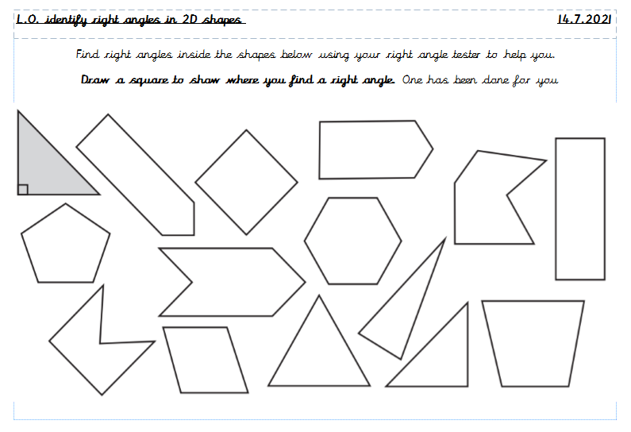
Task:

Slide 15
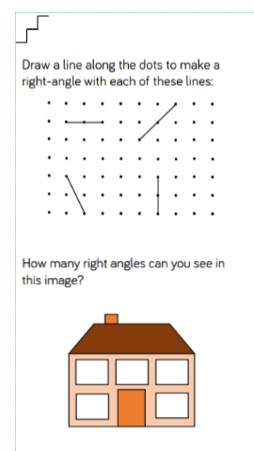
Next Step:
Use your right angle tester to help you solve the problems!

Slide 16
Task 2:
Using your right angle tester, move around the classroom and identify as many right angles as you can!
Record the object on a post it note and write how many right angles the object has next to it.
maths book =
4 right angles
door = 4 right angles

Slide 17
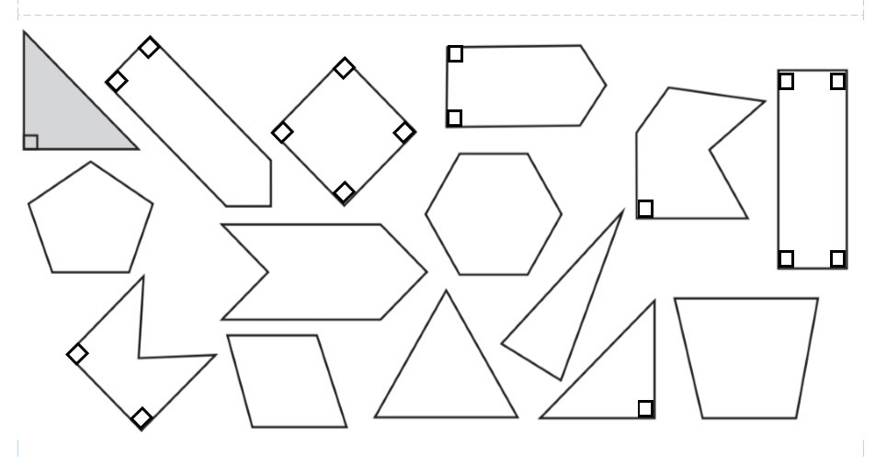
Answers:

Slide 18
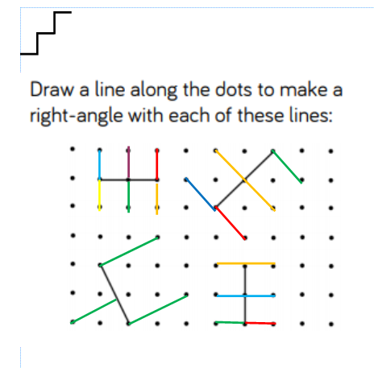
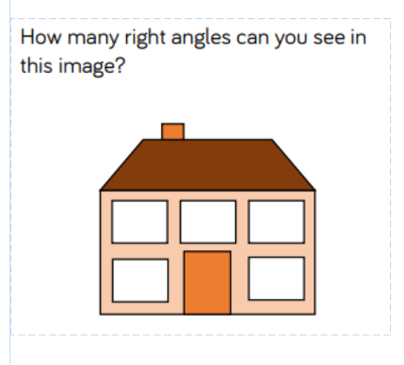
Answers:
There are 34 right angles.

