Slide 1
16.7.2021
L.O. to identify angles
Success Criteria:
I can identify right angles, representing the angle using a small square.
I can use an angle-checker to identify whether a given angle is greater than or smaller than a right angle.
I can use the vocabulary acute, obtuse and reflex to describe angles.

Slide 2
An angle is a measure of a turn, measured in degrees or °.
There are 360° in a full turn.
https://www.bbc.co.uk/bitesize/topics/zb6tyrd/articles/zg68k7h

Slide 3
What Is a Right Angle?
A right angle can face any direction.
A right angle can be in any position.
A right angle always has a quarter turn between two straight lines.

Slide 4
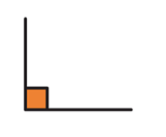
A right angle is an angle that measures 90°. It is also known as a 'quarter turn' because it is a quarter of a full turn, which measures 360°. A right angle is represented by a small square inside the angle.

Slide 5
What is an acute angle?
Here are some examples of angles that are smaller than a right angle.
A curved line is used to show an angle smaller than a right angle.
An angle can be in any position.
These angles are all less than a quarter turn.
Angles less than a right angle are called acute.

Slide 6
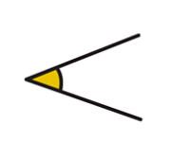
An acute angle is an angles that is less than 90°. This makes them smaller than a right angle.
A good way to remember this angle is to think that because it is small, it is “a cute” angle.

Slide 7
What is an obtuse angle?
Here are some examples of angles that are greater than a right angle.
A curved line is used to show an angle greater than a right angle.
An angle can be in any position.
These angles are all greater than a quarter turn.
These angles are greater than a right angle, but less than a straight line. They are called obtuse angles.

Slide 8
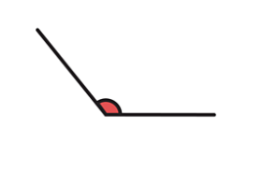
An obtuse angle is an angle that is bigger than 90° degrees, but doesn’t reach a straight line at 180°.

Slide 9
What is a reflex angle?
Here are some examples of angles that are greater than an obtuse angle:
A curved line is used to show an angle greater than an obtuse angle.
An angle can be in any position.
These angles are all greater than a half turn.
They are called reflex angles.

Slide 10
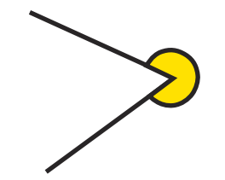
A reflex angle is any angle that is more than 180 degrees (half circle) and less than 360 degrees (full circle). A reflex angle will always have either an obtuse or an acute angle on the other side of it. It can be one of the more confusing angles to find because it's on the 'outside' of the angle.

Slide 11
Sort the angles into the table:
Smaller than a right angle (acute) | Right angle | Larger than a right angle (obtuse)

Slide 12
Use the symbols < or > to make the statements correct.
obtuse 90°
angle

Slide 13
Match the angle size to the correct label.
acute angle
obtuse angle

Slide 14
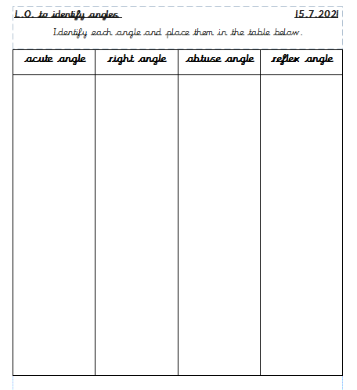
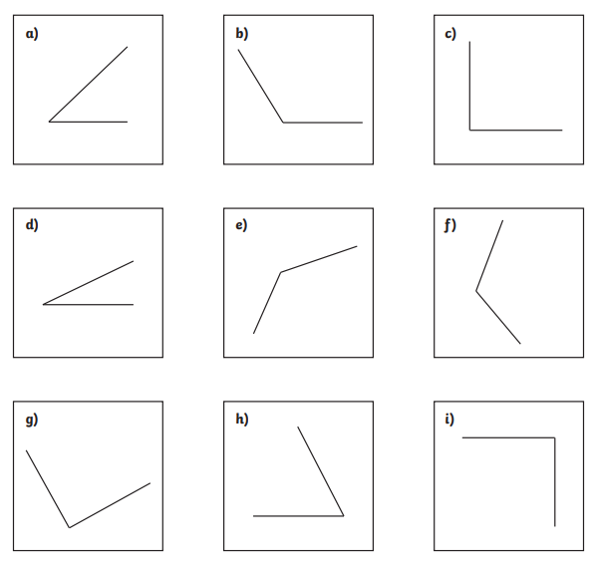
Task one:

Slide 15
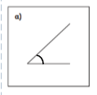
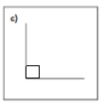
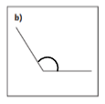
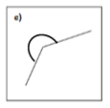
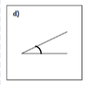
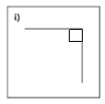
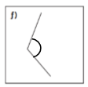
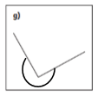
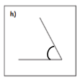
Answers:

Slide 16
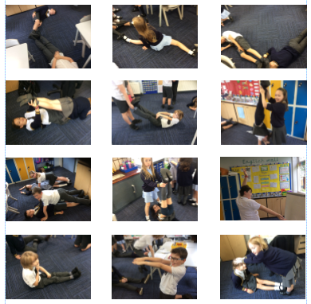
Task two:
Using your body, create different angles in your groups!
Be creative!

