Slide 1
15.7.2021
L.O. to compare angles
Success Criteria:
I can identify right angles, representing the angle using a small square.
I can use an angle-checker to identify whether a given angle is greater than or smaller than a right angle.
I can use the vocabulary acute and obtuse to describe angles.

Slide 2
Revisit:
How many right angles does each shape have?
A
B
C

Slide 3
What Is a Right Angle?
Instead a of a curved arc to show a right angle, we use two straight lines to create a small square. This is because right angles are square corners.
Here we can see a quarter turn.

Slide 4
What Is a Right Angle?
A right angle can face any direction.
A right angle can be in any position.
A right angle always has a quarter turn between two straight lines.

Slide 5
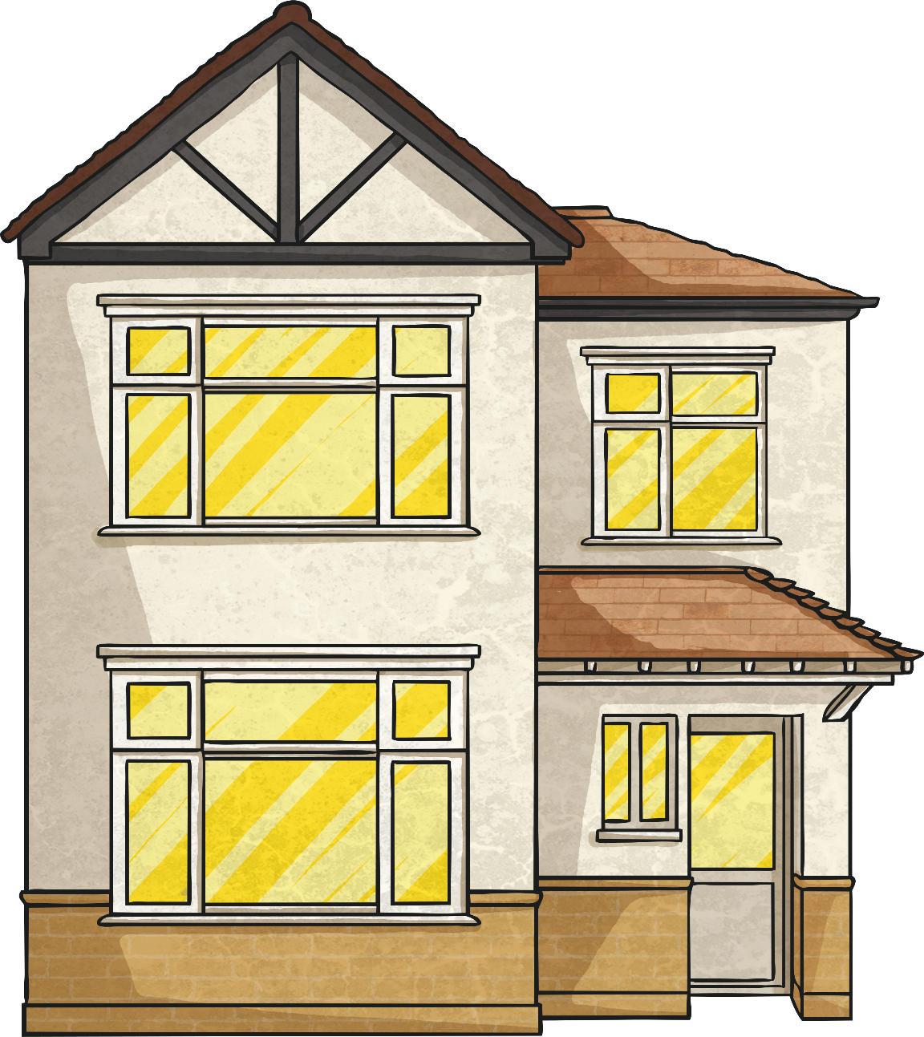
Find the Right Angles
Can you find any right angles in this picture?
Use a right-angle finder to help.
Here are a few of the right angles. Did you find any more?

Slide 6
Angles Smaller Than a Right Angle
Here are some examples of angles that are smaller than a right angle.
A curved line is used to show an angle smaller than a right angle.
An angle can be in any position.
These angles are all less than a quarter turn.
Angles less than a right angle are called acute.

Slide 7
Find Angles Smaller Than a Right Angle
Can you find any angles that are smaller than a right angle in this picture?
Use a right-angle finder to help.
Here are some acute angles. Did you find any more?

Slide 8
Angles Greater Than a Right Angle
Here are some examples of angles that are greater than a right angle.
A curved line is used to show an angle greater than a right angle.
An angle can be in any position.
These angles are all greater than a quarter turn.
These angles are greater than a right angle, but less than a straight line. They are called obtuse angles.

Slide 9
Find Angles Greater Than a Right Angle
Can you find any angles that are greater than a right angle in this picture?
Use a right-angle finder to help.
Here are some obtuse angles. Did you find any more?

Slide 10
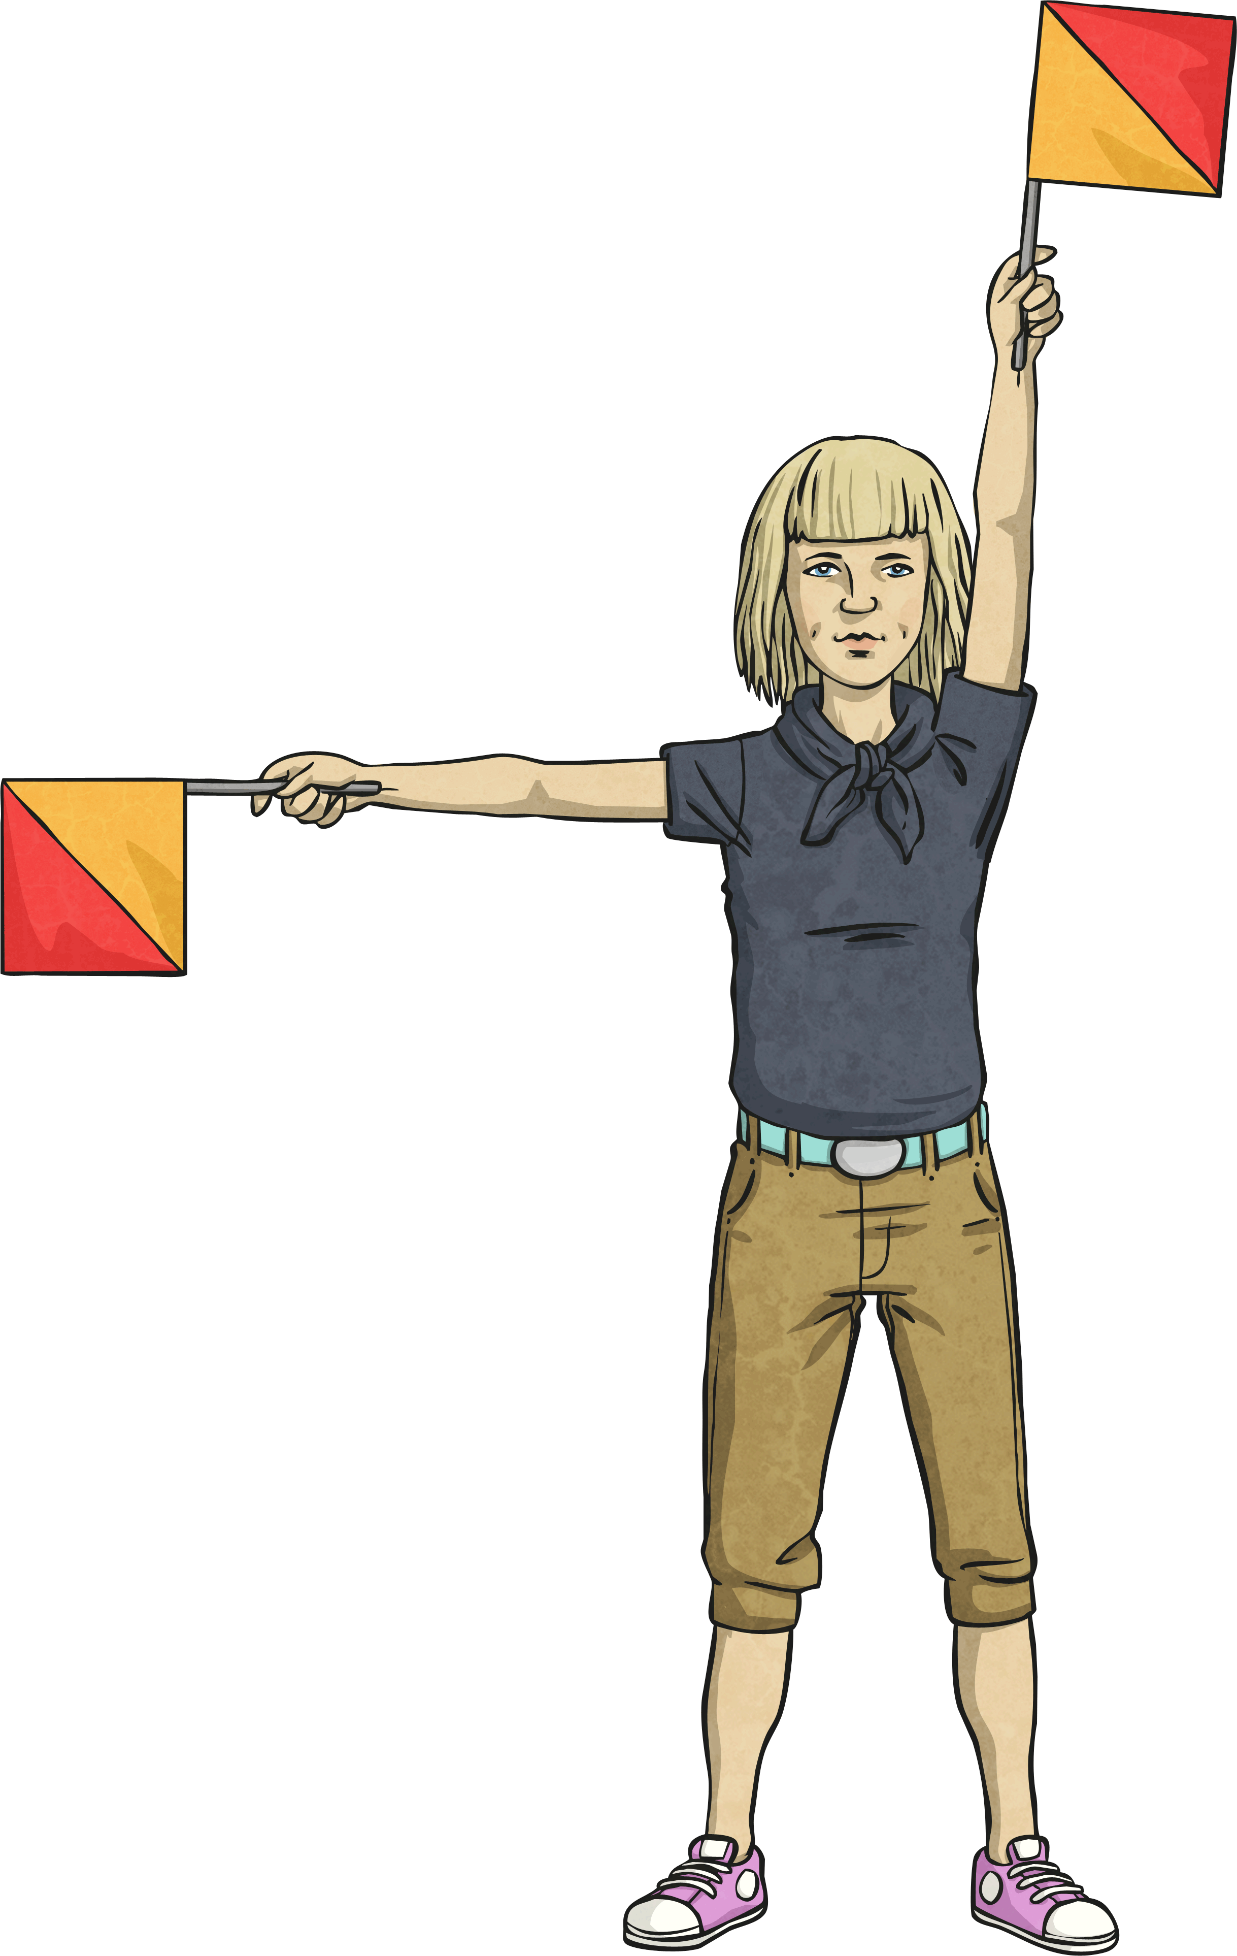
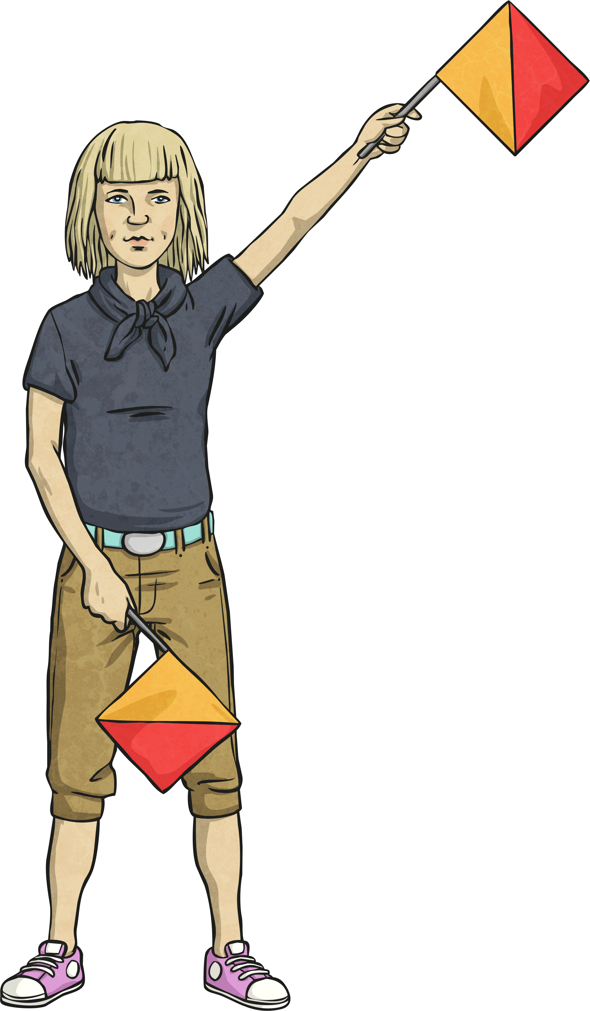
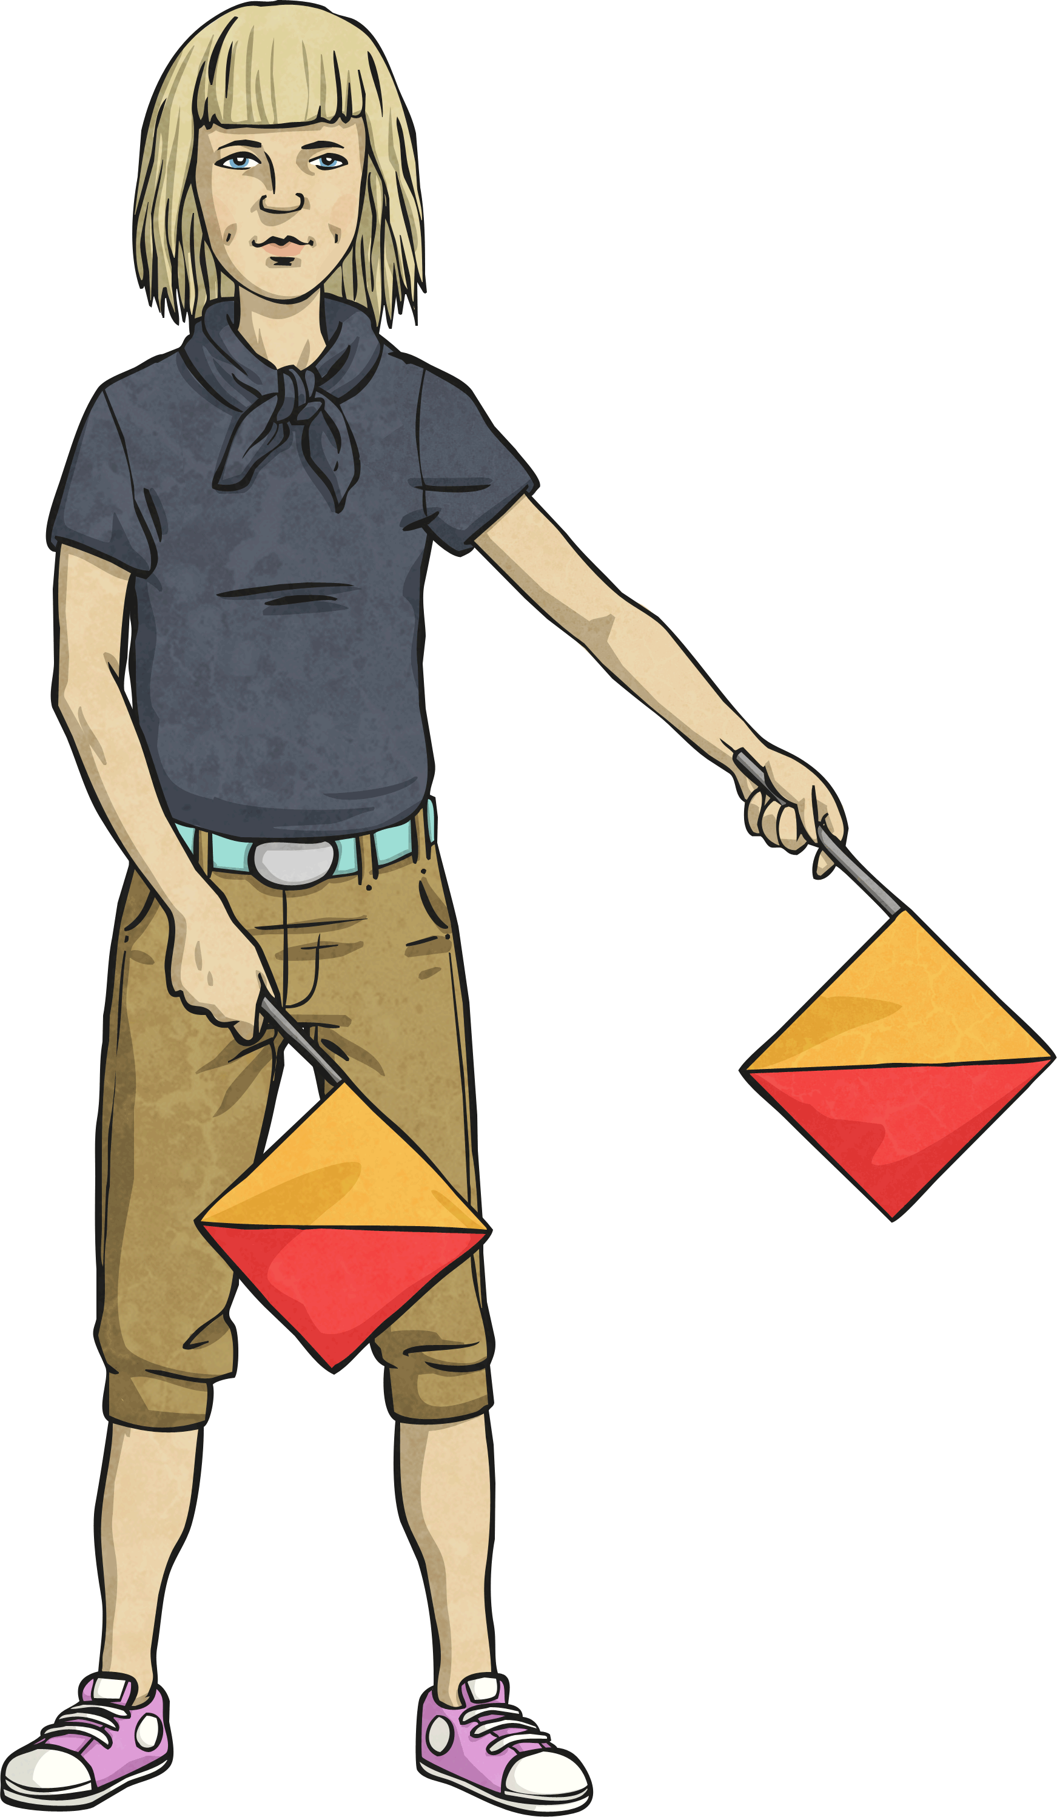
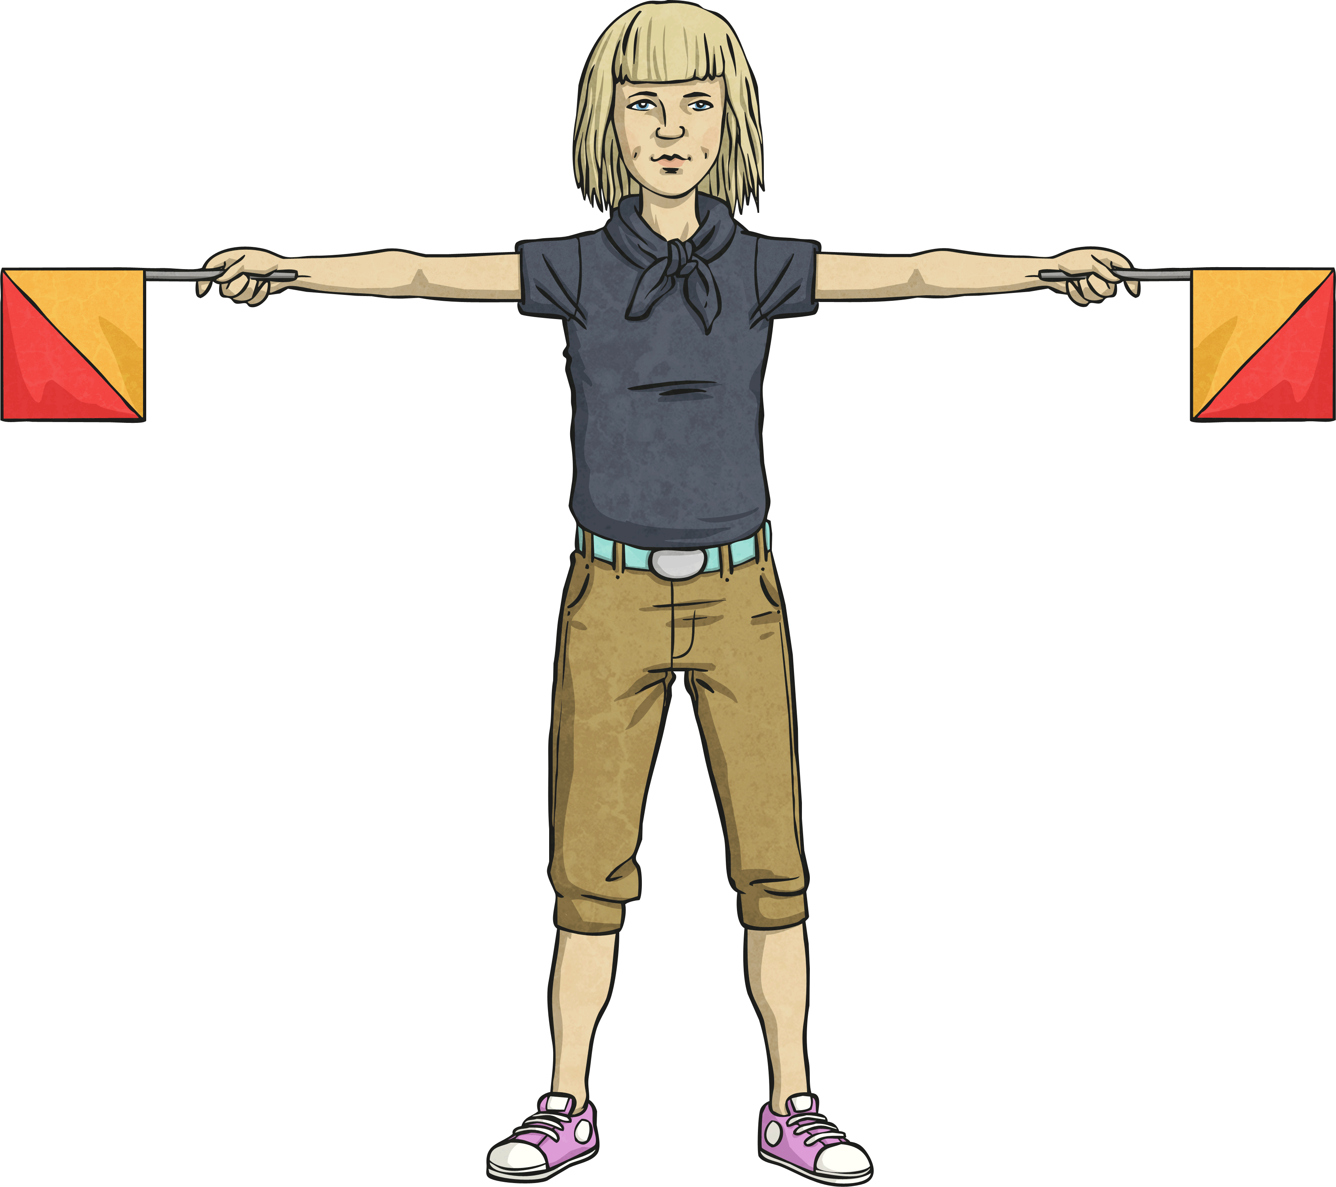
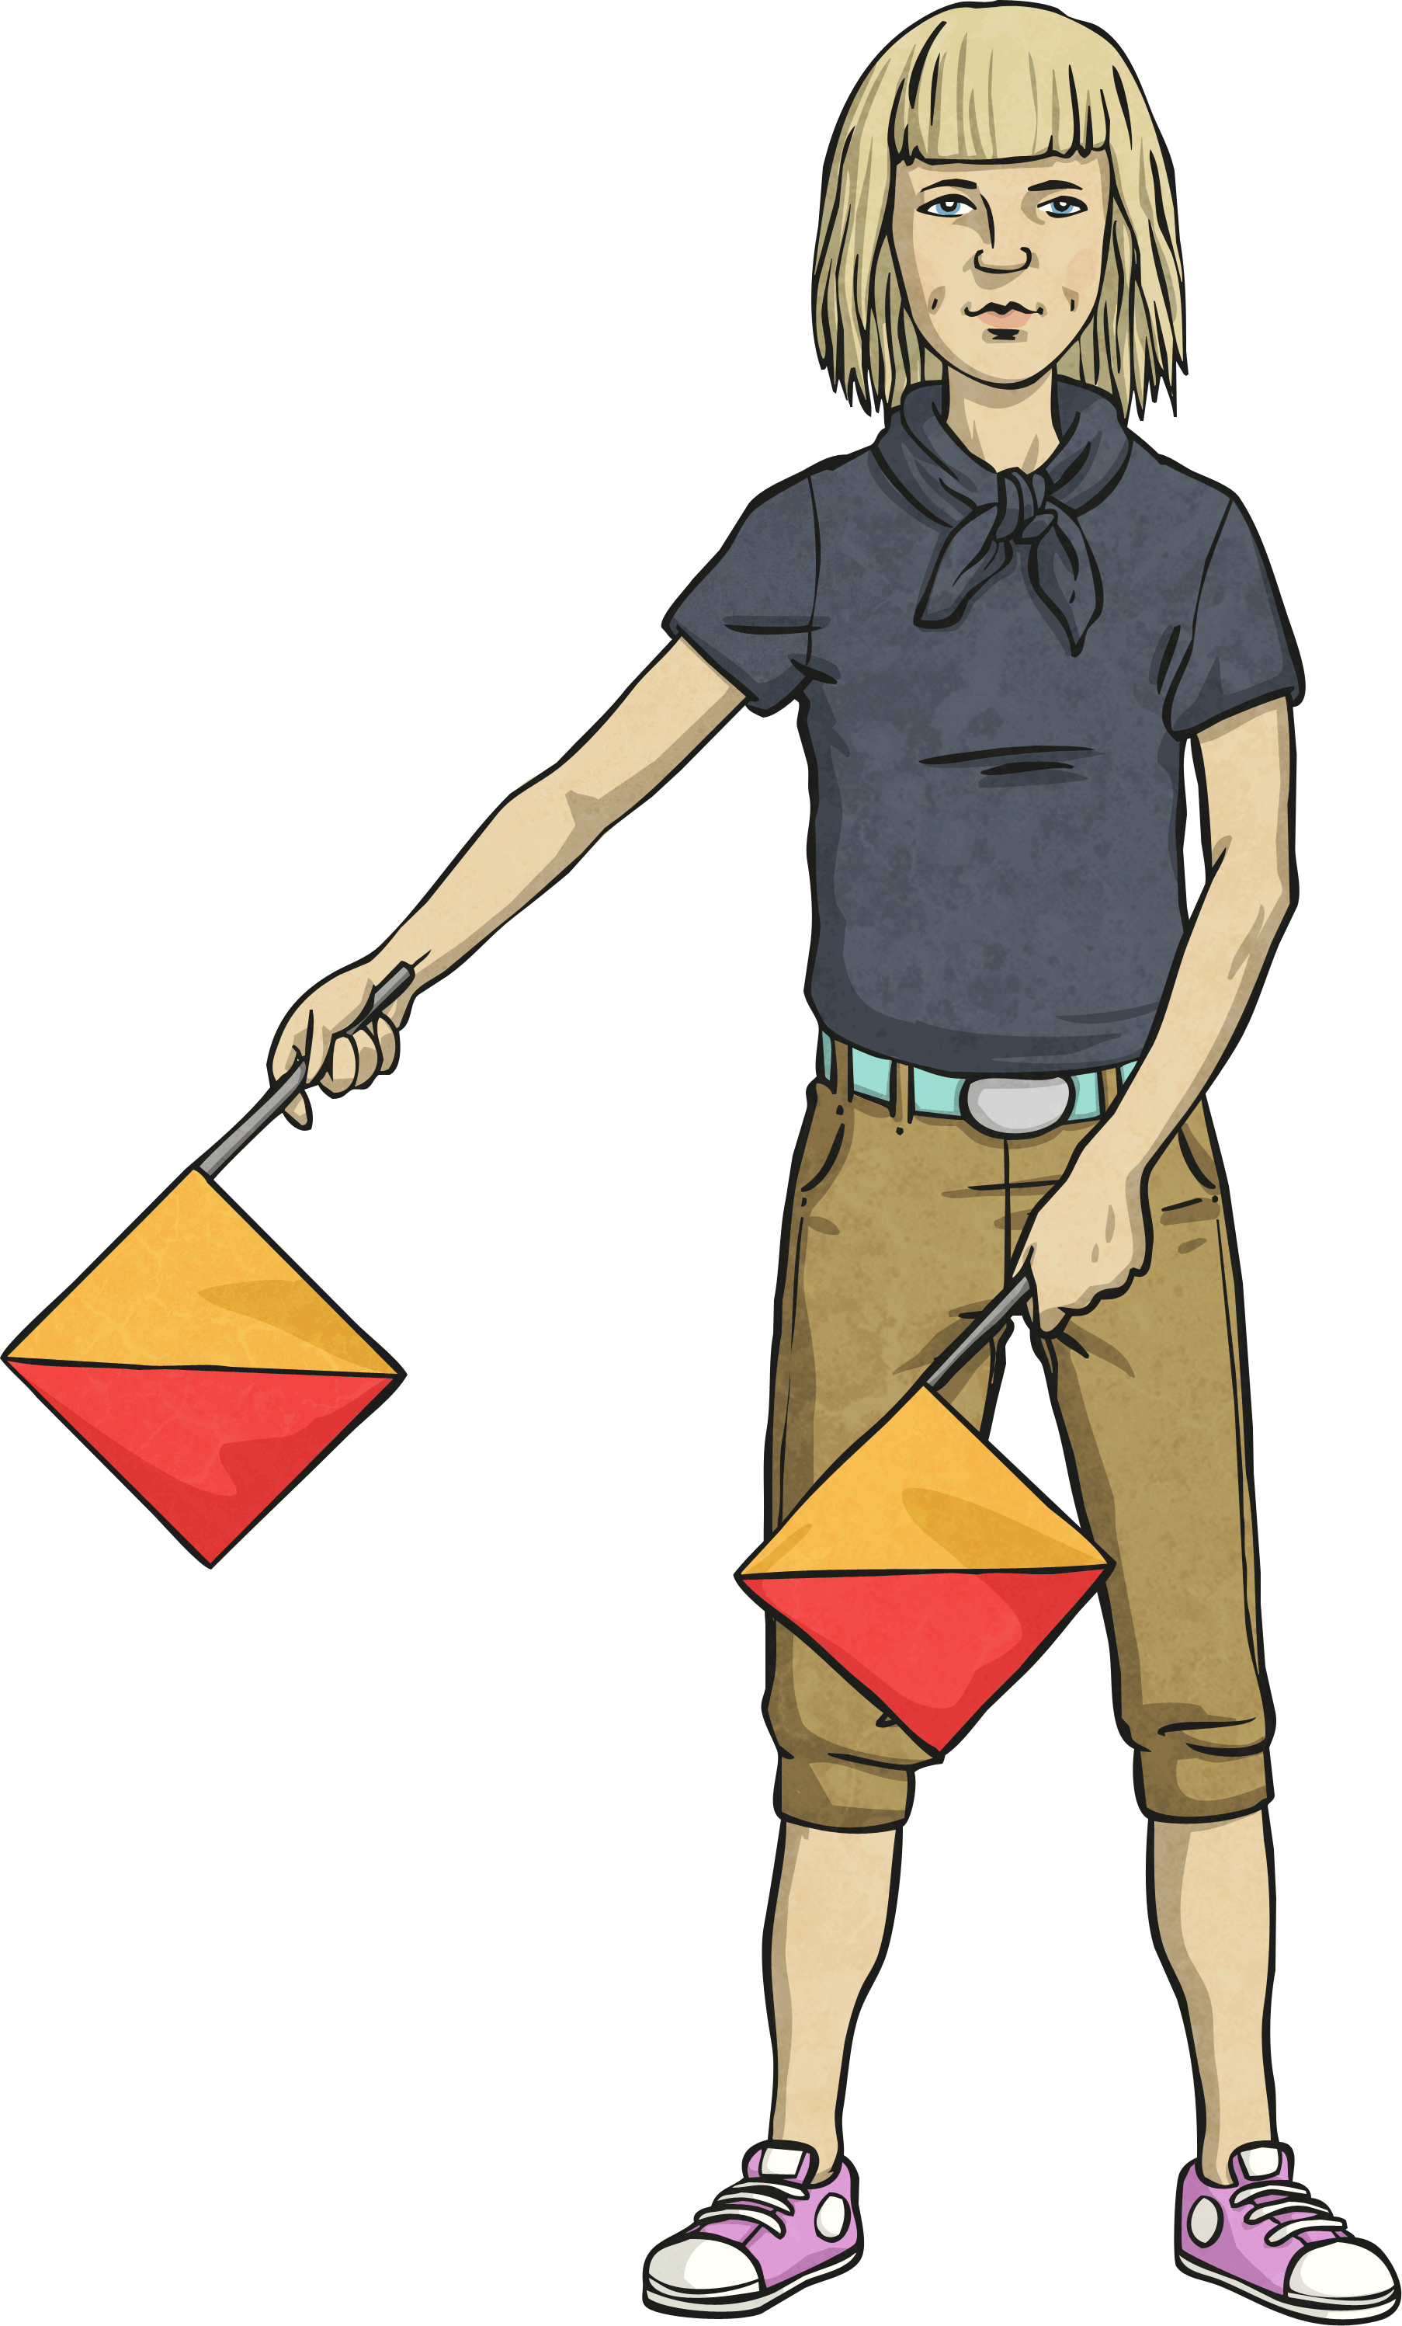
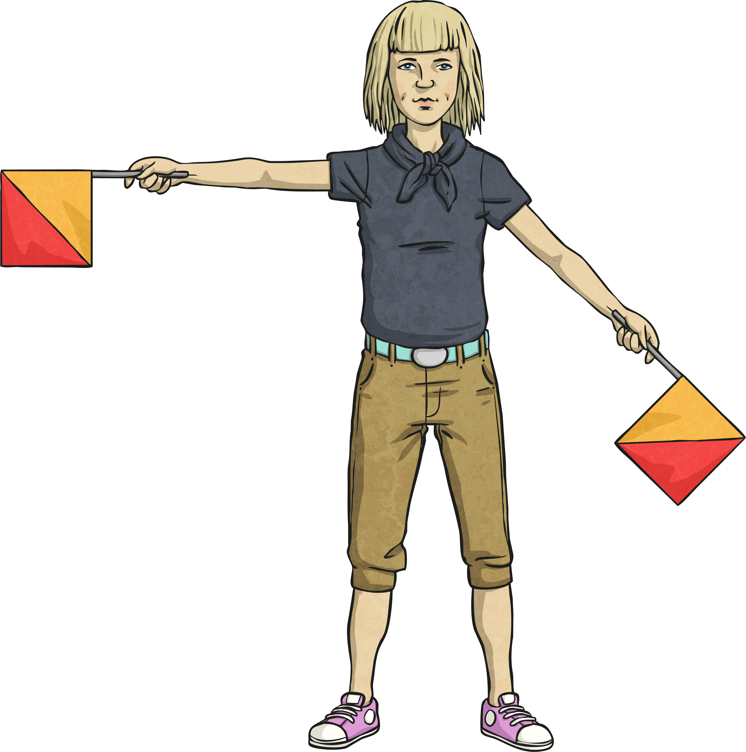
Challenge:
Semaphore is a signalling system which involves waving a pair of hand-held flags in various positions to indicate letters of the alphabet.
Here is the name of a fruit shown using semaphore.
Are the angles right angles or greater or less than a right angle?
G
R
A
P
E
S
Less than
Greater than
Right angle
Greater than
Greater than
Less than

Slide 11
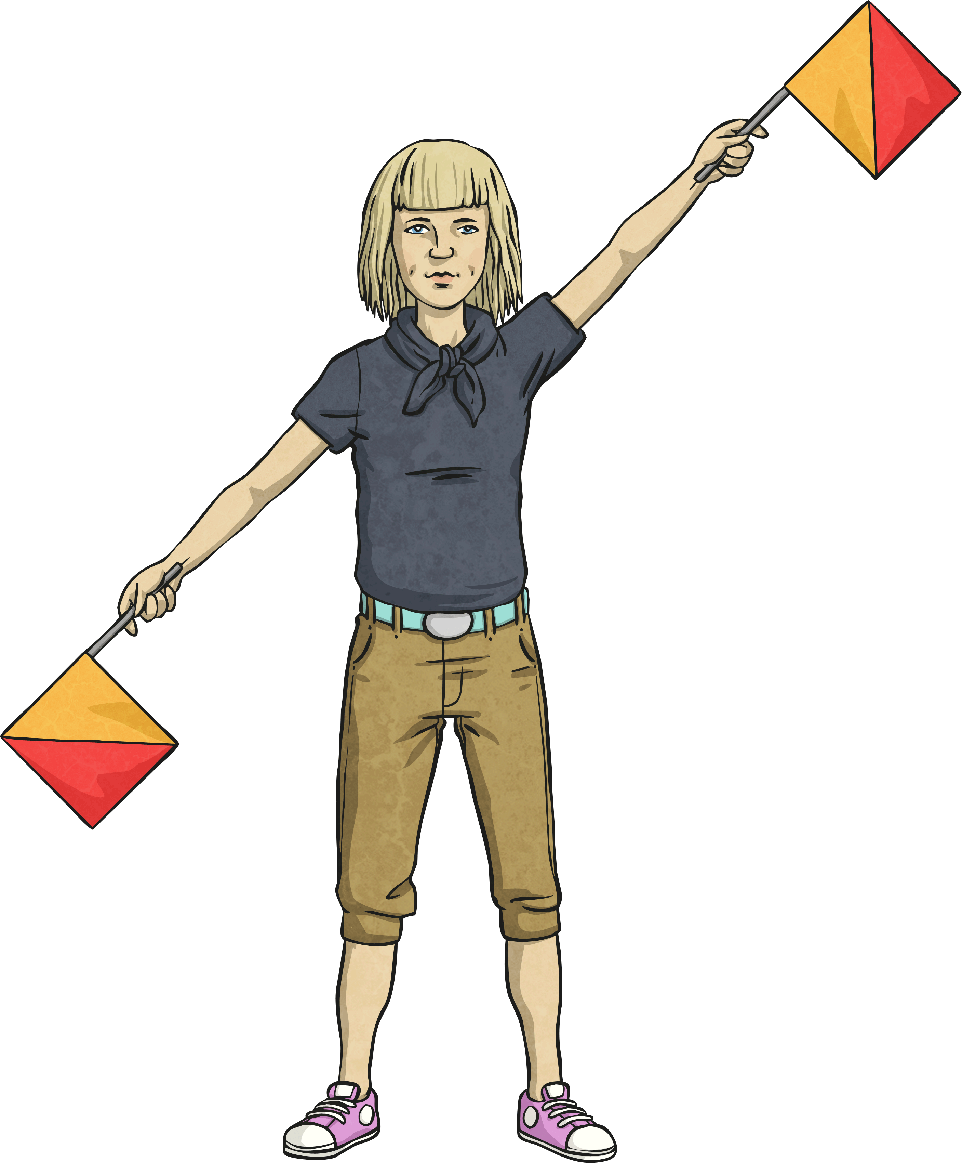
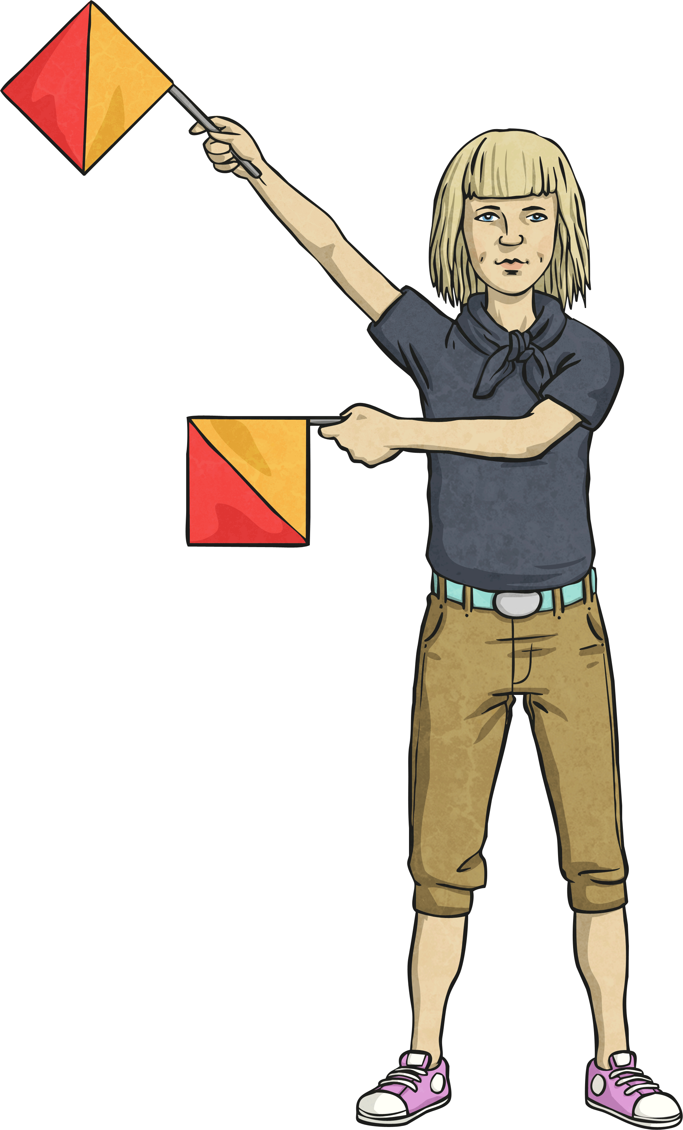
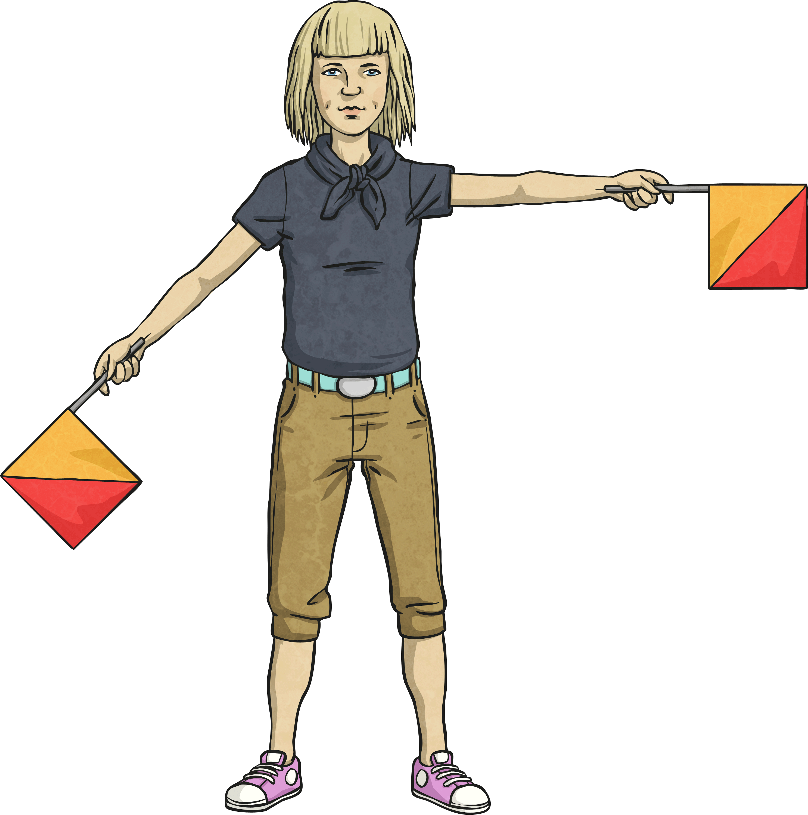
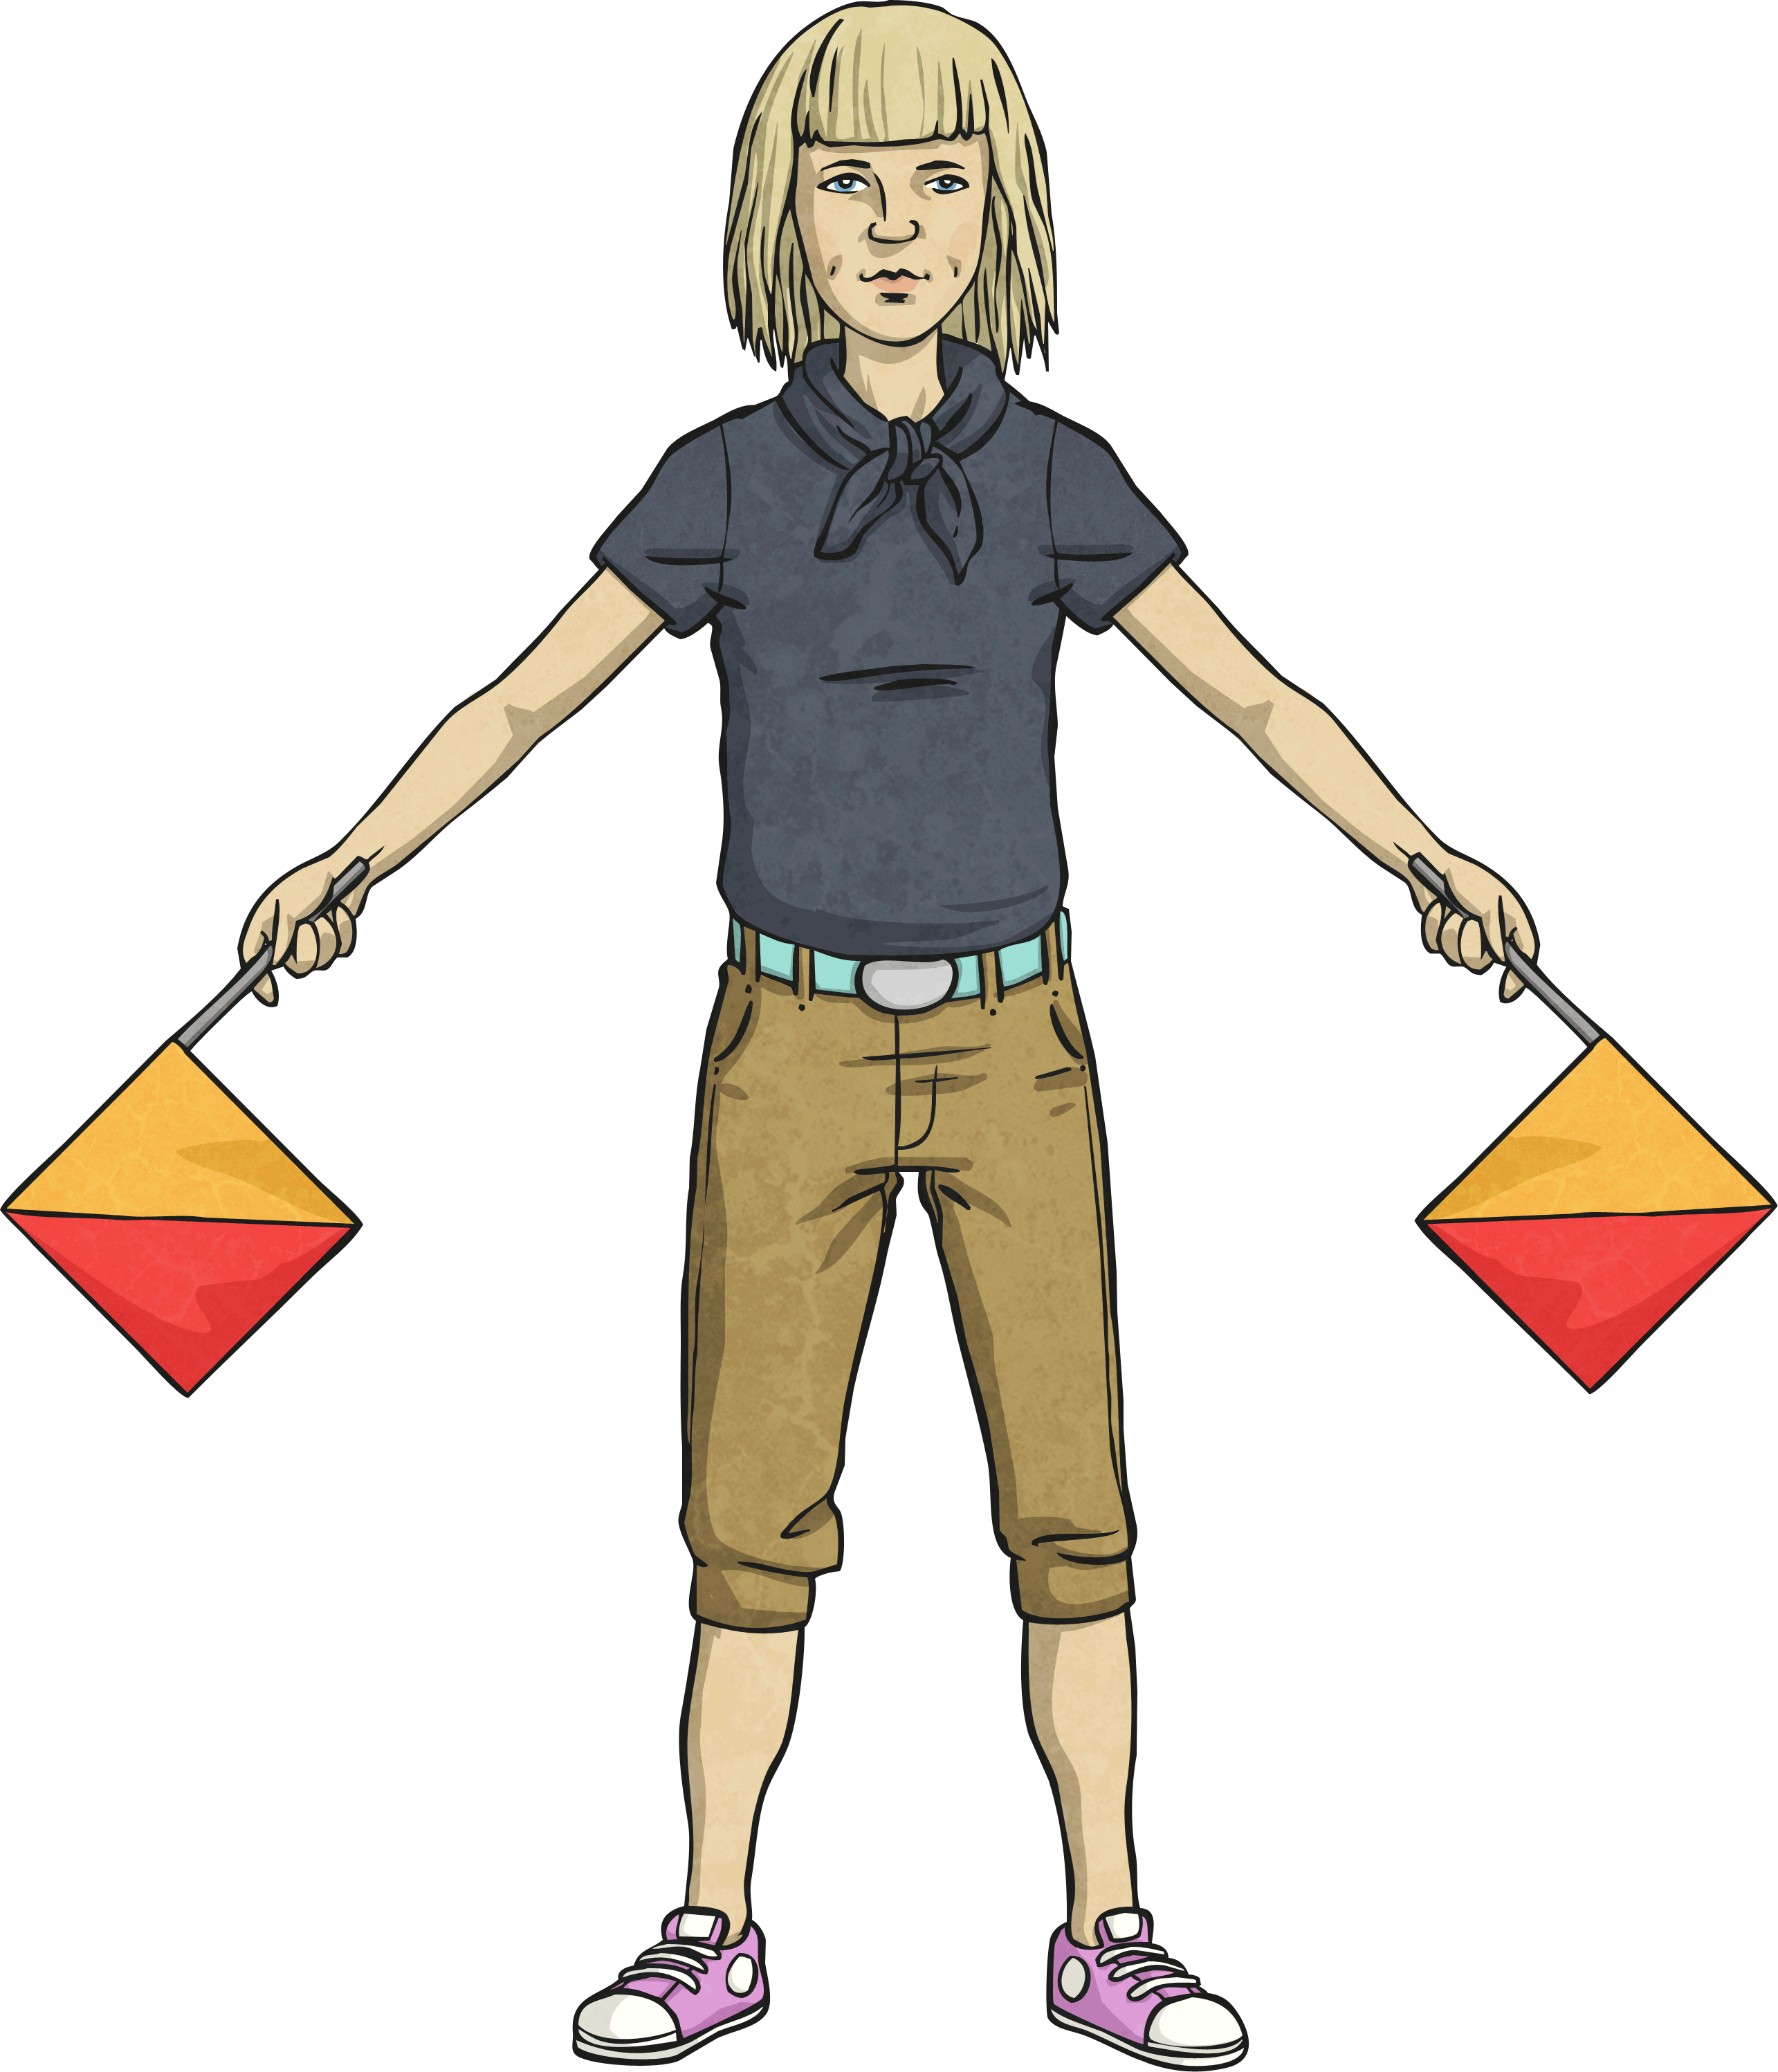
Challenge:
Semaphore is a signalling system which involves waving a pair of hand-held flags in various positions to indicate letters of the alphabet.
Here is the name of a fruit shown using semaphore.
Are the angles right angles or greater or less than a right angle?
M
E
L
O
N
Greater than
Greater than
Greater than
Less than
Right angle

Slide 12
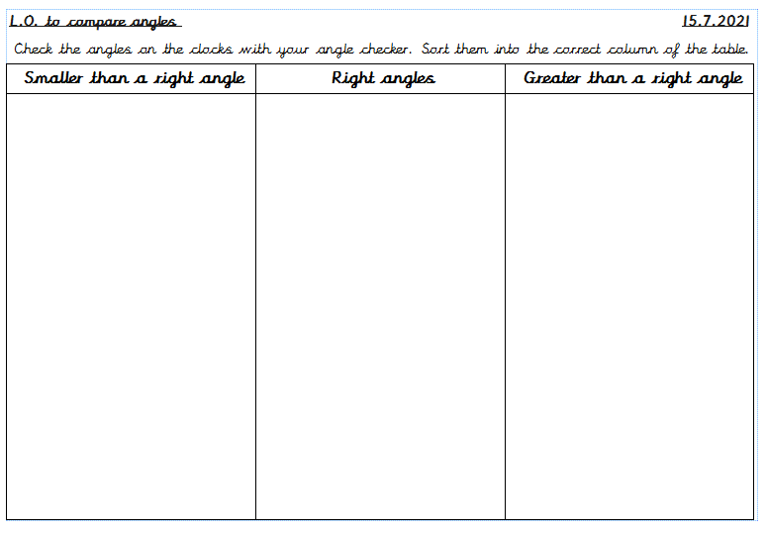
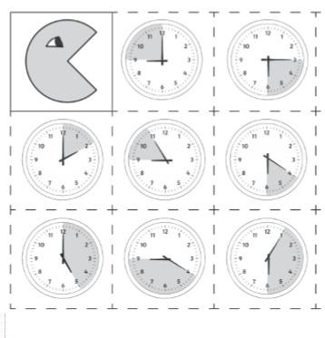
Task:

Slide 13
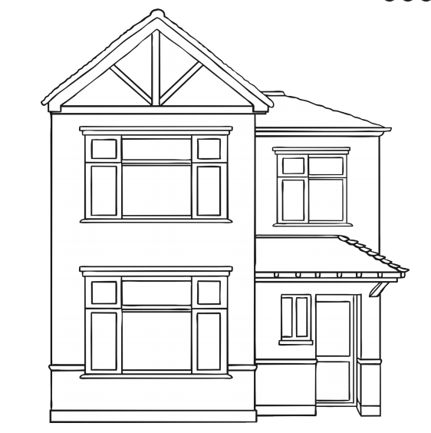
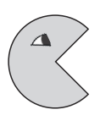
Next Step:
Using the right angle finder, identify the acute, obtuse and right angles.
Label these angles on the house:
A = acute
O = obtuse
R = right angle

Slide 14
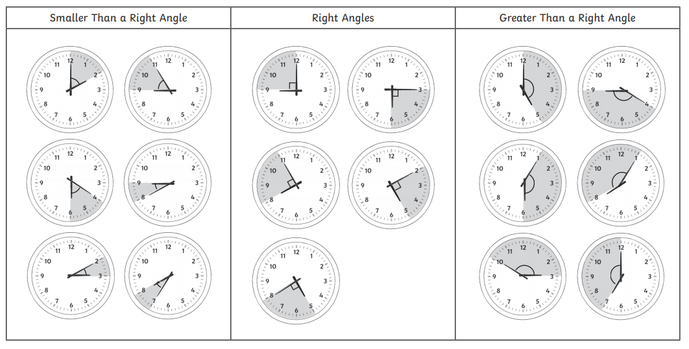
Answers:

Slide 15
Answers:
Did you find some of these angles?
There are lots more which can also be found!

