Slide 1
Friday 30th April 2021 L.O. to use hatching and cross hatching to show tone and texture.
To draw a pyramid using the cross hatching technique
To create a 3D shape
Create original pieces that are influenced by studies of others.

Slide 2
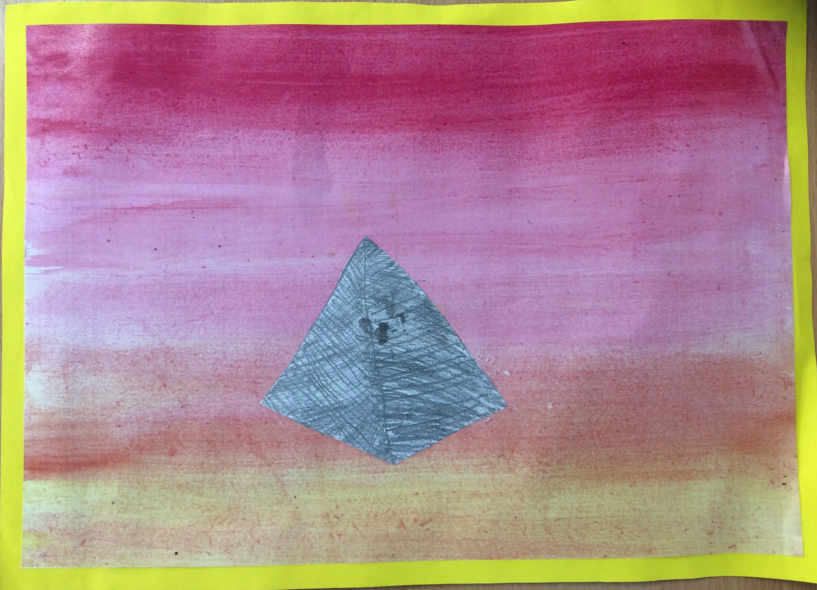

Slide 3
We are going to create a watercolour background for our artwork today. This will be our first task to ensure it has time to fully dry!

Slide 4
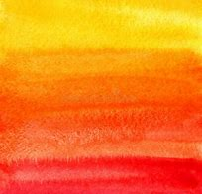
Watercolour backgrounds

Slide 5
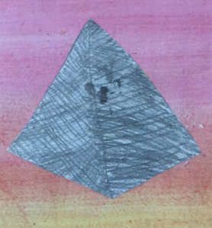
To create our pyramid, we are going to use cross-hatching. This will help to give the pyramids tone and will look effective against the watercolour background.

Slide 6
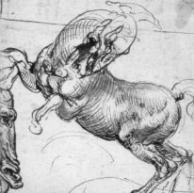
Leonardo Da Vinci, a famous painter, used cross hatching when sketching his work. This created light and shade giving the illusion that his drawings were 3D. He also was able to create shadows and reflections.

Slide 7
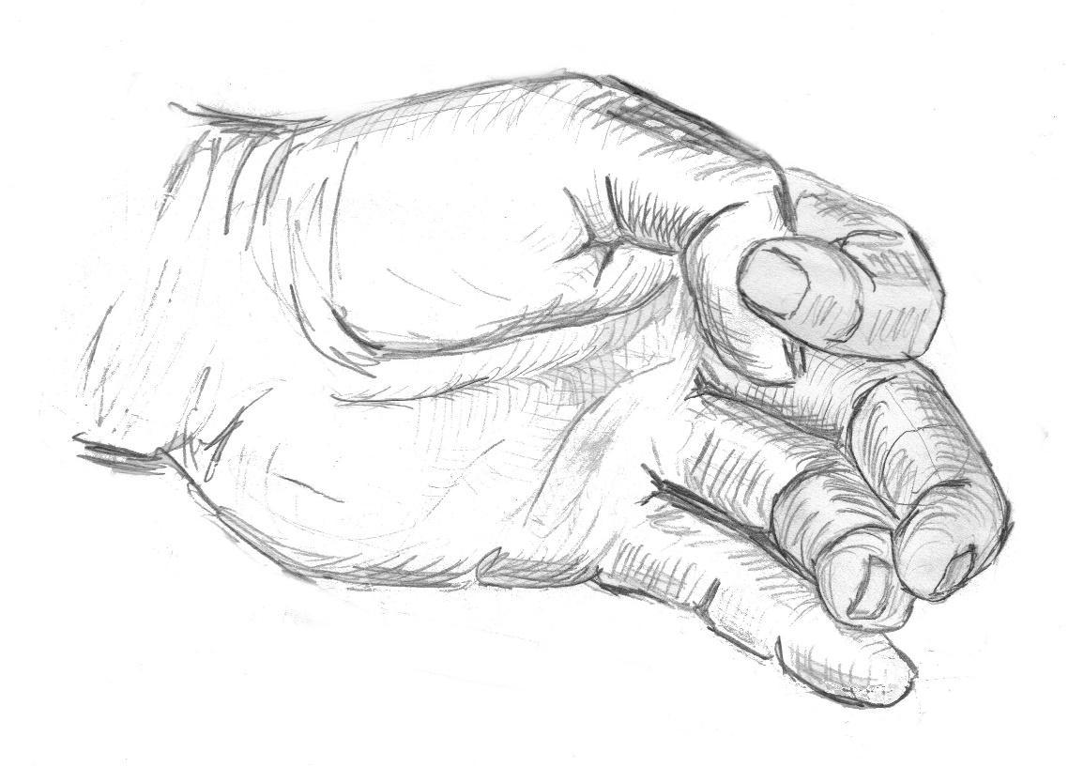
What is cross-hatching?
Cross-hatching is the layering of multiple lines to achieve tone. Artists draw in the direction of the shape they are drawing to achieve a realistic and lifelike appearance. The more layers you use the darker the tone achieved. Notice the curved lines in the folds of skin and lighter areas that have no lines.

Slide 8
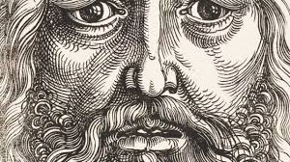
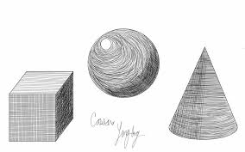
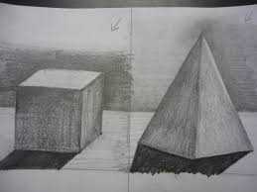
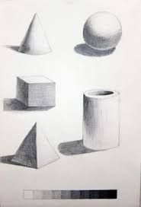
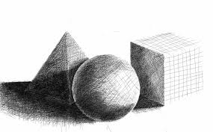

Slide 9
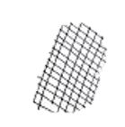
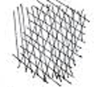
Using the cross-hatching practise sheet, try using your pencil in different directions to achieve the cross-hatching effect.

Slide 10
We are going to draw 3D pyramids using the cross hatching technique. This makes the drawings have tone and texture.
Your task is to use a variety of line, layers and cross-hatching to add light, medium and dark areas to the outline of the hand. You should continue to look at the image you are drawing, looking up at least three times a minute.

Slide 11
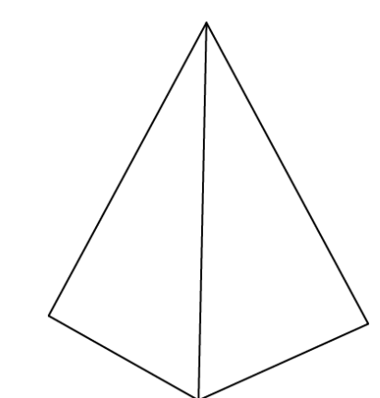

Slide 13
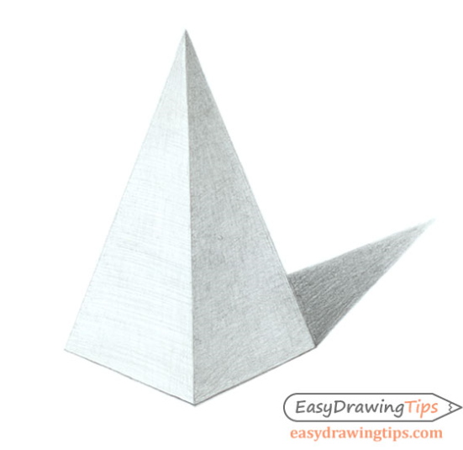
LIGHT
Shading the pyramid is fairly simple as there are really only two sides. Make the side facing towards the light lighter and the facing away side darker.
Keep the shading of each side lighter towards the bottom as these will also be illuminated by the light reflecting form the surface the pyramid is on.

Slide 14
Once you have drawn your pyramid and added tone to your drawing using cross-hatching, cut out the pyramid and stick it on top of your watercolour background to create your piece of art!

