Slide 1
L.O. use problem solving to create pyramids

Slide 2
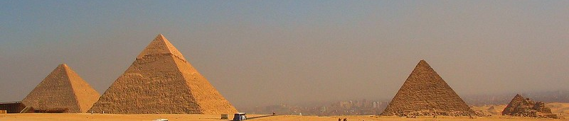
The Egyptian pyramids were built at a time when Egypt was one of the most powerful and wealthy civilisations in the world. Kings of Egypt, known as pharaohs, were considered to be almost like gods. It was believed that after they died, they were resurrected in the afterlife and became gods who judged others when they died. Because of this, they continued to be honoured even in death.
Pyramids were built as tombs for the pharaohs and their queens. One of the first pyramids was built in 2630 BC. That’s over 4500 years ago.
Pharaohs were buried in the pyramids with all the belongings they may need in the afterlife.

Slide 3
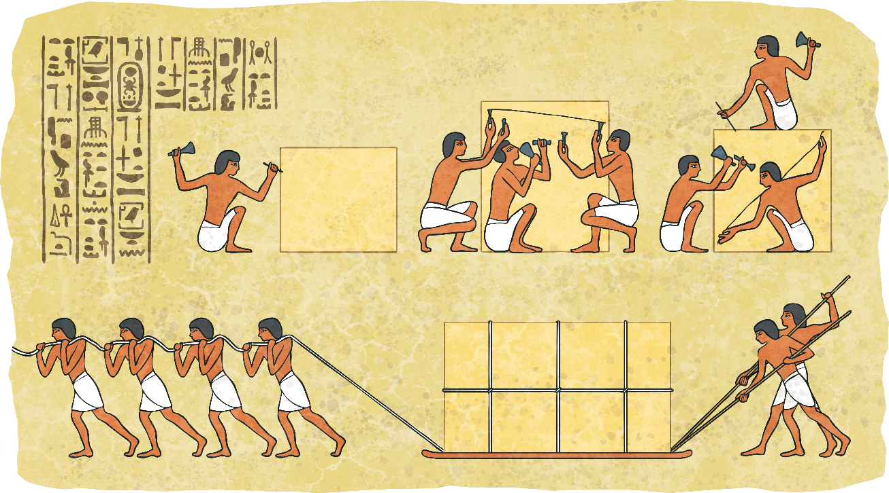
It is not known how many men it took to build a pyramid - estimates are anything from two thousand to a hundred thousand! Pyramid building would happen when the Nile was in flood.

Slide 4
Mastaba
Although more trapezoid than pyramid shaped, the mastaba was the basis that the pyramids came from. This flat-topped building with sloped sides was erected over a burial chamber, which was carved deep into the ground below.
The burial chambers were lined with wood and often decorated with paintings. As time went on, the chambers became more complex and would include a small ‘chapel’.
At ground level, there were rooms where offerings were left for the deceased.
The word ‘mastaba’ comes from the Arabic word meaning ‘bench’.

Slide 5
Step Pyramid
The first ‘pyramid’ was the Djoser, built in Saqqara, south of Cairo. It began as a traditional, flat-roofed mastaba.
It has six tiers and was built in stages. Each step was made of rough stones before being covered in limestone. The limestone was polished to make the pyramid gleam.
Before the creation of the true pyramid, three other step pyramids were built – the pyramids of Sekhemkhet, Khaba and Lepsuis.
Similar to the mastaba, the burial chambers of the step pyramids were underground and complex.
However, tunnels and passages of the Djoser were lined with limestone instead of wood.

Slide 6
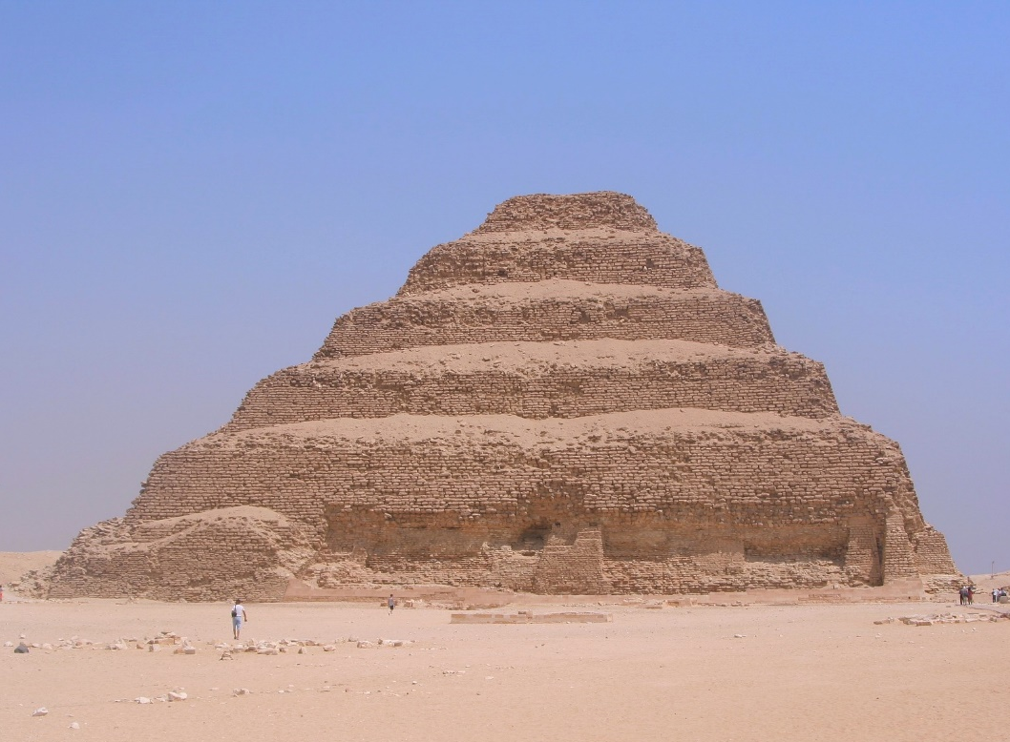
Pyramid of Djoser
There are over one hundred pyramids in Egypt, the first was the Pyramid of Djoser, built over four thousand years ago in Saqqara, south of Cairo.
It was designed by the architect Imhotep and built during the third dynasty.
This is thought to be the oldest monumental structure in the world made from cut stone.

Slide 7
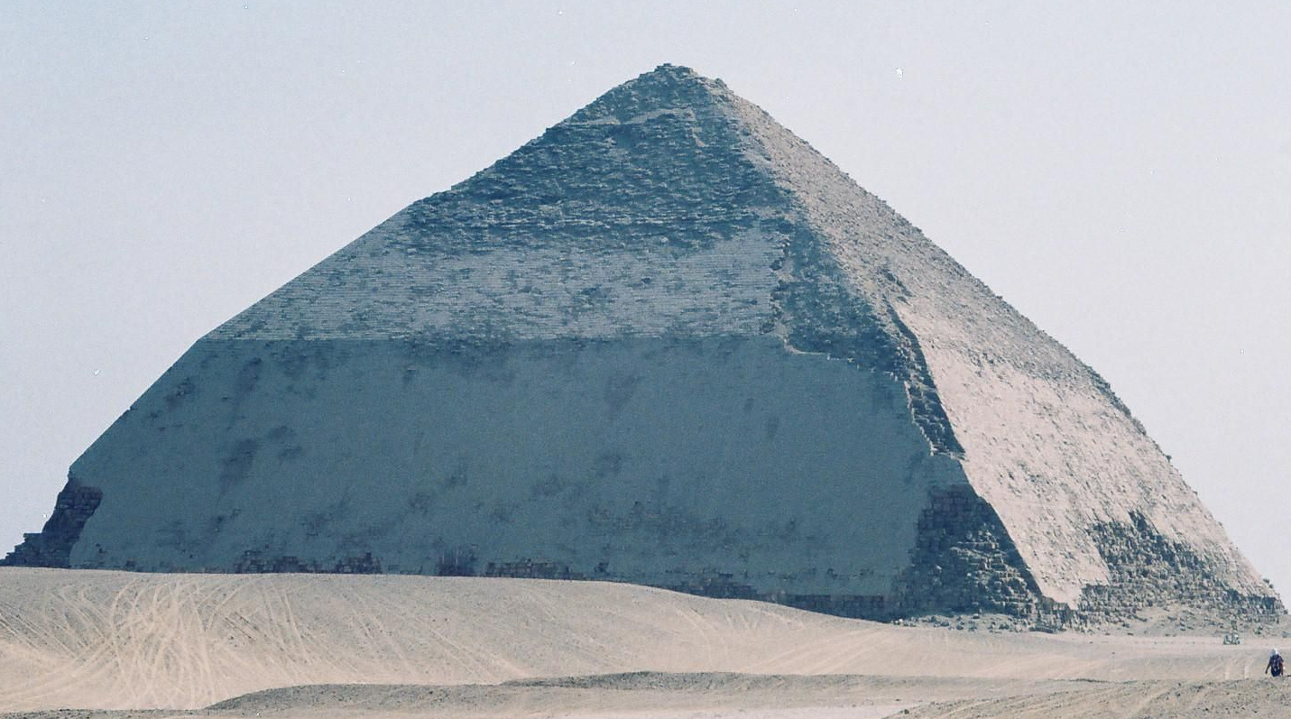
The Bent Pyramid
The Bent Pyramid at Dahshur was created by accident and was King Sneferu’s attempt to build the first smooth-sided (true) pyramid.
However, when the building began, the 55° angle of the slope was too steep and while building, engineers realised it was unstable.
So, half way up, the angle was changed to 43° to make it more shallow.
Sneferu learnt lessons in this error and would have the first true pyramid – The Red Pyramid – created in his name with this knowledge.

Slide 8
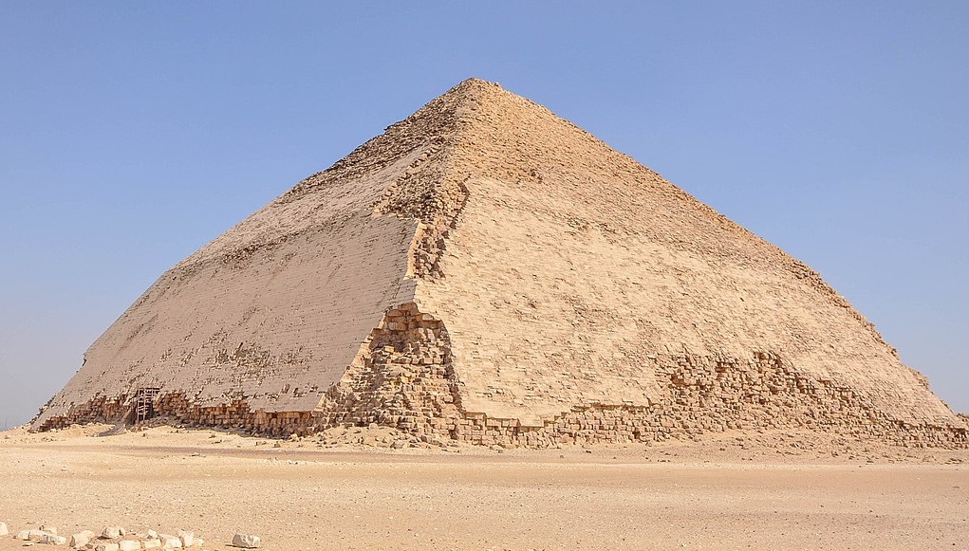
The Bent Pyramid
With it’s two-angled shape, the Bent Pyramid is the only pyramid of its kind. Not only does it provide valuable information about the development of the pyramids, but is unique for another reason.
Unlike the other pyramids, the limestone casing surrounding the bricks is largely intact so this pyramid provides great insight into how the rest of the pyramids would have looked.

Slide 9
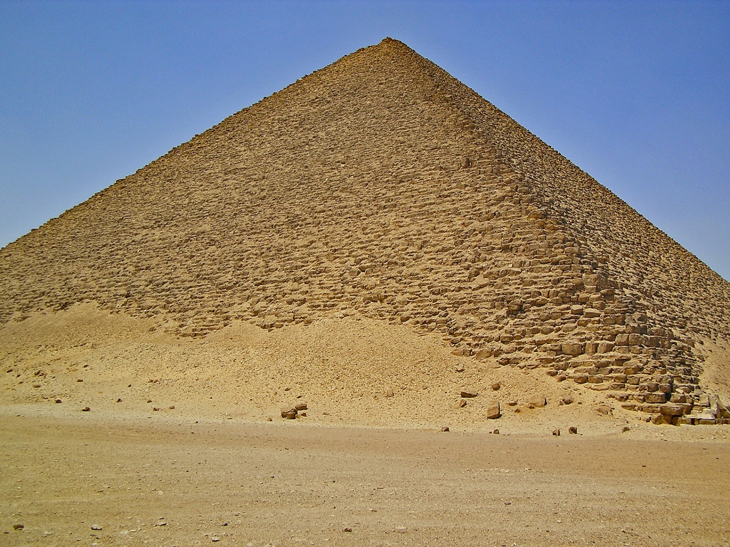
True Pyramid
Believed to be the first ‘true’ pyramid, the Red Pyramid was built in Sneferu’s name after the lessons learnt in the Bent Pyramid.
The construction of a true pyramid was initially similar to the step pyramid; however, the final product was cased in limestone to create the more appealing, smooth effect.
Historians believe the Red Pyramid took 17 years to build.

Slide 10
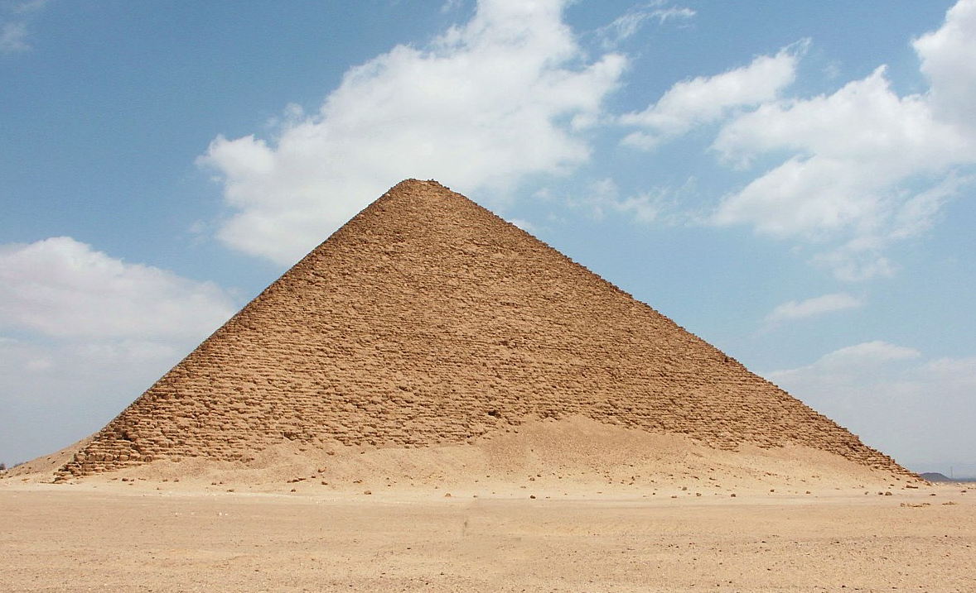
The Red Pyramid
The Red Pyramid of Dahshur gets its name from the sandstone used in its construction – it has a reddish hue.
Although the Red Pyramid is the third largest pyramid of Egypt at 104 metres tall, it
has the second largest base of all
Egyptian pyramids, each side
measuring 220 metres.
Most of the outer, white limestone casing was removed and used in the building of Cairo.

Slide 11
The Pyramids of Giza
The Great Pyramid of Giza is the largest of the pyramids which stand in Giza. They were built on the west bank of the river Nile, near the capital city of Cairo, Egypt.
Around 2550 BC, Pharaoh Khufu, also known as Cheops, instructed the first of the three pyramids to be built. This was the Great Pyramid and stands at 147 metres above the ground. The building of the second pyramid was instructed by Khufu’s son, Pharaoh Khafre, around 2520 BC. He included the structure known as the Sphinx, which guards the entrance to the pyramid.
The third pyramid at Giza was built by Pharaoh Menkaure around 2490 BC. Although it is a lot smaller than the first two, parts of it are a lot more complex.

Slide 12
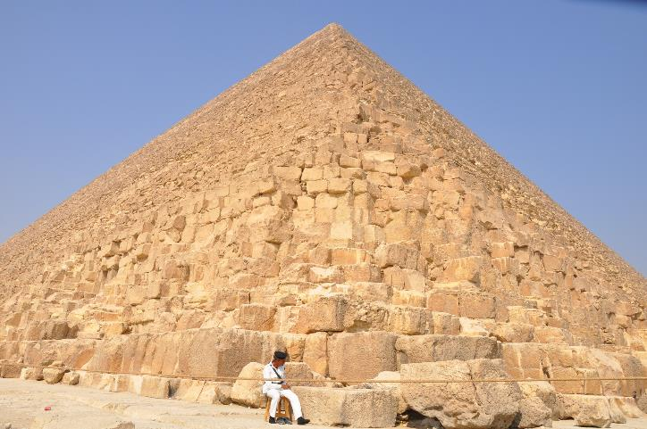
The Great Pyramid
The Great Pyramid was the tallest human-made structure in the world for around 3800 years and is the last remaining structure from the list of the ancient Seven Wonders of the World. It is thought to have taken up to 20 years to build, using 2.5 million limestone blocks (each weighing between 2 and 30 tonnes) which were cut, moved and positioned by hand. The limestone came from quarries nearby but the largest stones came from Aswan, which is 500 miles away from Giza.
Originally, the three pyramids would have had a smooth outer casing of lighter limestone, which would have shone white in the sun. That covering has since come away through earthquakes and has been used to build other structures in Cairo.

Slide 13
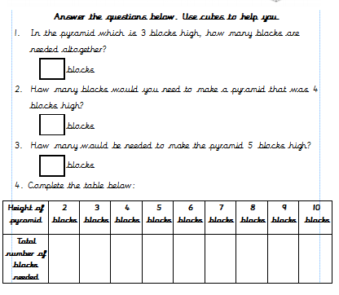
Task one:

Slide 14
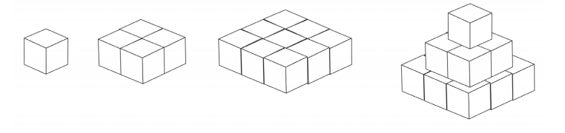
Support for task one:
+
+
=
1 X 1 +
2 X 2 +
3 X 3 = 14 blocks

Slide 15
Answers:
5
30
55
5
14
30
55
91
140
204
285
385

Slide 16
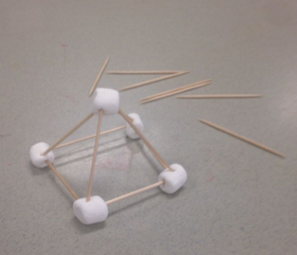
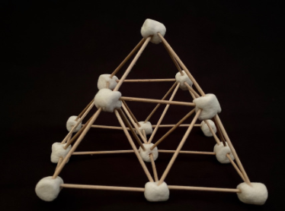
Task two:
Make a marshmallow pyramid!
Use marshmallows and cocktail sticks, see if you can build your very own ancient Egyptian pyramid!

