Slide 2
Menstruation
Thursday 13th June 2021 LO: To learn about menstruation I can describe menstruation I can explain effective methods for managing menstruation I understand the relationship between the sex cells (sperm and ovum), menstruation

Slide 3
Menstruation
Puberty for Girls
Larynx (voice box)
grows
Grow taller
Sweat glands produce more sweat
Skin becomes oilier
Gain hair on arms and legs
Grow hair under armpits
Grow breasts
Grow pubic hair
Start to menstruate
All parts of the
body grow
Remember that everybody's body looks different!

Slide 4
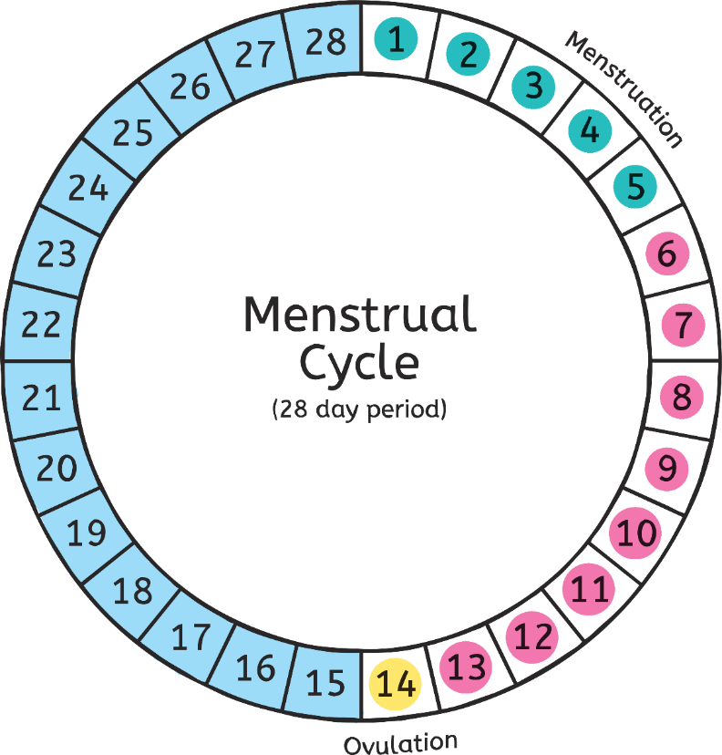
What does, “Starting your period” mean?
Menstruation
At some point during puberty (7-18) a female will begin her menstrual cycle (period) meaning that she will be able to have children if she has sexual intercourse with a male.
A period is when for a few days each month (3-7 days) she will lose blood from her vagina.
This blood is from the inside lining of the uterus which is the organ that holds a growing baby.
The menstrual cycle is usually around 28 days. However, it can vary from between 23-35 days.

Slide 5
Menstruation
The egg (ovum) travels through the fallopian tube from the ovary. It goes into the uterus. When the egg has not been fertilised by sperm (the male sex cell) then the egg along with the inside lining of the uterus, falls as blood. This comes out of the vagina.

Slide 6
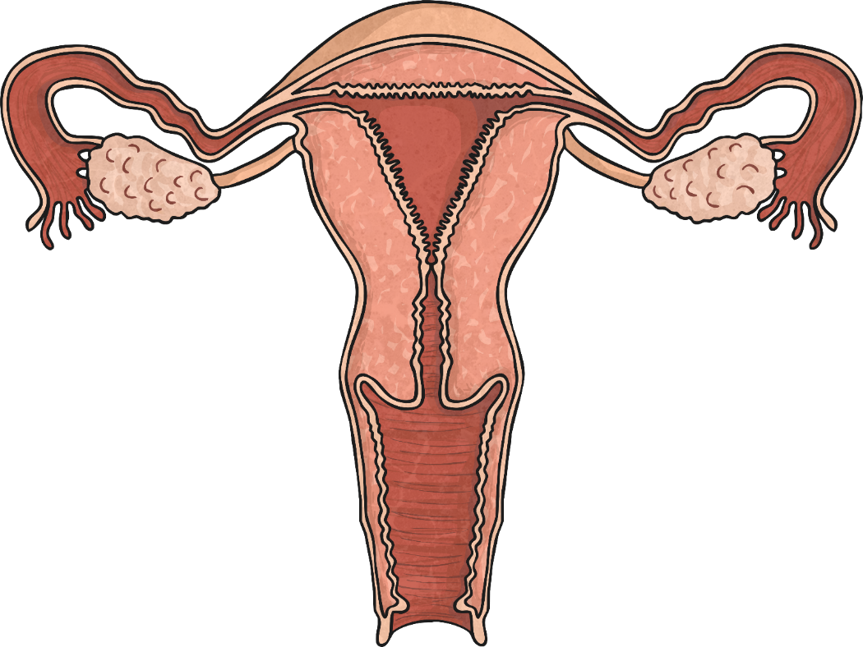
The Female Reproductive System
Menstruation
Fallopian Tube
Egg
Ovary
Uterus
Vagina
The opening of the female reproductive system.
Ovary
A pair of female reproductive organs in which eggs are produced.
Egg
A cell which is the beginning of a human embryo.
Uterus
A major organ where the human foetus develops.
Fallopian tube
The egg travels down the tube toward the uterus ready for fertilisation.
Click the points for more information.
Vagina

Slide 7
Do not worry!
Menstruation
How much blood will I lose?
It varies from girl to girl. The average amount is only 1 tablespoon of blood. Your period starts off lighter and can get heavier and then gets lighter again towards the end of your period.
How long does a period last for?
3-7 days
Does it hurt?
It can be a bit uncomfortable (tummy /back ache) but this won’t generally last all of the period. Paracetamol and hot water bottles help soothe any pain.
What if I start my period at school? What if I start away from home?
If you start at school just speak to your teacher and explain it is a personal body issue. The office have sanitary towels to use and to feel safer you might want to keep a sanitary towel in your bag in case.

Slide 8
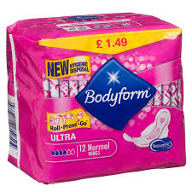
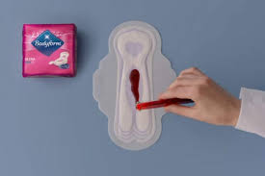
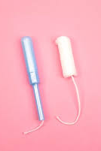
Menstruation
Where does the blood go? Will it go in my knickers?
Girls can wear protection for periods. These are called sanitary towels and tampons.
You need to change your sanitary wear every 4 hours or if you feel like it is heavy.
Can I go swimming on my period?
You can wear tampons in the pool but not sanitary towels.

Slide 9
Menstruation
Sanitary towels are super absorbent (There are varied thickness of pads depending on how heavy your period is) They stick to the inside of your underwear.
Tampons are cotton tubes that are pushed up the vagina. They have a string that dangles from the bottom to help pull it out. Some women prefer to wear these because they are less aware of the flow.
You will start wearing sanitary pads first- you may want to try tampons as you get older but lots of women wear pads!

Slide 10
Do you ever stop having periods?
Menstruation
You stop having periods through a pregnancy (9 months) and when you reach the age of around 50. This is because you go through the menopause. The menopause means that your body is too old to have children and no longer produces eggs.

Slide 11
Any questions?
Menstruation
Remember that your teachers, teaching assistants, office staff are more than happy to answer any questions you might have. We all go through it and are not embarrassed AT ALL!!! This is completely normal and we want you to feel like you have lots of knowledge. No question is a silly question!! Ask your mum or a female adult you trust to talk to you about periods and sanitary towels/tampons. They will be happy to answer any questions.

