Slide 1
Thursday 6th May 2021 LO: To learn strategies to deal with feelings in the context of relationships I am able to identify feelings and understand how they affect behaviour I can practise strategies for managing relationships and changes during puberty I can empathise with other people’s feelings in relationships, including parents and carers

Slide 2
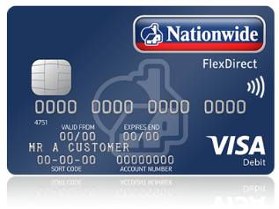
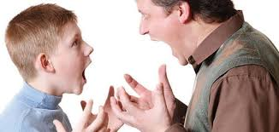
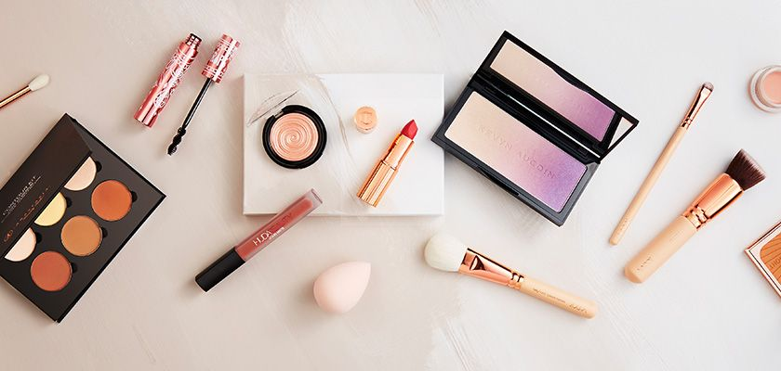
How can these images be linked to growing up?

Slide 3
Can you add to this list?
Independence
Self-conscious
Relationships might change
Privacy
New thoughts and feelings
Want to be “cool” and have the latest trends
Feeling emotional/angry due to hormonal changes

Slide 4
Hormonal Changes
When you go through puberty you have a surge of hormones, which are chemicals produced in the body. These have an effect on our mood. Sometimes when you go through puberty, you are more likely to have “mood swings” or become sensitive or emotional in various situations. This may be that you can get angry, upset or anxious in certain situations. We will look at a technique to help us during these moments. https://www.youtube.com/watch?v=mAPLTaRM48Y

Slide 5
Sabrina keeps a diary in which she writes very private things. She shares a room with their older brother. One Saturday she walks into their bedroom and finds her brother sitting on the bed reading the diary. How does Sabrina feel? How could Sabrina react to this scenario?

Slide 6
When we feel a negative emotion like anger it is important we don’t act impulsively. These actions could have negative consequences.
FEEL
What would Sabrina feel?

Slide 7
If Sabrina had time to think and reflect, she can consider her reaction.
THINK
What are the options Sabrina could consider?

Slide 8
Having thought about the sensible action, now Sabrina can do that action.
DO
What should Sabrina do?

Slide 9
REMEMBER!
FEEL
THINK
DO

Slide 10
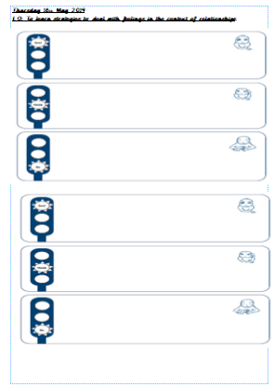
Main Task
Complete the worksheet for 2 of the given scenarios.
FEEL
THINK
DO

