Slide 1
Thursday 22nd May 2021 LO: To identify how sounds are made, associating some of them with something vibrating
I can identify how sounds are made
I understand that sounds are made with something vibrating
I can explore how sounds are made

Slide 2
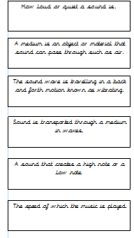
Task 1 Pre-Assessment

Slide 3
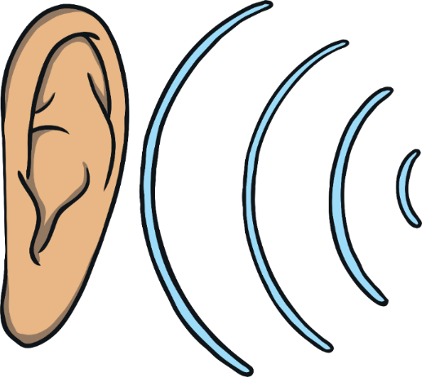
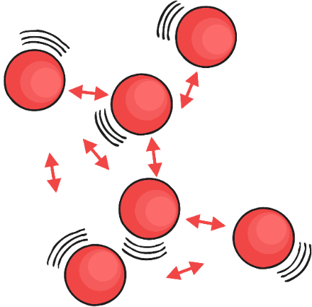
Sound waves
Like light, sound travels through the air in waves.
Sound is made by air molecules vibrating.
When you clap your hands, the air around your hands shakes. This is the air molecules vibrating.
The vibration of the air molecules around the hands, shake the molecules next to them and so on, until the air molecules in the ear are vibrating.
Glossary
Vibrating – shake quickly back and forth.

Slide 4
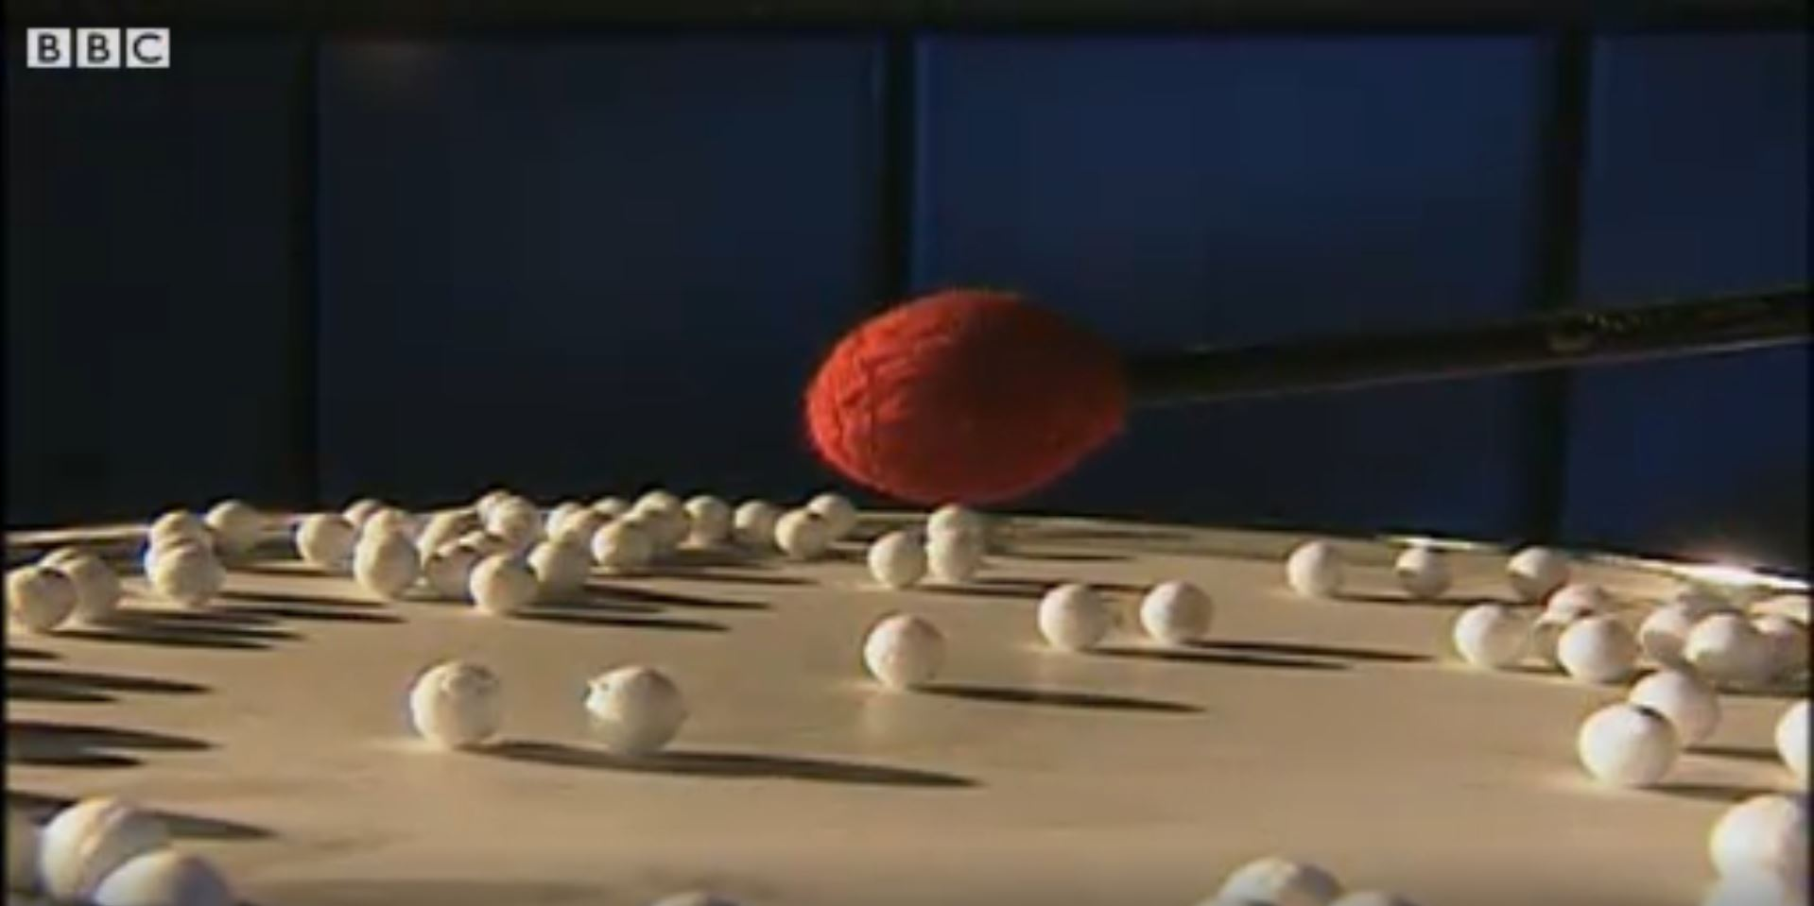
How Does Sound Travel
Watch this clip to see if you can identify how different sounds travel.
Click on this image to play the video in a new window.
Notes:
Teacher Note - Please check your volume is set to the appropriate level for this video. Please do not let the next video automatically play at the end of the clip. Please check the content in this link, including any comments, is suitable for your educational environment before showing. Twinkl accepts no responsibility for the content of third party websites.

Slide 5
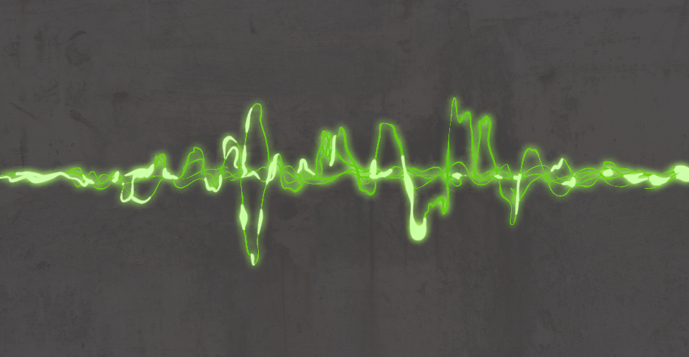
How Does Sound Travel?
Sound can travel through solids, liquids and gases.
Sound travels as a wave, vibrating the particles in the medium it is travelling in.
So in our example, when you hit the drum, the drum skin vibrated. This made the air particles closest to the drum start to vibrate as well. The vibrations then passed to the next air particle, then the next, then the next. This carried on until the air particles closest to your ear vibrated, passing the vibrations into your ear.

Slide 6
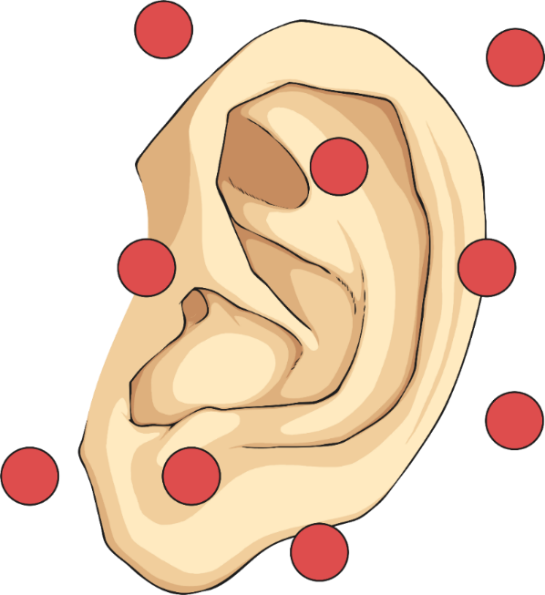
Have you ever felt a speaker when the sound is on? It vibrates
Watch how the cymbal vibrates in this video clip.
https://www.youtube.com/watch?v=QAlvdmQAEQ4

Slide 7
Press your fingers to your throat and talk to a friend.
Can you feel the vibrations in your throat?
If you put some grains of rice on a drum and gently strike the drum.
What would happen? Why?
The vibrations from the drum cause
the rice to dance around.
It is these vibrations that let us hear the
sound of the drum

Slide 8
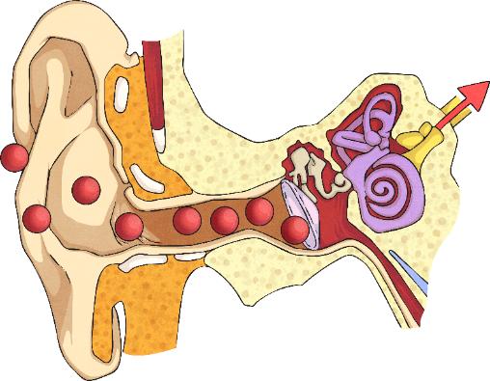
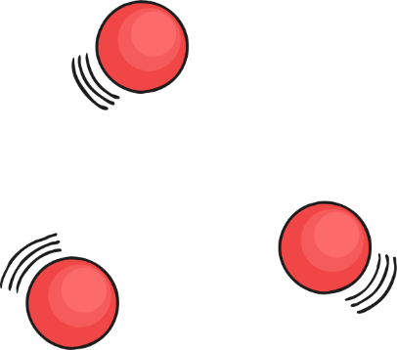
Hearing Sounds
Once in your ear, the vibrations travel into the ear canal until they reach the eardrum. The eardrum passes the vibrations through the middle ear bones (the hammer, the anvil and the stirrup) into the inner ear. The inner ear is shaped like a snail and is called the cochlea. Inside the cochlea, there are thousands of tiny hair cells. Hair cells change the vibrations into electrical signals that are sent to the brain through the hearing nerve. The brain tells you that you are hearing a sound and what that sound is.

Slide 9
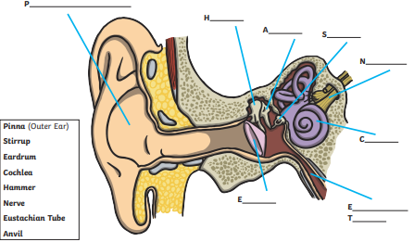
Label the worksheet to find out the names of parts of the ear.

Slide 10
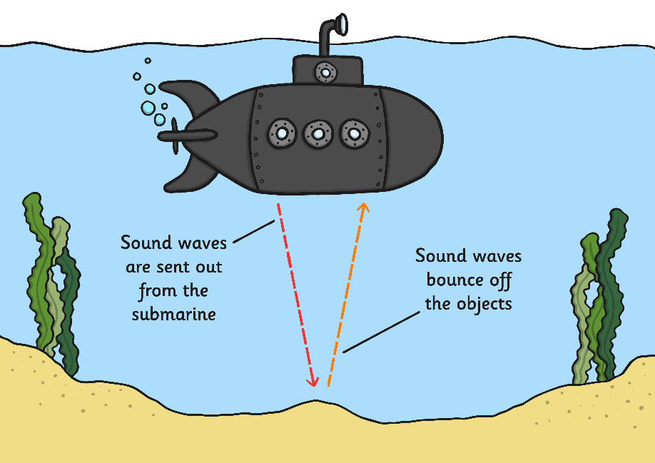
Sound needs molecules to move. It is impossible for sound to travel in space.
Sound doesn’t have to move through air. It can travel through water or metal.
In fact, sound travels faster through water and solids than it does through air because the molecules are closer together and can vibrate.

Slide 11
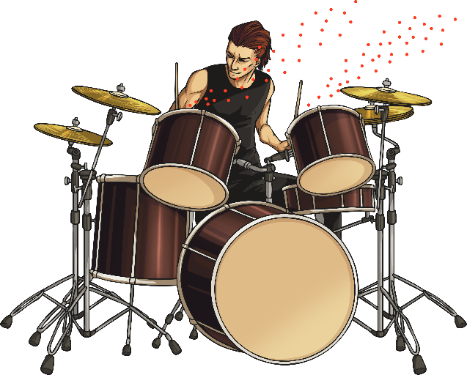
Sound travels much slower than light, whether in air or in water.
Light travels at 186,000 miles per second.
Sound travels at 770 miles per hour.
You often hear things after you see them, for example you see the lightning before you hear the thunder.

Slide 13
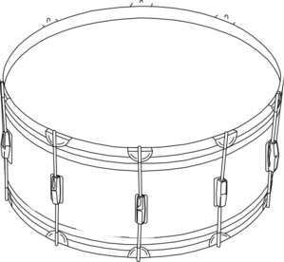
Next Step: Thought bubble:
Why do you think sound travels faster through solids and liquids, rather than gases?

Slide 14
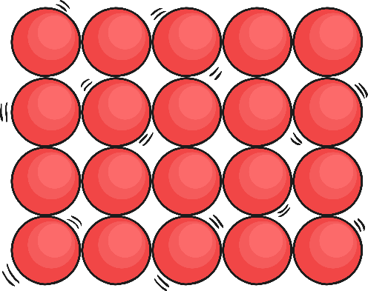
HINT: Think about how close the molecules are to each other.
SOLID
LIQUID
GAS

