Slide 2
Thursday 29th April 2021 LO: To learn about the way we grow and change throughout the human lifecycle I can identify changes throughout the human life cycle I understand change is on-going I understand change is individual

Slide 3
We are beginning a new unit where we will learn about what to expect when we grow older and go through puberty. Puberty is the changes that children go through (both physical changes to our body and emotional changes) that change us from a child to an adult. Everybody experiences puberty and Miss Hickey and Miss Lillington are here to help you understand what these changes are and explain what to expect.

Slide 4
Task 1: What are the changes we go through in the human life cycle? Order your set of cards chronologically.

Slide 5
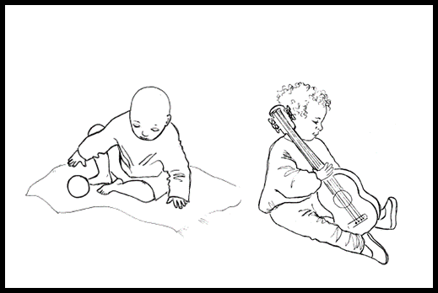
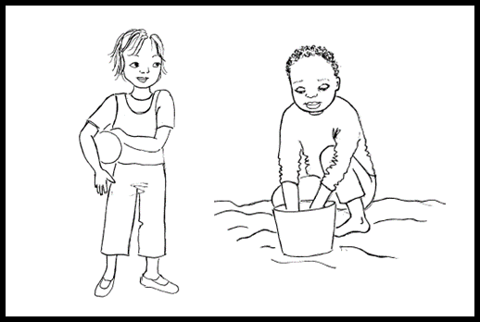
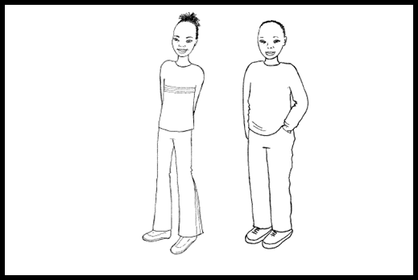
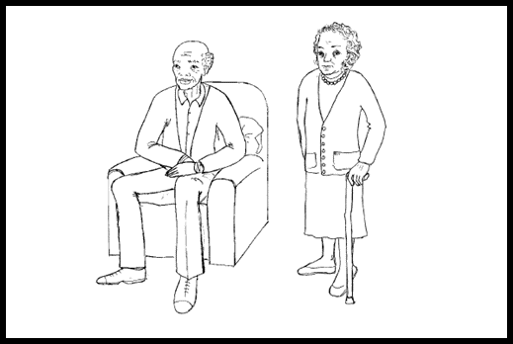
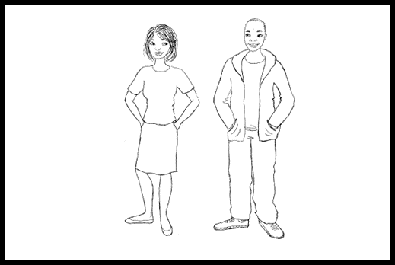
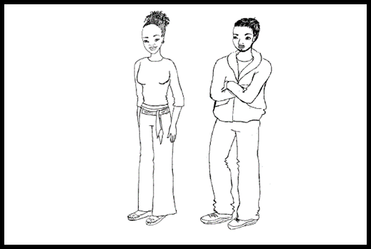

Slide 6
Task 2
What are these people able to do at this age in their lives? Write down your ideas on the images of the varied ages with your partner.
E.g. A baby is beginning to speak, a teenager may pass their driving test, an adult may choose to start their own family.
Remember these are changes that not everybody will go through!

Slide 7
Throughout all our lives we are always changing. As we get older we grow taller and heavier, learn more life skills and have more responsibilities. Not everybody has the same milestones, we are all individual and unique. There is nothing wrong with going to university as a middle aged adult or never learning to drive! As long as your life choices are sensible, safe and you are happy, it really doesn’t matter what everybody else is doing!

