Slide 1
Monday 3rd May 2021
L.O. to observe and record changes over time

Slide 2
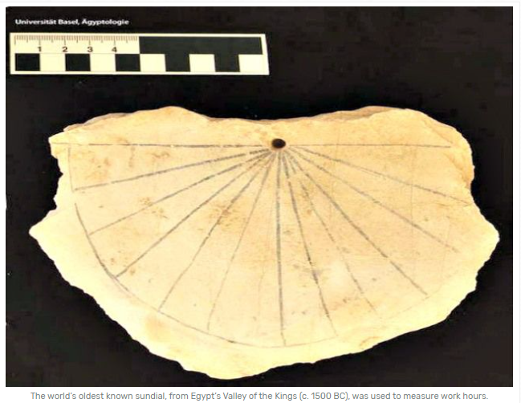
Sundials are the oldest known instruments for telling time. The surface of a sundial has markings for each hour of daylight. As the Sun moves across the sky, another part of the sundial casts a shadow on these markings. The position of the shadow shows what time it is.

Slide 3
The ancient Egyptians were the first people to divide both the night and day into 12 equal parts, which gave us the 24 hour day!
The ancient Egyptians had several ways of using the shadows cast by the Sun to tell the time.
The ancient Egyptians made the earliest known sundial in about 3500 bce. This sundial was simply a stick or a pillar that cast a shadow on the ground.
Click the link below to see how the sundial would work.
https://kids.britannica.com/kids/article/sundial/403911

Slide 4
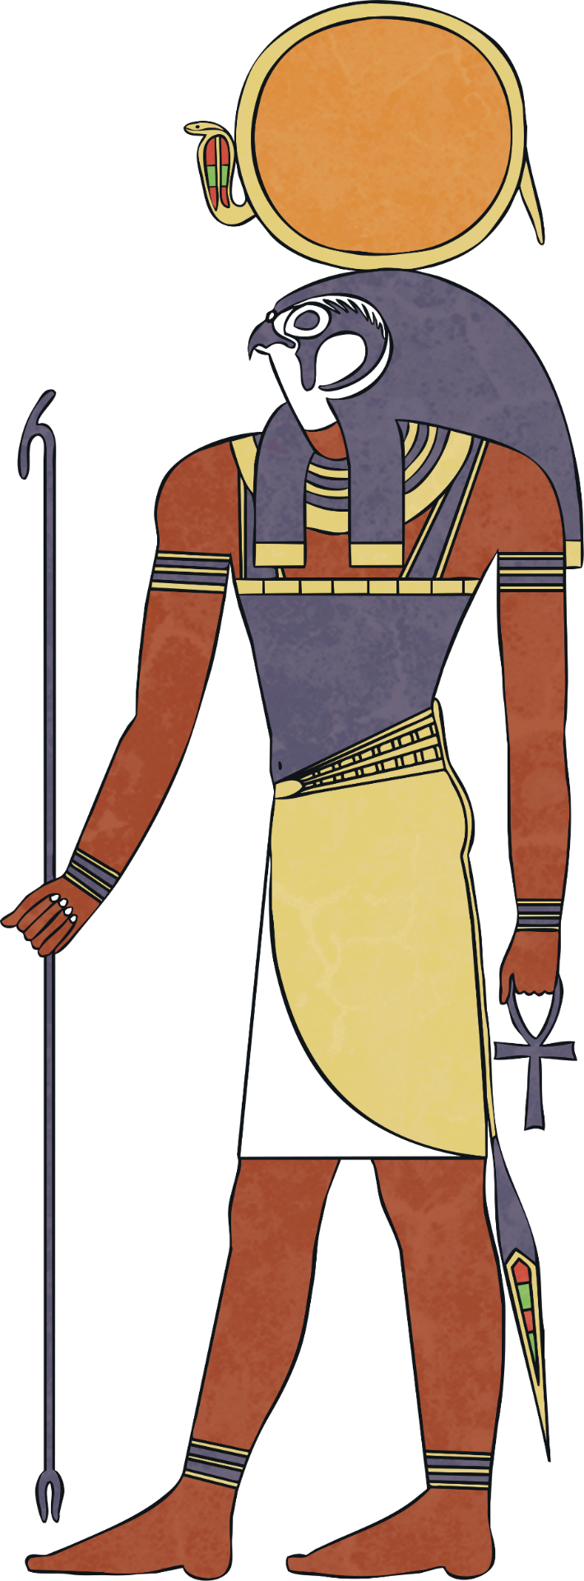
NAME: Ra
GOD OF: the sun
Ra was the most important god to all the Egyptians.
It was believed that he was swallowed by Nut the sky goddess every night and born again in the morning.
The Egyptians also believed that Ra travelled through the underworld at night, where he appeared as a man with the head of a ram!
https://www.bbc.co.uk/bitesize/clips/zwfvr82

Slide 5
How to create an ancient Egyptian sundial!
The ancient Egyptians would simply use an upright stick or pillar (known as a gnomon) to cast a shadow onto the ground. The sloping edge of the gnomon is called the style. As the day passes, the gnomon’s shadow moves around the dial. Every hour it falls on a new hour line.
As the sun moves across the sky, the shadow will also move. The position of the shadow indicates the time of day. The flat surface of the sundial is called the dial plate.

Slide 6
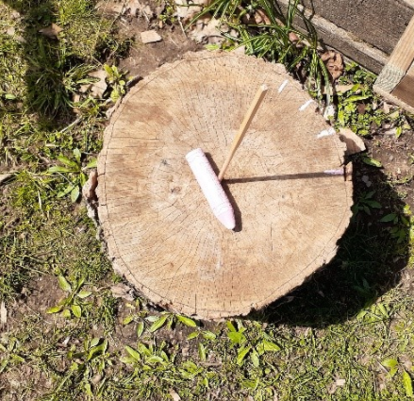
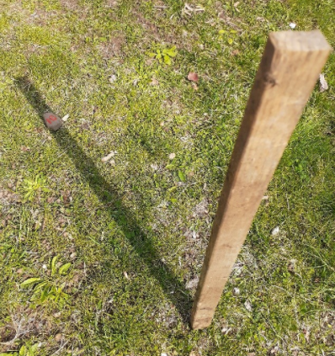
How to create an ancient Egyptian sundial!
Equipment:
- Straight stick
- Numbered stones for hour markers.
- Bucket with sand to weight down the stick
- Piece of chalk
- A compass

Slide 7
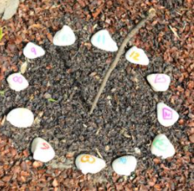
Method:
First, use your compass to
accurately identify North.
2. Next, find a sunny location and place your stick upright into the bucket filled with sand.
3. Then, carefully bend the stick slightly towards the North.
4. Starting in the morning, place a stone on the shadow line every time it is 9 am, 10 am, etc. Set an alarm at the start of each hour to remind yourself to check the movement of the shadow!
5. Continue to do this until the sun goes down and you will have a sundial to tell the time of day!

Slide 8
Let’s think…
Did you notice in which direction your shadow moved (clockwise/counter clockwise)?
Are the hourly markers evenly spaced around the dial plate? Why or why not?
Could you use this sundial to tell time in one month or 6 months from today? Why or why not?

