Slide 1
L.O. to identify Egypt’s physical features
Tuesday 27th April 2021

Slide 2
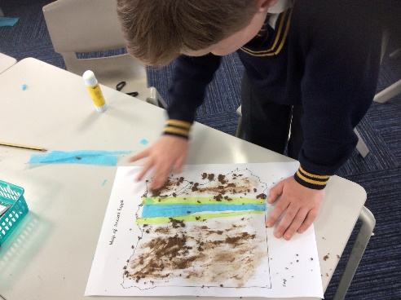
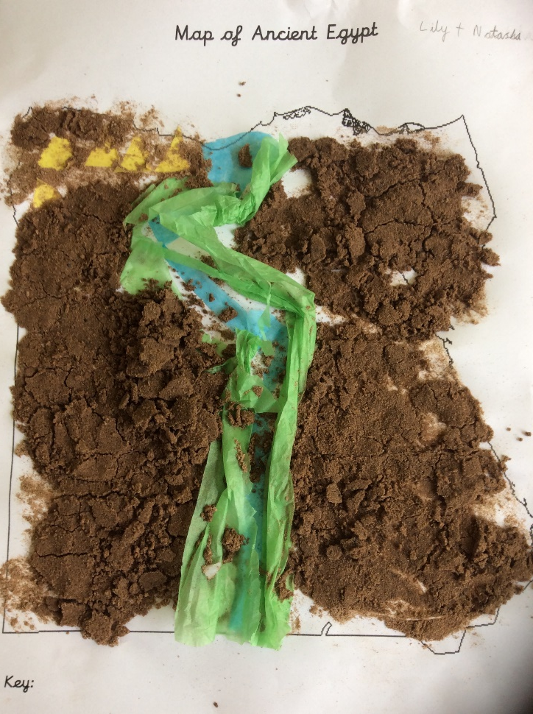
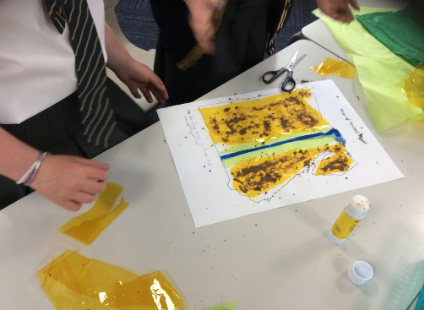
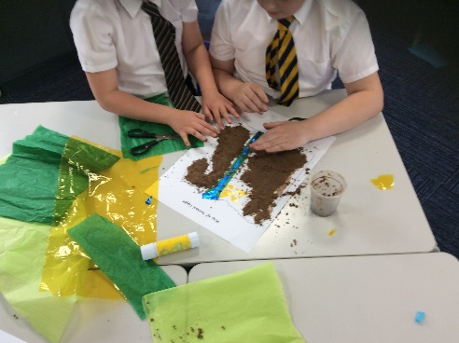
Today we are going to create our own collage maps to help us discover more about Egypt’s physical features.

Slide 3
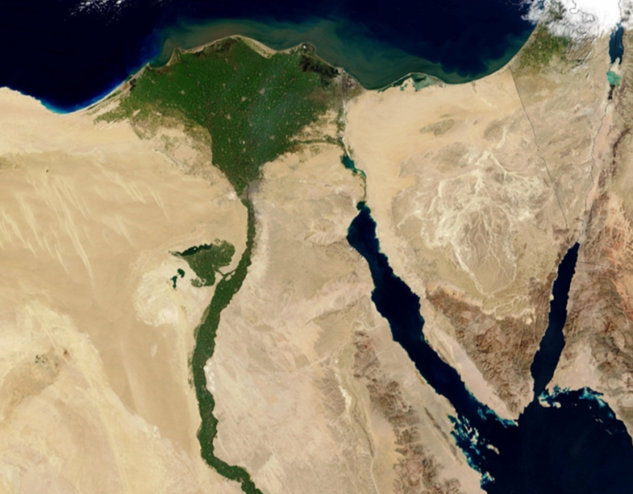
Egypt’s natural landscape, flora and fauna were important sources for the ancient Egyptian economy and inspired and shaped the religious beliefs, art and architecture of its people. Therefore, understanding Egypt’s unique environment and landscape is key to understanding its culture and its people.

Slide 4
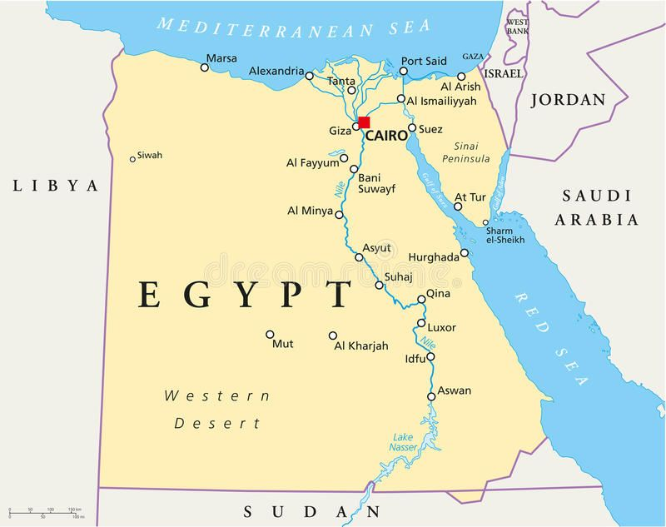
Egypt is located in the north-eastern corner of Africa and is today bounded by Libya to the west, Israel to the north-east and Sudan to the south. The Mediterranean Sea provides a natural boundary to the North of the country whilst the Gulf of Suez and the Red Sea form part of Egypt’s boundary to the east. The country has six main physical regions: the Nile Valley, the Nile Delta, the Western Desert, the Eastern Desert and the Sinai Peninsula.

Slide 5
Egypt has a very dry climate with the majority of the landscape being dominated by large deserts to the east and west of the Nile River with vegetation occurring only in the Nile Valley, the Nile Delta and pockets of desert Oases.

Slide 6
Egypt is predominantly desert. Only 35,000 km2 (3.5%) of the total land area is cultivated and permanently settled. Most of the country lies within the wide band of desert that stretches eastwards from Africa's Atlantic Coast across the continent and into southwest Asia.
Egypt's geological history has produced four major physical regions:
- The Nile river and Delta
-Western Desert (from the Nile in the west to the Libyan border)
- Eastern Desert (extends from the Nile Valley east, all the way to the Red Sea coast)
- Sinai Peninsula

Slide 7
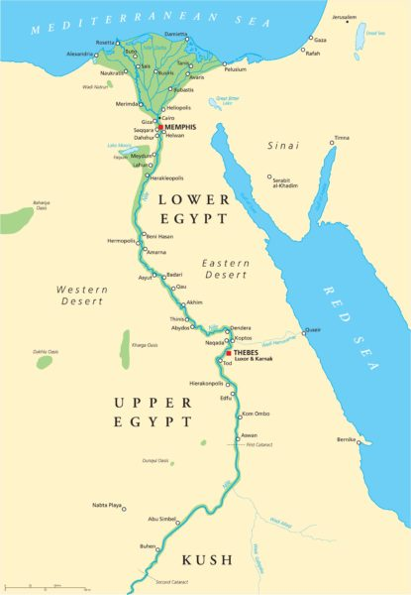
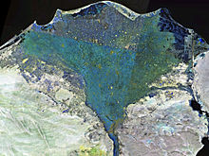
Egypt’s most important geographical feature is the Nile River. The Nile is the longest river on earth, which winds its way from the south of the country to north where it ends in the Nile Delta and flows into the Mediterranean Sea.
Satellite photograph of the Nile Delta

Slide 8
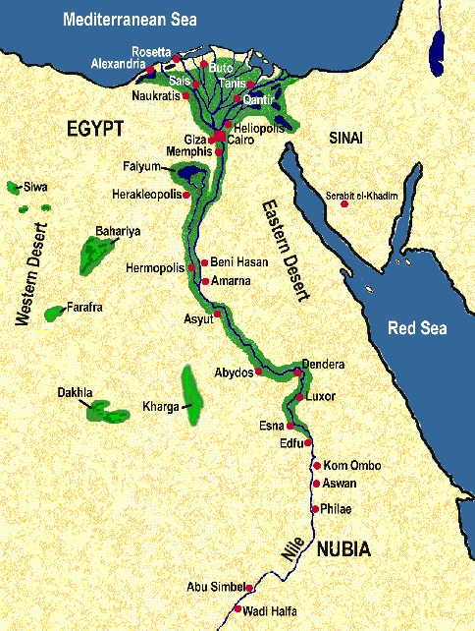
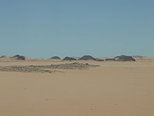
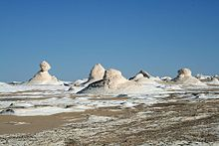
The Western Desert of Egypt is an area of the Sahara that lies west of the river Nile, up to the Libyan border, and south from the Mediterranean sea to the border with Sudan. The Western Desert is mostly rocky desert, though an area of sandy desert, known as the Great Sand Sea, lies to the west against the Libyan border.

Slide 9
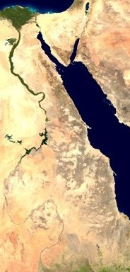
The Eastern Desert is the part of the Sahara desert that is located east of the Nile river, between the river and the Red Sea. It extends from Egypt in the north to Eritrea in the south, and also comprises parts of Sudan and Ethiopia. The Eastern Desert's main geographic features are the western Red Sea coastline—with the "Red Sea Riviera"—and the Eastern Desert mountain range that runs along the coast.

Slide 10
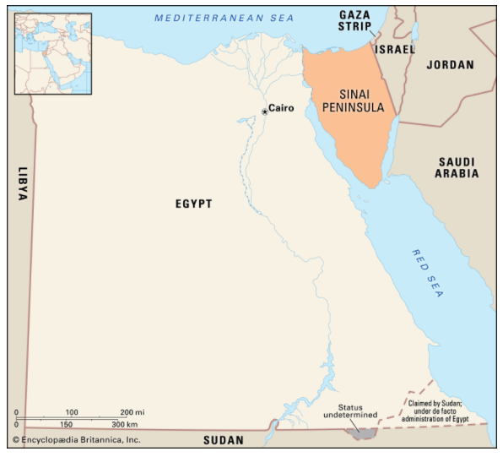
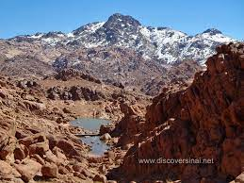
Egypt's Sinai Peninsula, also known as the "Land of Fayrouz" meaning "turquoise," is a triangular formation at the north eastern end of Egypt and the south western end of Israel, it looks like a corkscrew-like cap at the top of the Red Sea and forms a land bridge between the Asia and Africa.
Sinai is also one of the coldest areas in Egypt because of its high altitudes and mountainous landscape.

Slide 11
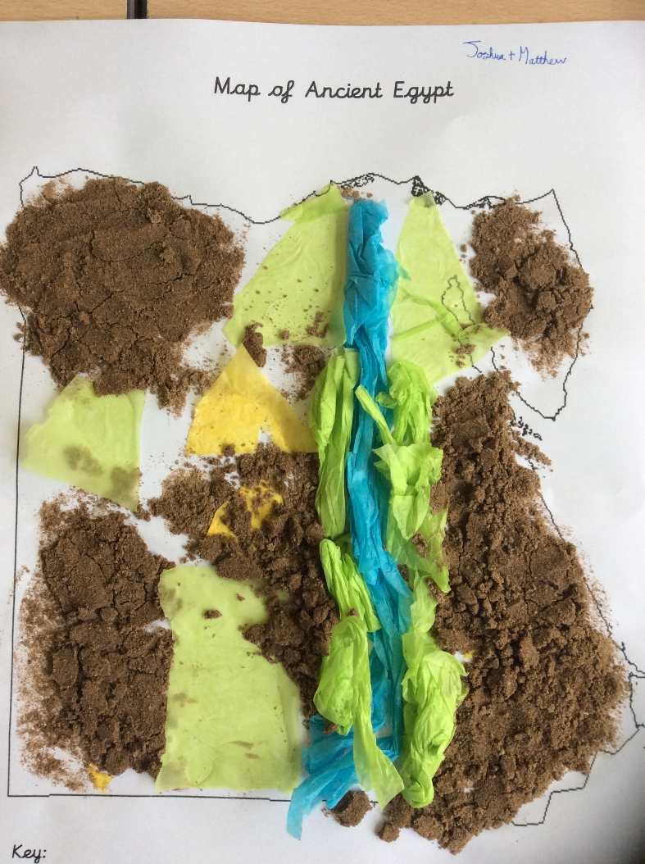
Using our knowledge of Egypt’s physical features, we are now going to create collage maps to show the different landscapes Egypt has.

Slide 12
Use this map to help you when creating your collage. Think carefully about the different physical regions: Nile (Delta) Desert (East and West) Mountains (Sinai)

