Slide 1
World Book Day 2021
Thursday 4th March

Slide 2
World Book Day is a charity on a mission to help change children’s lives by making reading together and reading for pleasure a habit for life. Even just reading for 10 minutes a day can make a huge difference.
““Reading can take you places you have never been before.”
Dr Seuss

Slide 3
Getting involved in world book day online…
On the world book day website there are lots of video by different authors giving you tips for writing your own stories.

Slide 4
Getting involved in world book day…
Join a live event. These take place on Wednesday, Thursday and Friday.

Slide 5
There’s also ways to get involved through school too…
We know lots of you are still at home but we want to see your enthusiasm and love of reading!
On Thursday hopefully your teacher will have a book themed activity for teams but it might be nice to bring your favourite book to talk about – no spoilers though!

Slide 6
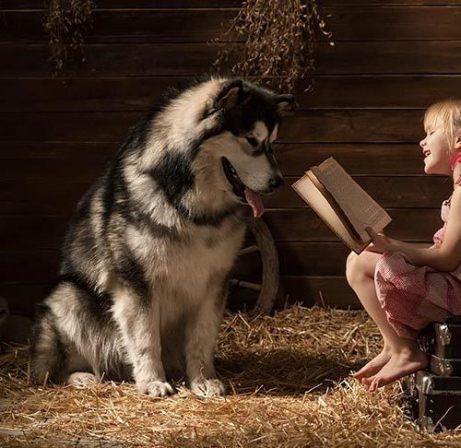
Share a story
We’d also love to see photos of you sharing stories. This could be reading with a parent or sibling. You might want to read with a grandparent or friend over a video call or you may just want to tell a story to your pet or even your teddy! It doesn’t matter what you read or where as long as it’s a story your enjoy! ☺

Slide 7
You could even enter your photo into a share your story competition on the world book day website…
Follow the link to upload your photos but remember to ask a grown-up first. You could win a £100 book token…that’s a lot of new books!!
https://www.worldbookday.com/show-your-shares/

Slide 8
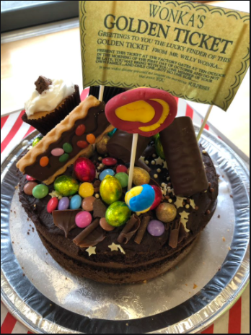
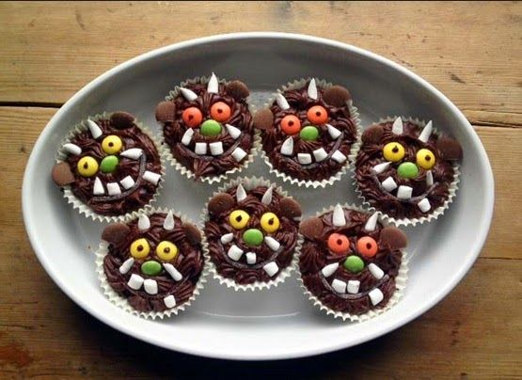
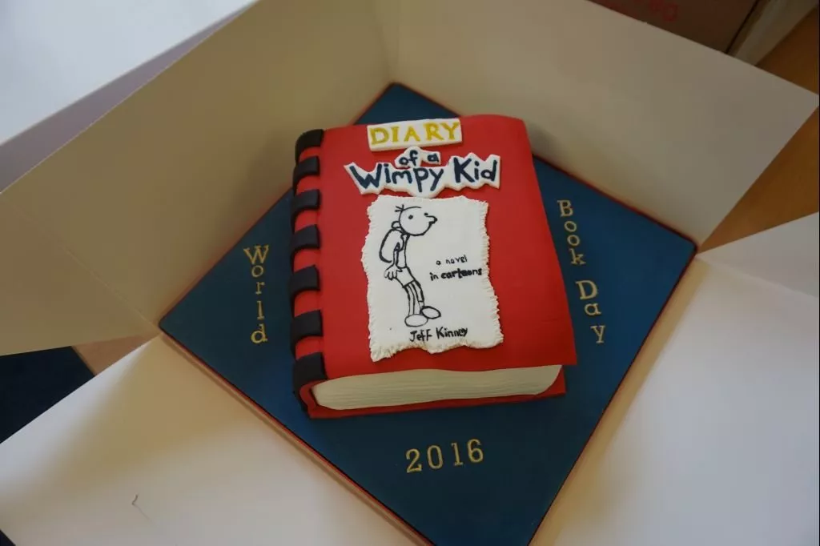
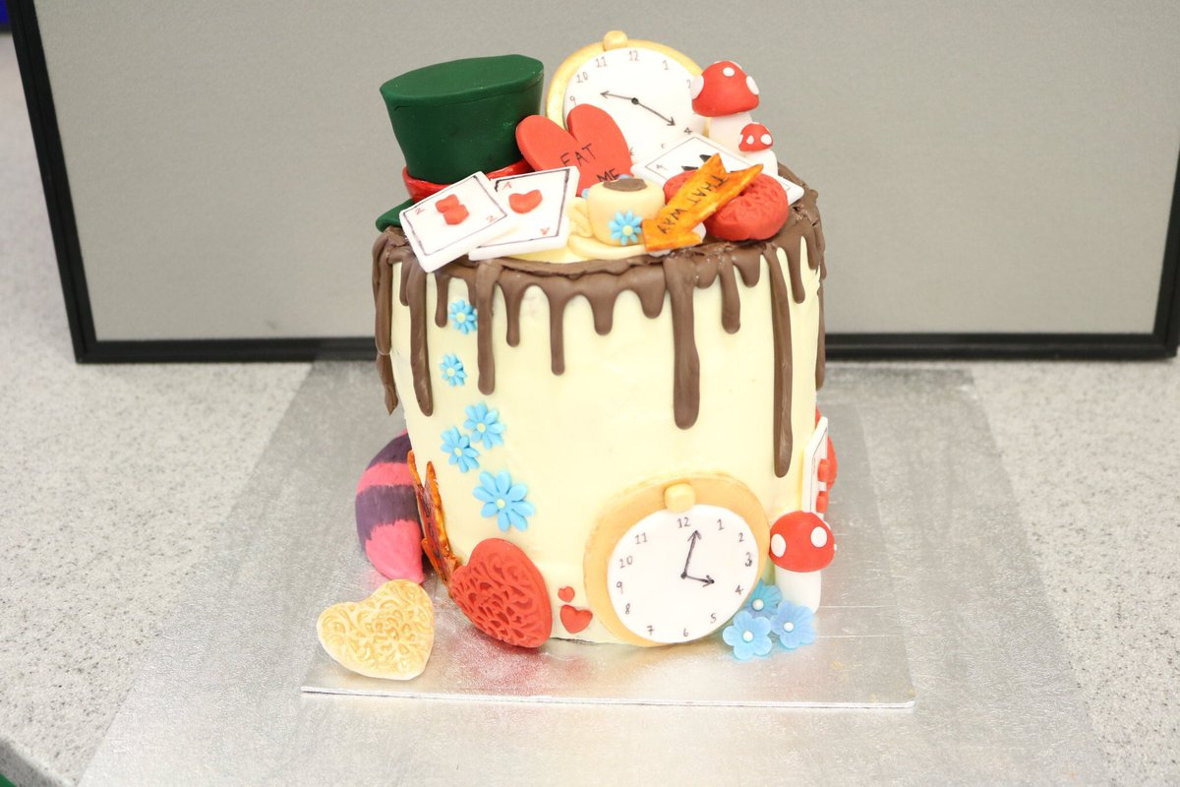
Bake a Book
We know we have a school filled with star bakers, so we’d love to see you turn your hands to some book themed bakes! You might decide to take inspiration from the feasts described in Harry Potter, create something from Mr Wonka’s factory or make rock cakes that could be found in a dragon’s lair. Be as creative as you want!

