Slide 1
Children’s mental health week 2021
w/c 1st February 2021

Slide 3
Children’s Mental Health Week 2021
This week in school we would have been focusing on children’s mental health week, so we want to continue this plan even in lockdown as it is so important.
This year the theme is ‘Express Yourself’.
Each day there will be a P4C starter question set by your teacher at the morning Teams meeting for you to reflect upon and share with your families.
There will be time in the day to do some yoga, calming strategies or mindfulness activities.
There will be some PSHE challenges around wellbeing e.g. self esteem, celebrating success, overcoming challenges and worries.
There will be creative activities.

Slide 4
Plan for the week
Monday – dress to express yourself ☺ If you want to dress up for your Teams call in an outfit that best represents yourself you can do – this is optional. It might be your favourite clothes, sports kit, something linked to a hobby, or just a bright, colourful accessory, hat or crazy hairstyle!
Tuesday – focus: inspirational people
Wednesday – focus: being creative
Thursday – focus: being resilient and overcoming challenges – how can we deal with our worries?
Friday – inside out day – celebrate the work this week by thinking about the way we present ourselves on the outside, and how we might be feeling on the inside. If you want to, wear your clothes inside out for your Teams meeting!

Slide 5
Support in school
Everyone in school is here to support you – your teachers, your teaching assistants, your friends, and lots of other adults in school. Even if you are not in school at the moment, you can still ask for hep and support if you need it.
The following slides show some familiar faces that you can ask for help in school.
We have visitors into school when we can, such as D-side (Dave) who teach us about online safety and keeping our bodies safe from things like drugs and alcohol.
We have weekly PSHE lessons and P4C lessons when we learn about healthy minds and bodies and how we cope with our emotions and react to things
Each classroom has a worry monster box that the teachers check regularly in case anyone has shared a worry
During lockdown, you can see your teacher every day on Teams and Mrs Al-Kaseed will check in with some of you she usually sees in class
We have a nurture room which the school council are involved in renovating with Mrs Casling and Mrs Al-Kaseed – ready for your return to school ☺

Slide 6
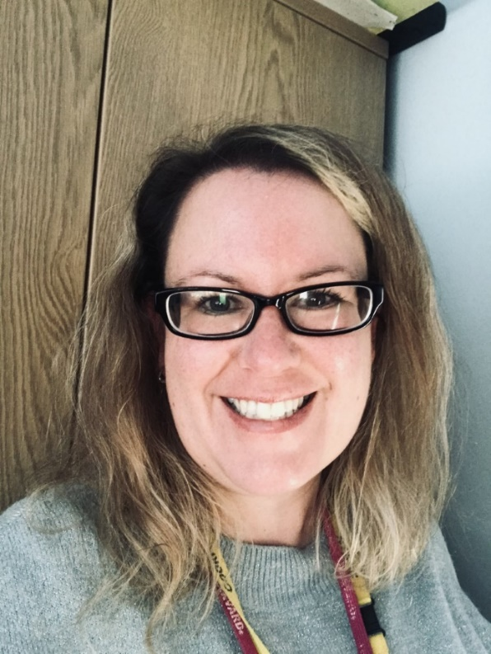
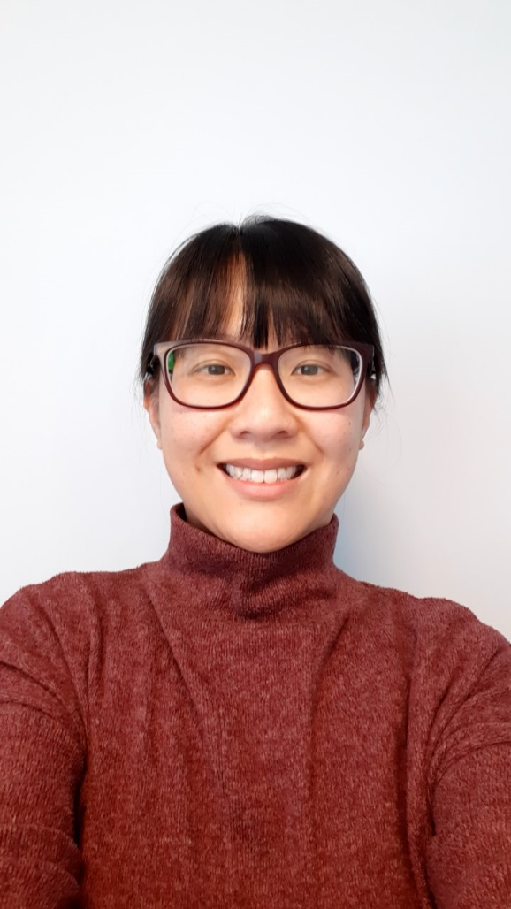
Who can help?
Miss Chang
I am the SENDCo in school so my job is about supporting children with special educational needs. I can help you with your learning or behaviour by supporting you in school, giving you and your parents advice and strategies, or seeking help from outside of school if we want some more support. I also work with lots of children across school to do interventions and speak regularly to all your teachers.
Mrs Casling
I am the Deputy Head and Inclusion leader in school – this means I have an overview of all classes and make sure anyone who might need some extra support gets it. I can also help your parents/carers if they need support and I work with adults from other schools to find the best help and advice for people. I run the school council to make sure your pupil voice is heard in school. We are still meeting during lockdown via Teams to work on re-vamping the nurture room in school and make it a really welcoming place for all.

Slide 7
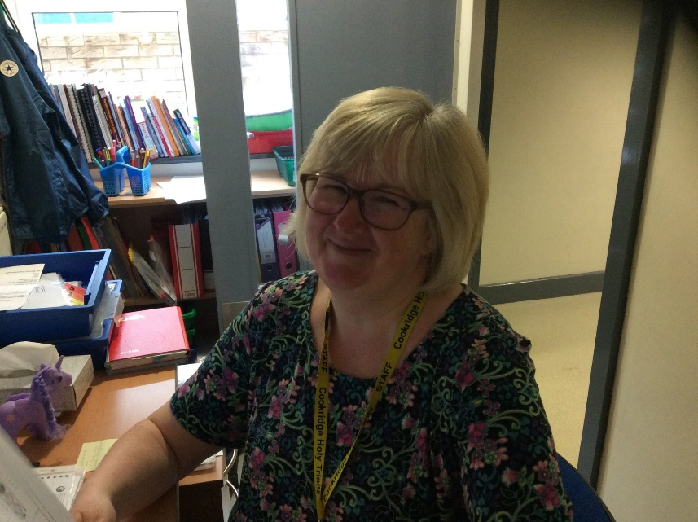
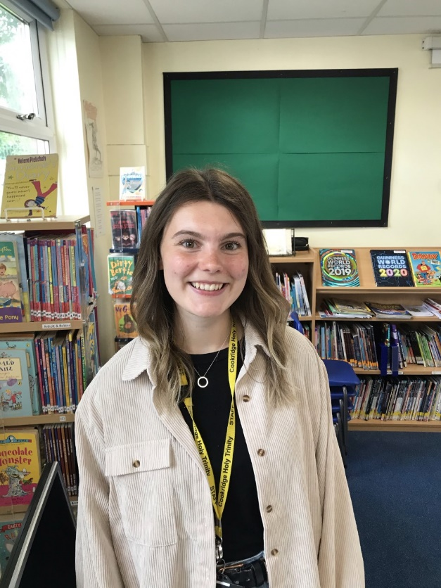
Miss Russell
I am the PSHE leader in school and teach in Year 3. I make sure that your teachers plan in activities to teach you about health and wellbeing, and ways to keep yourself safe. You will learn about different things in different year groups so by the time you finish at Holy Trinity you are confident young people who are ready for high school.
Mrs Al-Kaseed
I am the learning mentor in school. I visit individual children to talk about things that might be worrying them, and I also work with small groups to develop skills that will help them feel better at school and at home. I speak to lots of parents about ways to help at home too. I have lots of books and games and resources that I can use or recommend to your teachers if you have any worries – don’t forget to use the worry monsters when you are back in school if anything is bothering you.

Slide 8
Monday 1st February
Dress to express yourself ☺ If you want to dress up for your Teams call in an outfit that best represents yourself you can do – optional. It might be your favourite clothes, sports kit, something linked to a hobby, or just a bright, colourful accessory or hat
Todays’ P4C question:
What is true happiness?
Today’s activities: Who are you?

Slide 9
Tuesday 2nd February
Tuesday – focus: inspirational people
Todays’ P4C question:
If you could choose just one thing to change
about the world, what would it be, and why?
Today’s activities: Who is your hero?

Slide 10
Wednesday 3rd February
Wednesday – focus: being creative
Todays’ P4C question:
Is it worse to fail at something, or to never attempt it
in the first place?
Today’s activities: Get creative!
(you will need at least one toilet roll for today’s task!

Slide 11
Thursday 4th February
Thursday – focus: being resilient and overcoming challenges – how can we deal with our worries?
Lots of activities on the website https://www.time-to-change.org.uk/get-involved/time-talk-day
Todays’ P4C question:
Why do people get angry?
How can they control this feeling?
Today’s activity: Worry dolls

Slide 12
Friday
Friday – inside out day – celebrate the work this week by thinking about the way we present ourselves on the outside, and how we might be feeling on the inside. If you want to, wear your clothes inside out
https://www.insideoutday.org.uk/
Todays’ P4C question:
Can kindness change the world?
Today’s activities:
Have you filled a bucket
today?

Slide 13
Physical activity and Yoga
There are lots of great ideas across the internet to keep kids active at home and we have provided links to these below such as Joe Wicks workouts and Cosmic Yoga. However, these are not physical education lessons, and we all know the importance of physical education to a child’s development and self-confidence. Therefore we will provide 2 links to Physical Education lessons here. Learning and practicing the fundamental skills of agility, balance, coordination and strength are so important.
The department for education have recommended the Yorkshire Sport Foundation #ThisisPE campaign https://bit.ly/ThisIsPE_YouTube
Leeds Rhino Challenges
Cosmic Kids Yoga
GoNoodle Dance Workouts
Joe Wicks Daily Workouts
10 minute shake ups – Disney new 10 minute shake up games!
BBC Supermovers – move while you learn.
Yoga and Mindfulness
Warm up
Yoga
Relax
Mindfulness

Slide 14
Mindfulness and breathing exercises you might like to try ☺
Muscle relaxation/Mindfulness https://www.youtube.com/watch?v=aaTDNYjk-Gw
Belly breathing https://www.youtube.com/watch?v=RiMb2Bw4Ae8
Box breathing https://www.youtube.com/watch?v=AOL3isokmY4
Square breathing https://www.youtube.com/watch?v=YFdZXwE6fRE
5 finger breathing https://www.youtube.com/watch?v=DSgOW879jjA

Slide 15
What to do if you are worried
Huge bag of worries book https://www.youtube.com/watch?v=NbcswBYnmeQ
The Colour Monster https://www.youtube.com/watch?v=Ih0iu80u04Y
Speak to your teacher via email or at the Teams meeting
Ask your parents to let school know

