Slide 1
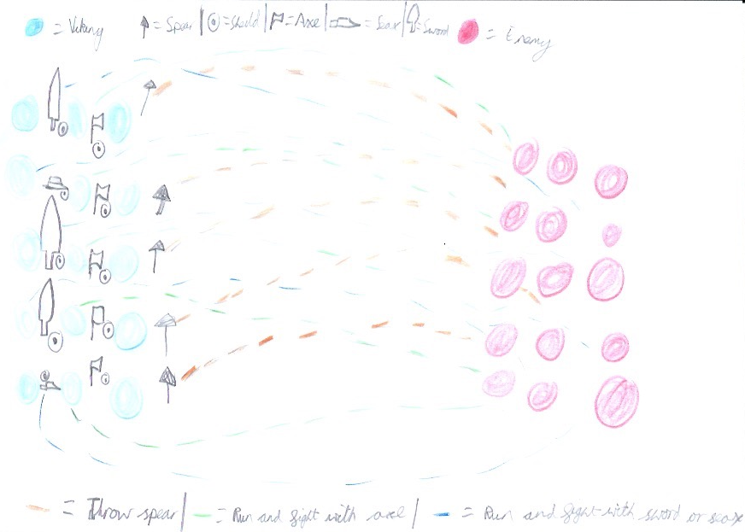

Slide 2
The Vikings on the front row throw spears to make a diversion so the lines of the enemies split up. Then the Vikings on the second row with the axes and shields run ahead and start fighting people on the first row of the enemies or the second. Then the Vikings with the swords or seaxes and shields run and fight the second or third row of the enemies

