Slide 1
The Americas
North, South and Central America

Slide 2
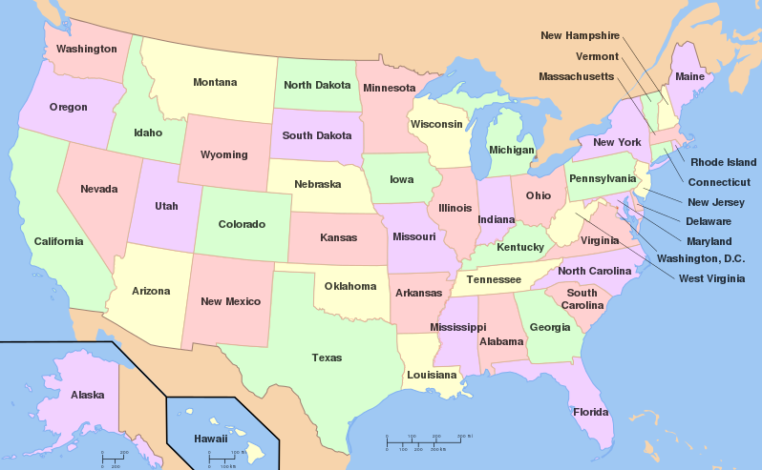
This term, Year 5 will be studying The Americas.
As an introduction to the topic, you are to research the U.S.A. and learn about a state of your choice.
Some states you will know about, others you my not have heard of. Challenge yourself to learn about a new state or learn about one you just want to know more about.
You may choose how you would like to present your information and what on: maybe you would like to use a PowerPoint like these slides, maybe you would like to complete a giant poster, maybe you would like to make a leaflet or a booklet. The choice is yours.

Slide 3
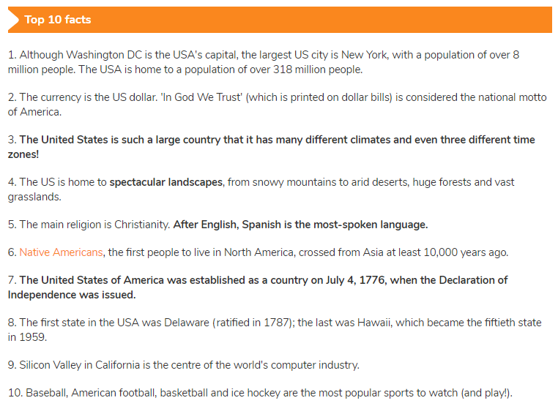
If I researched the country, the United States of America, and not a state, I would use a range of details, pictures and facts to show off my information.
If you’re thinking about what sort of information you could use, let’s think together.
You could research interesting facts to start with, like the ones opposite. You might research photos that could go with your facts. For fact number 2, you could find a photo of a dollar. For fact number 6, you might choose to find a photo of a Native American.
What sort of photos would you use? You would need to make sure your photos or pictures match the writing. You would need the photos to show off your state and prove that it is special.

Slide 4
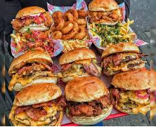
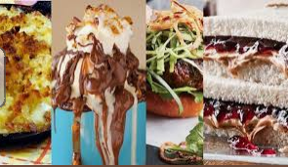
These photos look great…but are they perfect for my research project? Possibly not all of them. Some of them are very similar and most of them are about the scenery.
I would definitely keep the American flag but what else could I include?
I would want monuments and landmarks
These are perfect- not too many and they show some of the most famous landmarks in the country.
What else might I want? I would want to know about the best food available in the state. Because I’m researching the country, I’m choosing food known all over America.
Other subjects you might research about:
Sports
People
Cities
Wildlife
National Parks
Symbols or flags
Nicknames
Physical features

