Slide 1
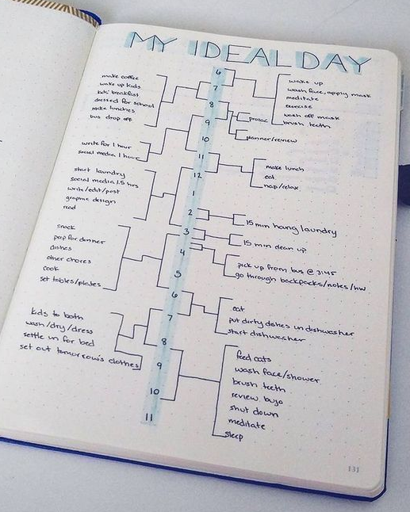
Your final transition piece is to create your own ‘My Ideal Day’ entry.
Take a look at the entry opposite. Now, I must disagree with this one because at 2pm it says ‘hang laundry’ and between 6 and 7 it says ‘put dirty dishes in dishwasher’- that is no-one’s ideal day. Am I correct?
Your task is to recreate this piece of work with your own ideal day. Of course, it needs to be varied- you can’t play computer games all day (even if you really want to).
Use the design on the right for inspiration and create yours so it looks the same.
Step 1) Write down the hours of your ‘awake hours’ down the centre of the page.
Step 2) On rough paper, write down what you would do during each hour.
Step 3) Add the lines to your page, one hour at a time.
Step 4) Add your activities.

