Slide 1
Life Cycle of a Butterfly!
By Joshua . Smith .

Slide 2
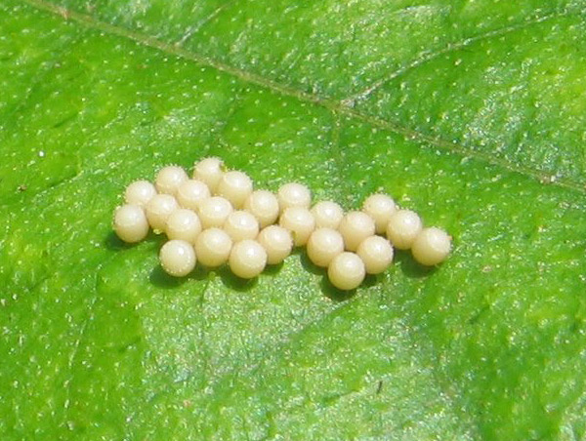
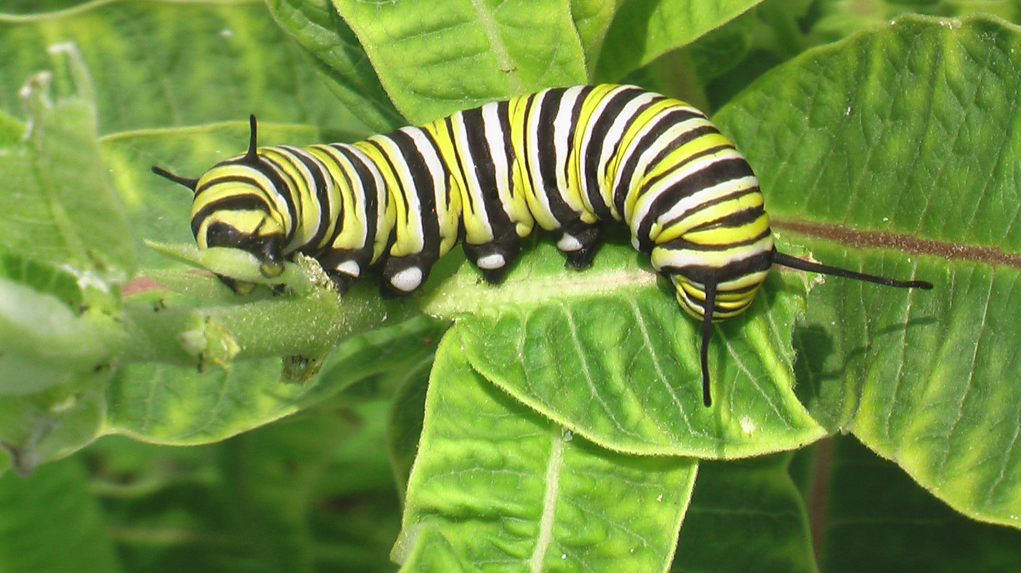
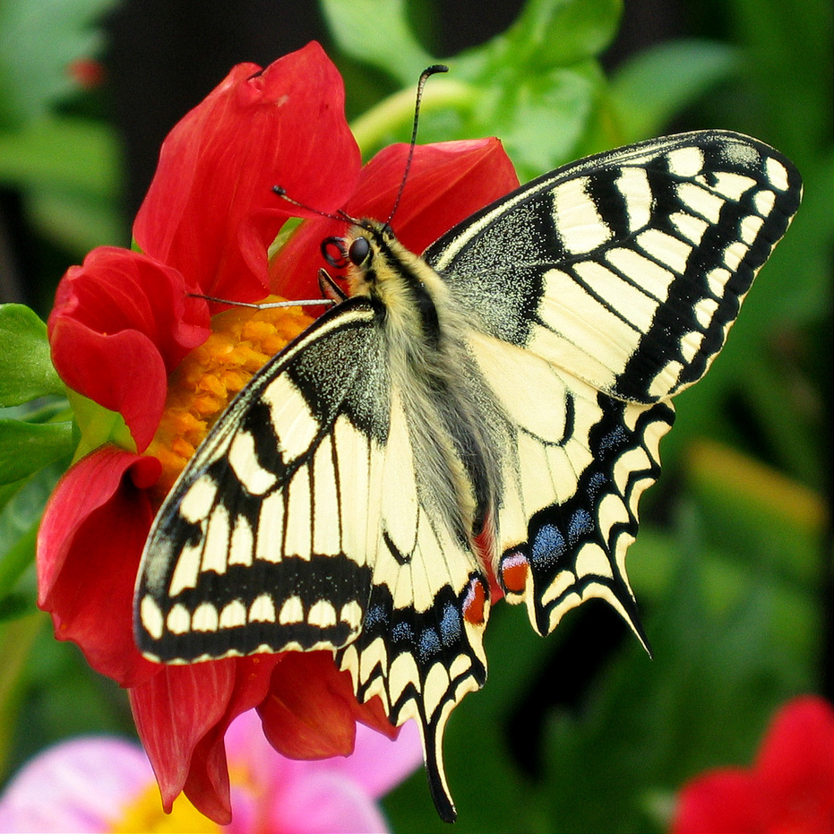
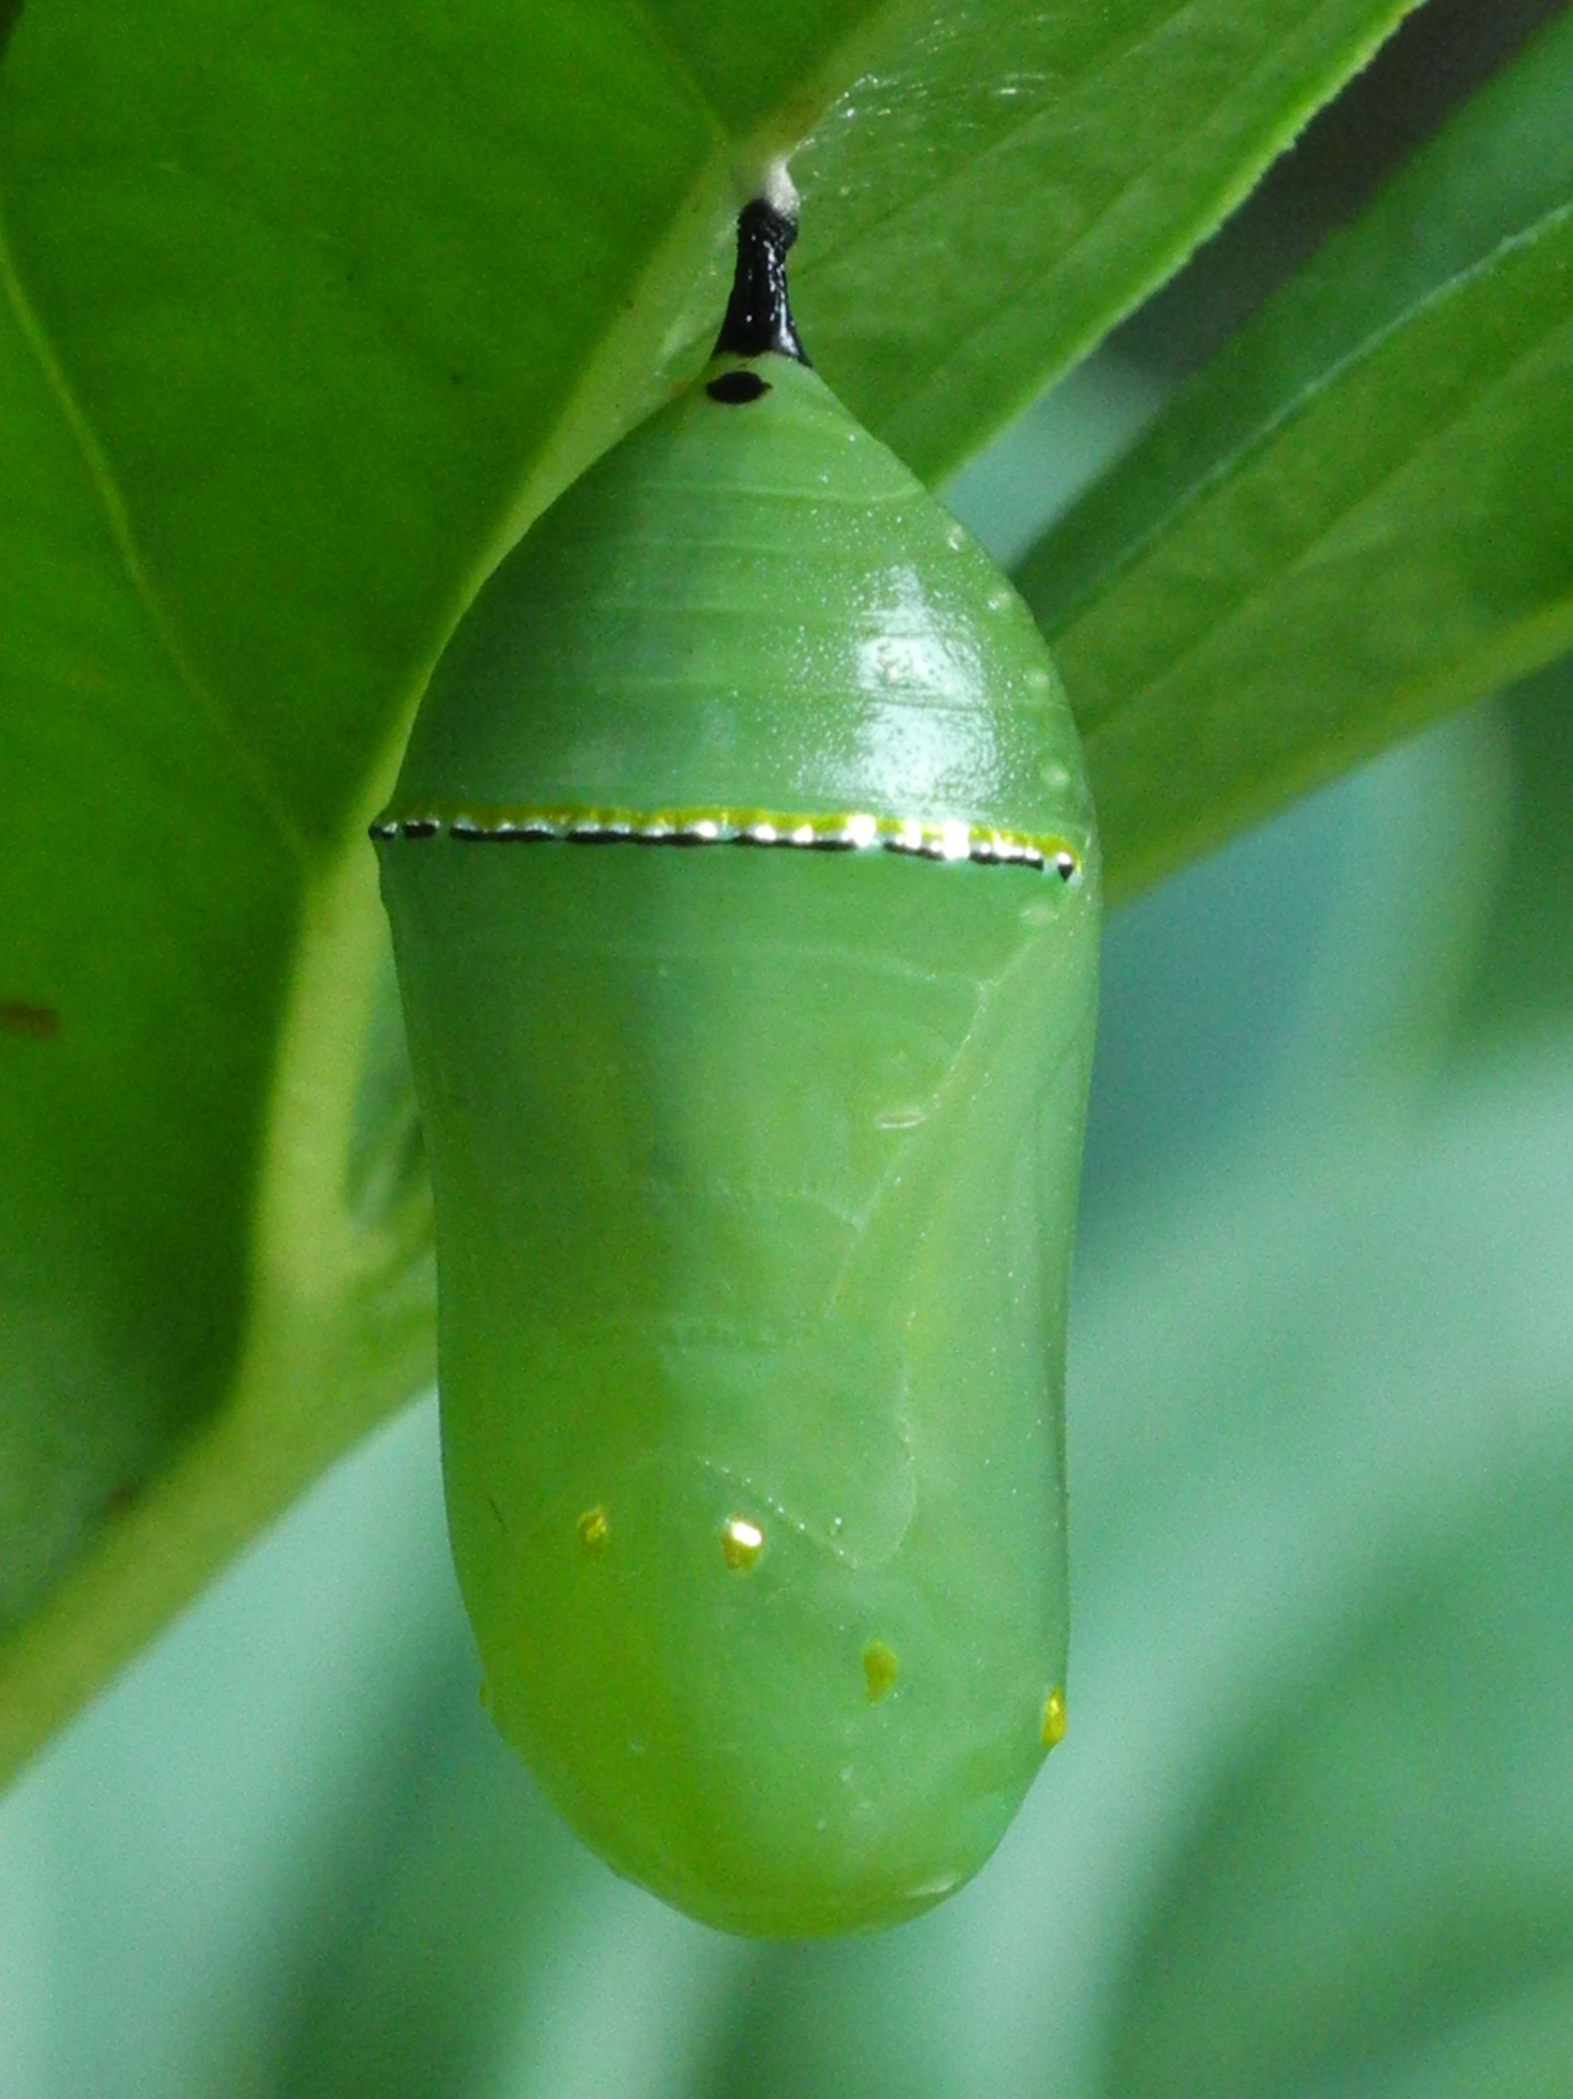
This is the life cycle of a butterfly.
Eggs Caterpillar
In the cocoon the caterpillars grow whilst sleeping and change through an amount of time. All butterflies have ‘’ complete metamorphosis ’’ to go through four stages : egg larva , pupa adult. Each stage has a different goal-for instance, caterpillars need to eat a lot , and adults need to reproduce.
Butterfly Cocoon

