Slide 1
Viking Gods
Vikings believed in a polytheistic religion – a religion with many deities. Gods and goddesses were very important in Norse culture. The Vikings often made decisions or acted in ways to please the gods.
There are many different Viking gods, each possessing a mixture of human traits and magical abilities. They were split into different groups who were at war with each other, until they realised they were equally powerful:
Vikings believed that there were Nine Worlds connected together by an enormous mythical tree called Yggdrasil. Each world was home to different living creatures or mythical beings.
Asgard – home to the Æsir (pronounced ‘A-seer’) gods, including Odin, Frigg and Thor. Asgard is home to Valhalla, the place where fallen warriors go when they die.
Vanaheim – home to the Vanir gods, including Freya, Freya and Njord.
Midgard – the Norse name for Earth, the realm of mortals.
Alfheim – home of the elves.
Niflheim – home of the frost giants.
Jotunheim – home of the giants.
Helheim – the underworld and realm of the dead.
Svatalfheim – home of the dwarves and dark elves.
Muspelheim – home of the fire giants.
By Joshua Smith 5E

Slide 2
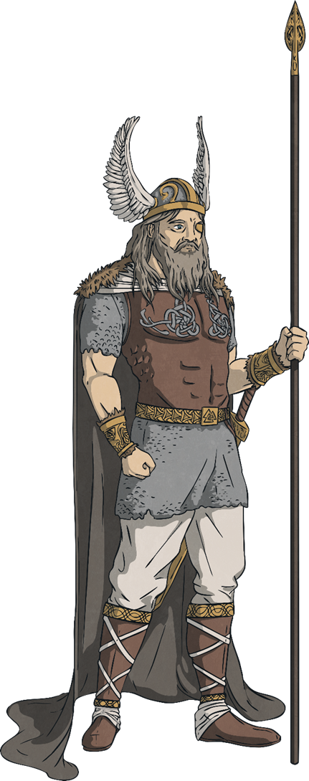
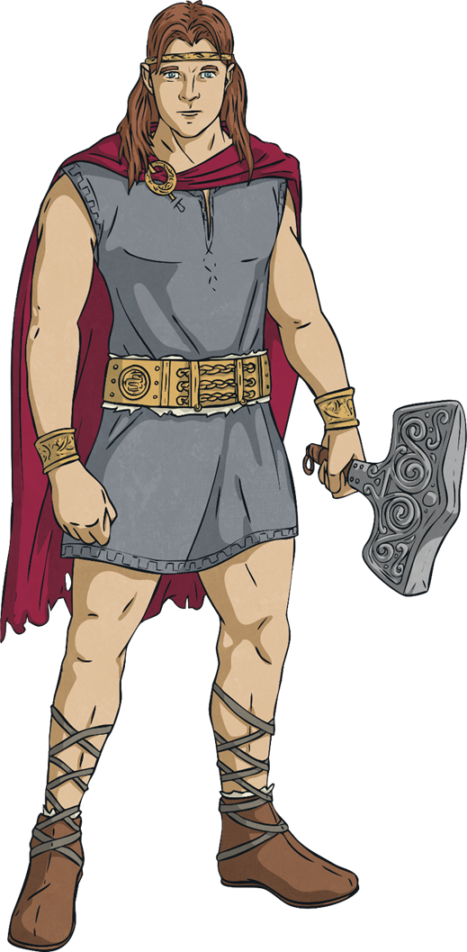
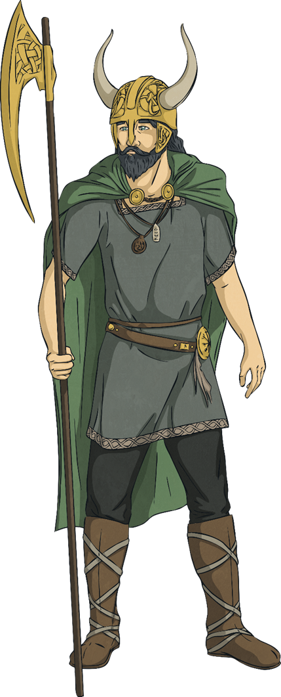
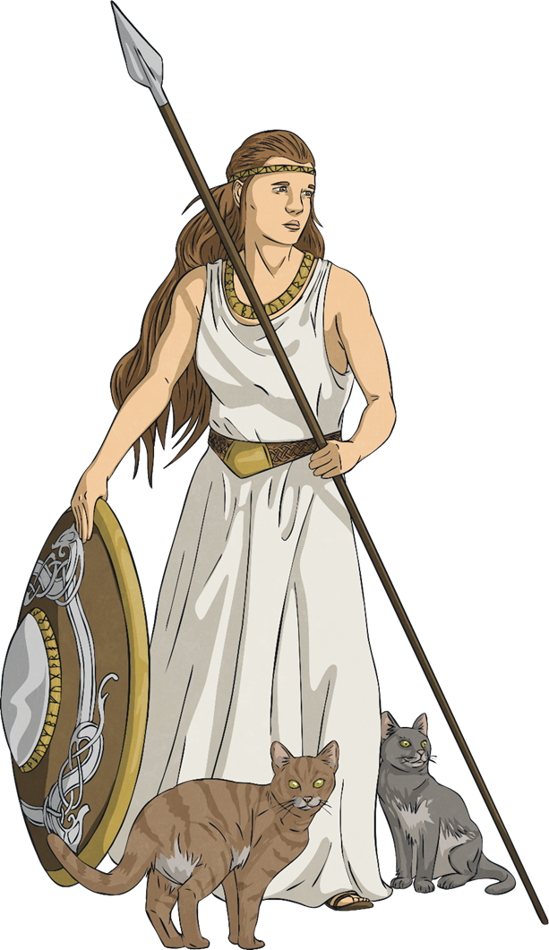
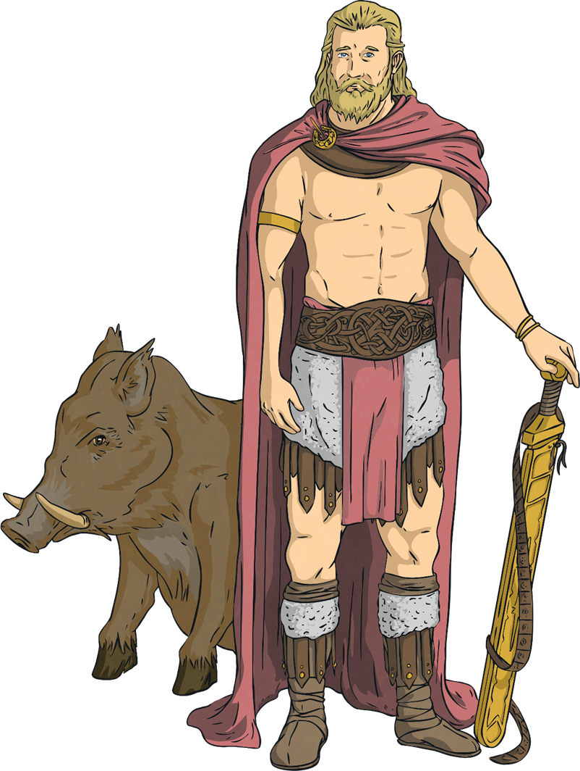
Odin Thor Loki Freya Frey
God of: thunder, fertility, the sky and law
Son of Odin and Fjorgyn, he had super strength and an enchanted hammer that could destroy most things. He was the most popular god as he has a good heart.
He is a relative of Loki.
God of: Odin was the chief and most important god of them all.
He ruled in Asgard and is the father of Thor. He rode an eight-legged horse.
He liked to roam the Earth in disguise in order to be with women he fell in love with.
God of: mischief and chaos
Loki is known as a naughty god, who lied and betrayed the other Gods.
It was said that his relationship with Thor was a rather strange one.
God of: love, beauty, fertility and war
She was married to the God Od, who abandoned her.
She has been known to appear as a bird to people and made sure the sun shone, rain fell and crops grew.
God of: fertility
He was the son of Njord. He arrived at Asgard as a hostage along with his sister Freya and his father.

Slide 3
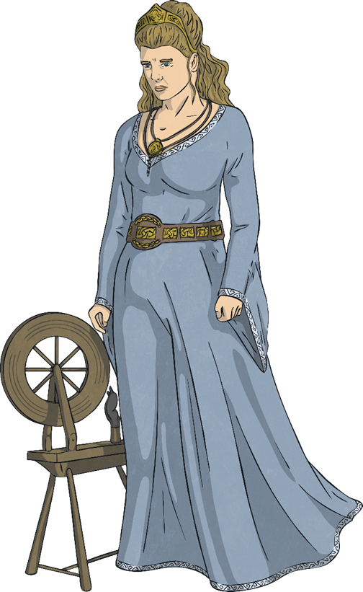
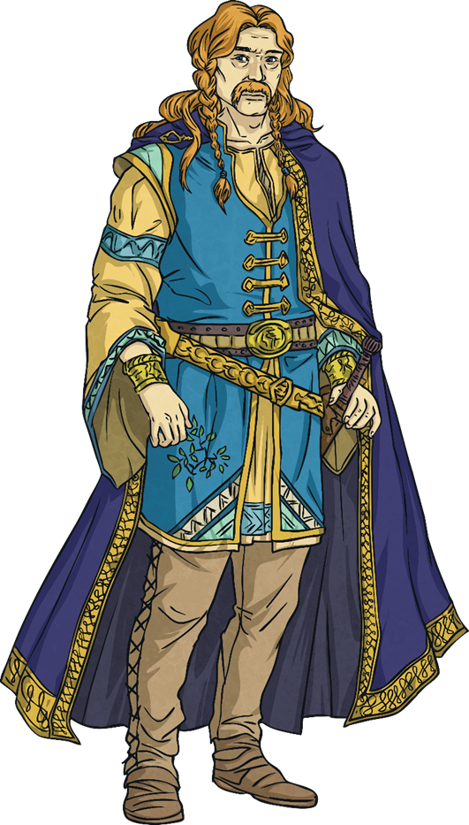
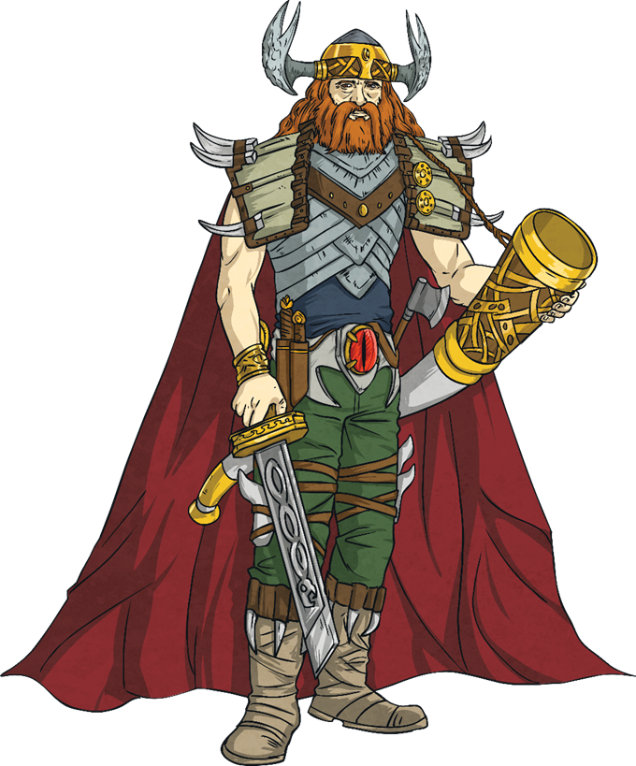
Frigg Baldr Heimdau
Frigg, or Frigga, is the goddess of motherhood and the sky, the wife of Odin and mother of Baldr and Hodr. She is part of the Æsir pantheon.
Many of the stories surrounding Frigga are about her family role, alongside her husband and children. She is shown to be strong-willed and protective of those she loves.
Frigga is usually depicted as a beautiful woman in peaceful backgrounds, showing her calm nature.
Her symbols include the full moon, the spinning wheel, mistletoe and silver, which are often included in images of her.
Baldr, or Baldr, is the god of light and purity. He is the son of Odin and Frigg and the brother of Thor and Hodr. He is part of the Æsir pantheon.
Baldr is said to be so bright that light shines from him and he is so beautiful that flowers bow to him.
In Norse tales, Baldr was unable to be hurt by anything in existence, except for mistletoe. The gods would amuse themselves by trying their weapons on Baldr and seeing them fail to hurt him.
Heimdall is the guardian of the gods. He watches over the Bifrost – the rainbow bridge which leads to Asgard. He lives in a fortress which sits at the top of the Bifrost where he keeps watch. He is the son of Odin and part of the Æsir pantheon.
Heimdall has incredibly strong hearing and vision. He keeps watch for approaching enemies and uses his mighty horn, Gjallarhorn, to summon the other gods from across all nine worlds to battle if needed.
In tales, Heimdall is believed to have used his horn to sound an incoming invasion to Asgard at the beginning of Ragnarök.

Slide 4
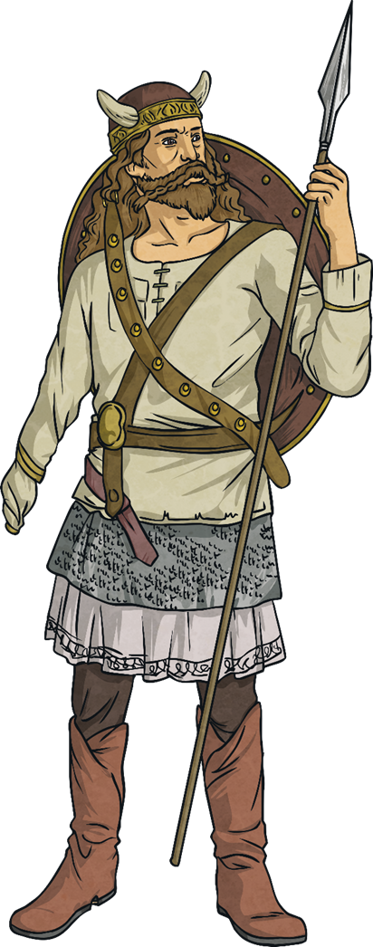
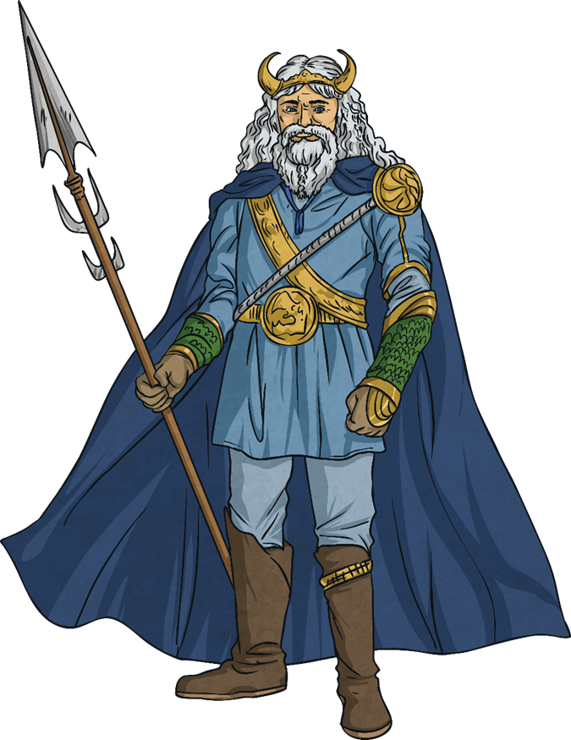
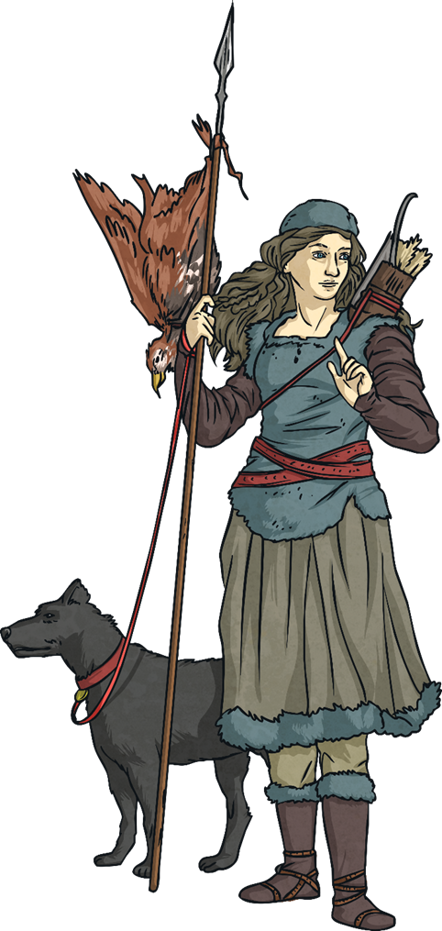
T’yr Njord Skadi
Týr is the god of single-handed combat, justice and law. He is the son of Odin and part of the Æsir pantheon.
Týr is one of the main Norse gods along with Odin and Thor, as people would pray to Týr in the hope of being victorious in battle.
Týr is shown as having one hand after the other was bitten off by the giant wolf Fenrir while trying to tame it as a pup. This sacrifice shows Týr as a heroic figure willing to put himself in danger in order to protect others.
Njord is god of the sea and is part of the Vanir pantheon.
Njord is also associated with wealth and Vikings would often describe rich people as being ‘as rich as Njord’.
Vikings believed that whenever Njord was angry or sad, storms would rage at sea. Vikings would pray to Njord in the hope of a safe journey on their voyages.
Njord is the father of the twins Freya and Frey and married to the giant goddess Skadi.
Skadi is the goddess of winter, mountains and skiing. She is a jötunn (giant) and lives in the highest of the mountains where the snow never melts.
Skadi is a huntress and is often shown with her hunting bow, skis and occasionally with snow shoes.
She was once married to the god Njord. Odin allowed her to marry one of the gods but only by looking at their feet. Thinking they belonged to the beautiful god Baldr, Skadi chose the shapeliest feet which actually belonged to the sea-ravaged god Njord.

Slide 5
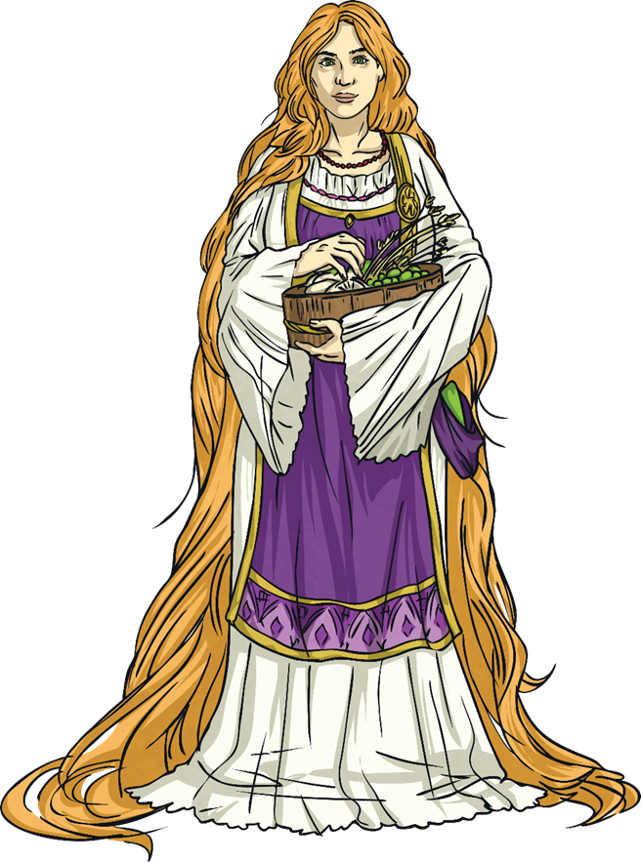
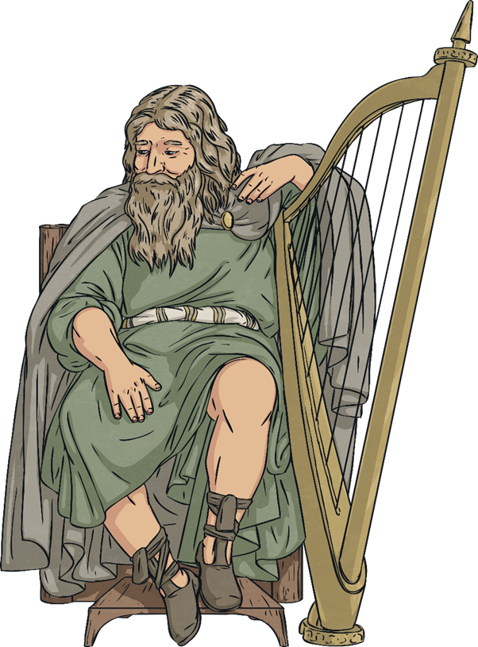
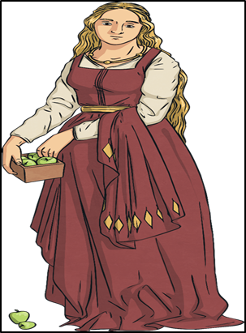
Sif Bragi Idun
Sif is the goddess of the earth, homes and crops. She is the wife of Thor and part of the Æsir pantheon.
Sif has long golden hair which represents fields of golden wheat. Vikings believed she would travel around seeking families and farms where she would protect crops from cold winds and winters.
In one tale, the trickster god Loki cut off Sif’s hair as she slept. When she woke and saw her hair was gone, she wept and the fields of crops that she protected flooded. Thor demanded Loki find a way to make amends and had the dwarves of Nidavellir make her a cap of floor-length hair.
Bragi is the god of poetry, music and wisdom. He is renowned for his wisdom, fluency of speech and skill with words. He is part of the Æsir pantheon.
Bragi has a long beard and runes marked on his tongue. He plays music and recites poetry in the halls of Valhalla, greeting fallen warriors as they enter the afterlife. He also travels between the nine worlds, singing of peace and working together.
Bragi is married to the beautiful goddess Idun.
Idun is the goddess of the spring, new life and youth. She is the wife of the god Bragi. She is part of the Æsir pantheon.
Idun is often shown as a beautiful young woman carrying a basket of fruit. The fruit she carries grants immortality and her power keeps the gods of Asgard youthful.
In one tale, the god Loki turns into an eagle and steals Idun away. Her absence causes the gods to turn old and grey and Loki is ordered to return her to Asgard.

Slide 6
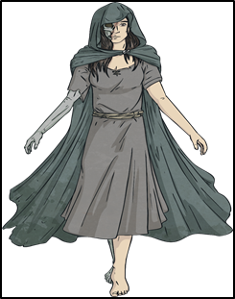
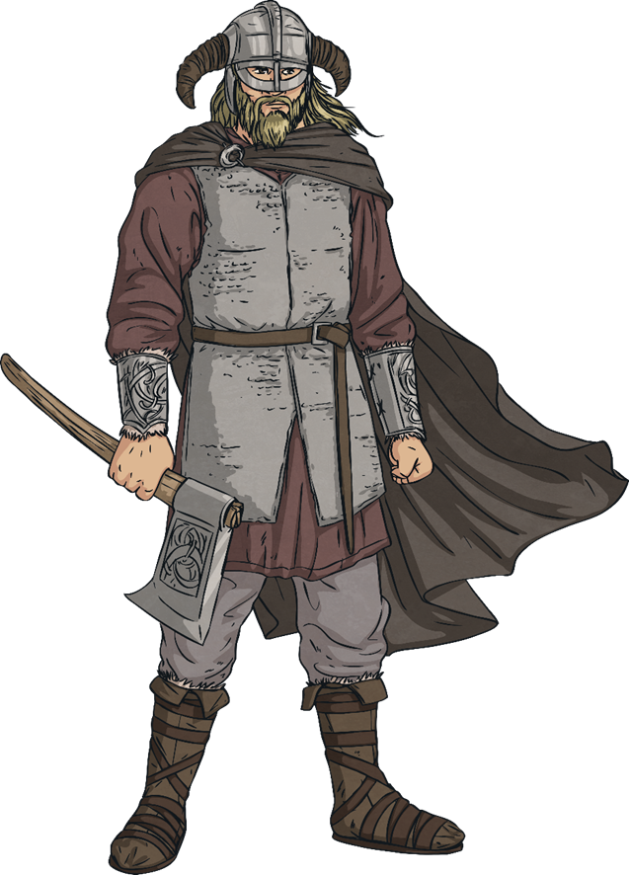
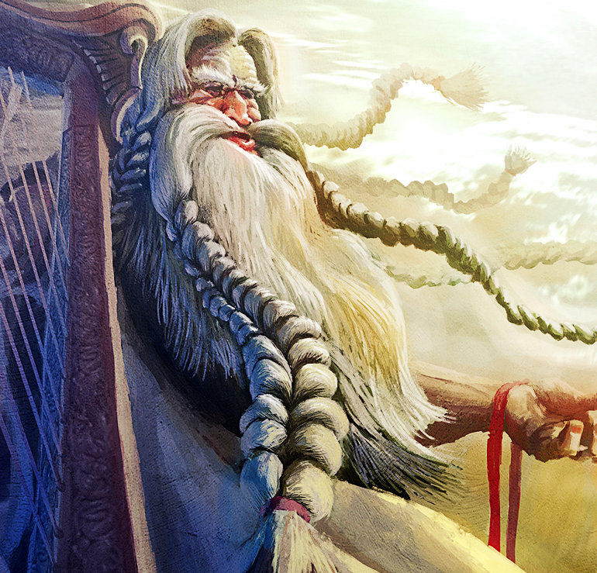
Hel Vidar
My favourite god is Bragi because I am musical like him and I like how he plays music for warriors who are going to the after life.
Hel is the goddess of the underworld. She is the daughter of Loki and regarded as highly dangerous.
Hel is often shown as having half the face of a beautiful woman and half the face of a monster. She is greedy and cruel and unconcerned with the problems of others.
She rules over the underworld realm, also called Hel, the ninth of the nine worlds, which lies at the roots of Yggdrasil.
Hel watches over the dead who arrive and dwell in the underworld.
Vidar, or Vitharr, is the god of vengeance. He is the son of Odin and the brother of Thor. He is part of the Æsir pantheon.
Vidar is very powerful and one of the mightiest of the gods – only Thor is stronger than him. He wears a pair of magical shoes that are incredibly strong and they helped him defeat the giant wolf Fenrir during Ragnarök.
Vidar is sometimes known as ‘Vidar the Silent’, which may show that Vidar took a vow of silence as part of his role as the god of vengeance.

