Slide 1
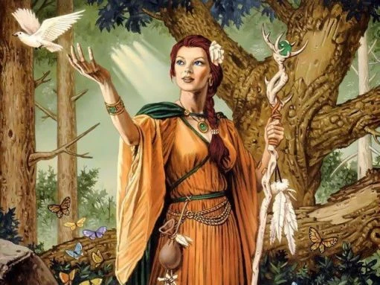
Eir Goddess of Medicine

Slide 2
Eir Goddess of Medicine
Eir had the power of healing living things.
Eir means help or mercy.
She was said to be a very good physician.

Slide 3
Eir Goddess of Medicine
Studies show Eir was more of a Valkyrie than a Goddess.
A Valkyrie is one of the twelve handmaids of Odin. They get to choose who will live and die.

Slide 4
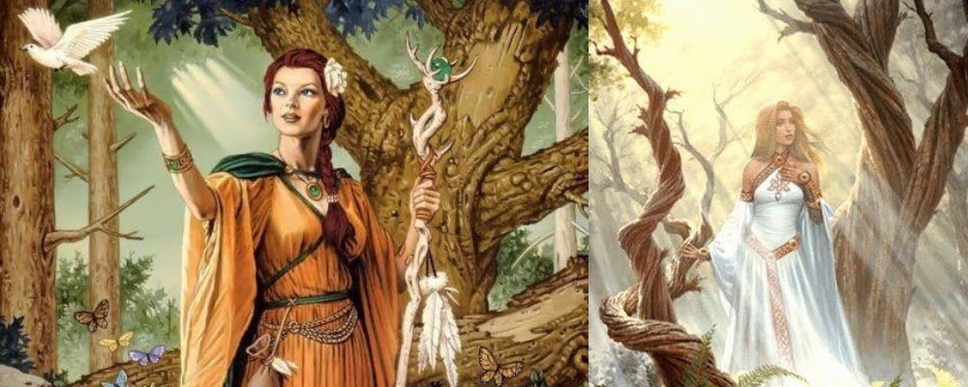
Thank you for watching! ☺

