Slide 1
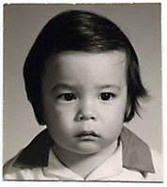
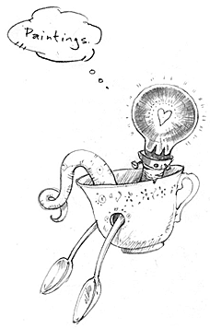
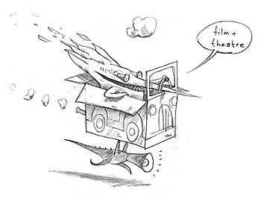
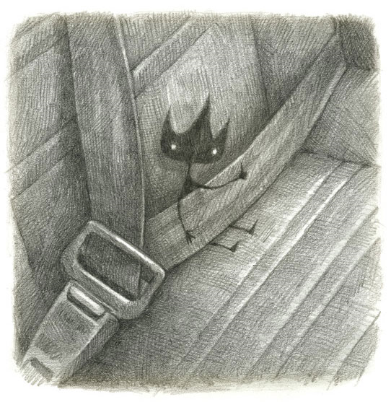
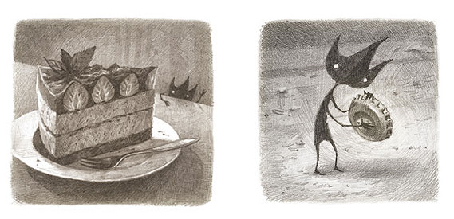
Shaun Tan grew up in the northern suburbs of Perth, Western Australia. In school he became known as the 'good drawer' which partly compensated for always being the shortest kid in every class. He graduated from the University of WA in 1995 with joint honours in Fine Arts and English Literature, and currently works as an artist and author in Melbourne.
Shaun began drawing and painting images for science fiction and horror stories in small-press magazines as a teenager, and has since become best known for illustrated books that deal with social and historical subjects through dream-like imagery. The Rabbits, The Red Tree, Tales from Outer Suburbia, Rules of Summer and the acclaimed wordless novel The Arrival have been widely translated and enjoyed by readers of all ages. Shaun has also worked as a theatre designer, a concept artist for animated films including Pixar's WALL-E, and directed the Academy Award-winning short film The Lost Thing. In 2011 he received the presitgious Astrid Lindgren Memorial Award, honouring his contribution to international children's literature.
Paintings
All of my work as an illustrator is based either directly or indirectly upon direct observation from life. I spend as much time as I can producing singular paintings, often semi-abstracted, but almost always drawn from things I know well; familiar landscapes, objects and people.
A few of my picture books have caught the interest of film and theatre producers and directors, resulting in collaborations on adaptations as well as new work in these media.
Eric
This is a small, Eric-sized edition of the story that originally appeared in Tales from Outer Suburbia, edited with some new artwork and layout design - which has proved to be very popular!
Eric is a foreign exchange student who comes to live with a typical suburban family. Although everyone is delighted with the arrangement, cultural misunderstandings ensure, beginning with Eric's insistence on sleeping in a pantry cupboard rather than a specially prepared guest room.

Slide 2
The story of my strangest visitor by Joshua Smith
One day we were making some Rocky Road for a bake sale. I was cutting up some of the marshmallows when we heard scratching at the front door and loud meowing. I went and opened the front and suddenly a cat appeared on the step and walked straight into my house. I quickly ran to shut Willow in the living room as the cat went to explore upstairs. She went into my Mum and Dad’s bedroom and hid under the bed. She also went and sat on top of my wardrobe watching and scratching the cage of my hamster. Once we managed to catch her we put her outside. She continued to meow and this went on until 4am. The next day when I was at school my Dad opened the front door and she raced in again and hid under the bed upstairs. My Dad kept her in the house and when my Mum came home with me we went to the vet’s who scanned her for a chip. They managed to find the information of the owner who they phoned straight away. The owner was really relieved that she cried on the phone.
I said goodbye to the cat and we have never seen her again.

