Slide 1
Vikings
Vikings lived over 1000 years
Ago.

Slide 2
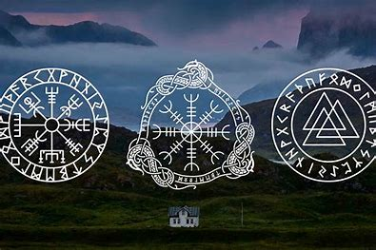
Viking Symbols
Symbols are what Vikings believe in there are three different beliefs unlike other country's and places. Valknut is the most popular symbol
that Vikings believe in. He was the god of guides.
Notes:
Viking symbols

Slide 3
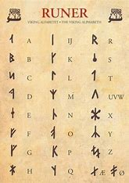
Viiking alphabet
Some of the Viking alphabet is like the English just with more lines. Vikings believed that a letter was more than just a single letter they believed that each letter has secret powers.
Notes:
Viking alphabet

Slide 4
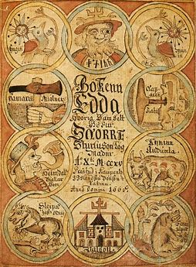
Viking gods
They believed in many different gods unlike most country's they all had different symbols representing the different gads . They had many different story's about all the different gods , (Odin , Thor an fray)
Notes:
Viking gods

Slide 5
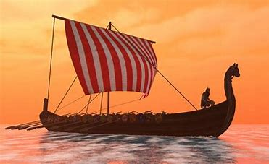
Viking Longship
They had to row a ship because they didn’t have engines or any electric motors . They made them this way so they could get through the water faster. The top speed was 17 knots.
Notes:
Viking longship

Slide 6
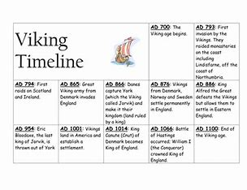
Viking times facts
Vikings never had horned helmets on. Vikings used different teniques to start fires and instead of them burying people in graves they burred them in boats.
Notes:
Viking times facts

Slide 7
The End
Hope you enjoyed my facts and information about the Vikings

