Slide 1
Viking Gods
The are the Gods in this presentation
Anna T 10.6.20

Slide 2
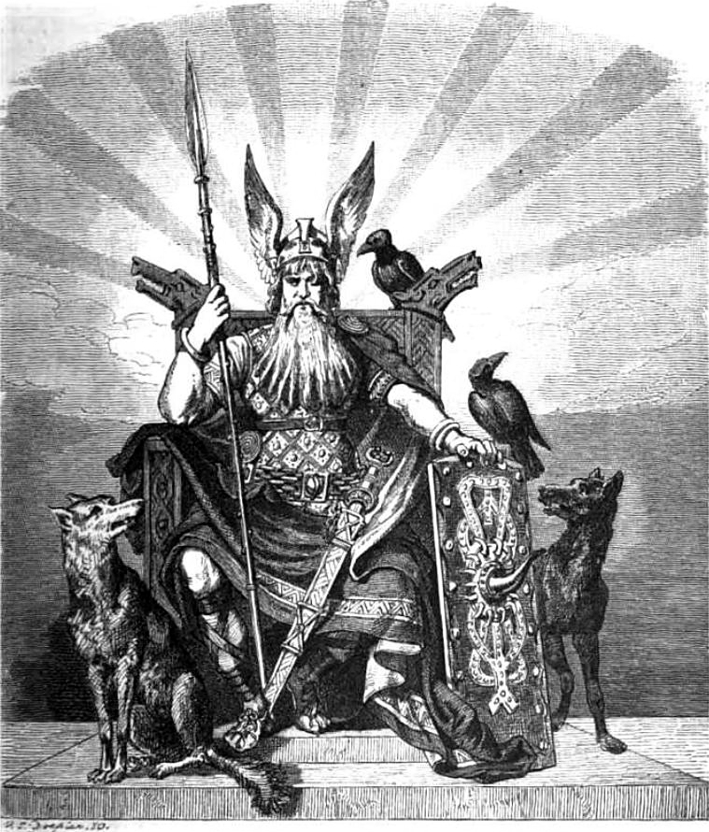
Odin
The vikings believed that Odin built the world. They also believed that Odin was good friends with Loki.

Slide 3
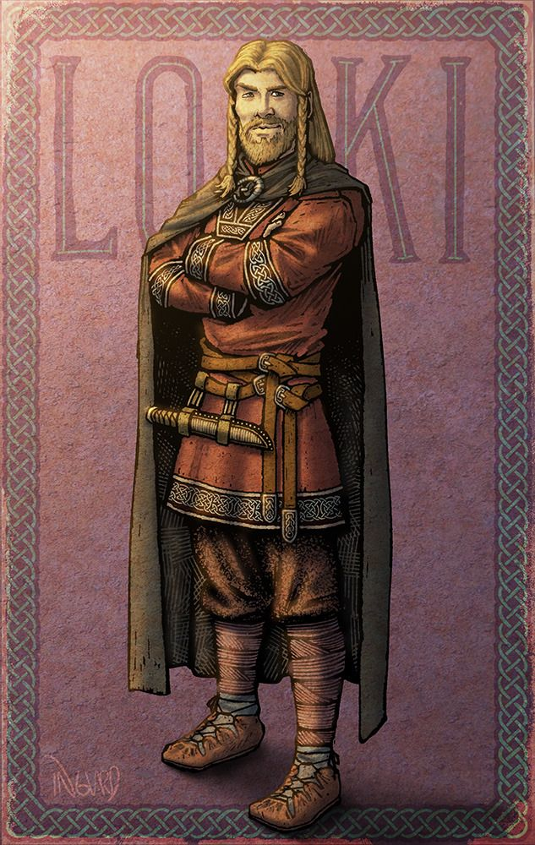
Loki
Loki is the God of fire and can make fire with the click of his fingers. Loki can also shape shift into anything he wants to . He can also be a trickster sometimes.

Slide 4
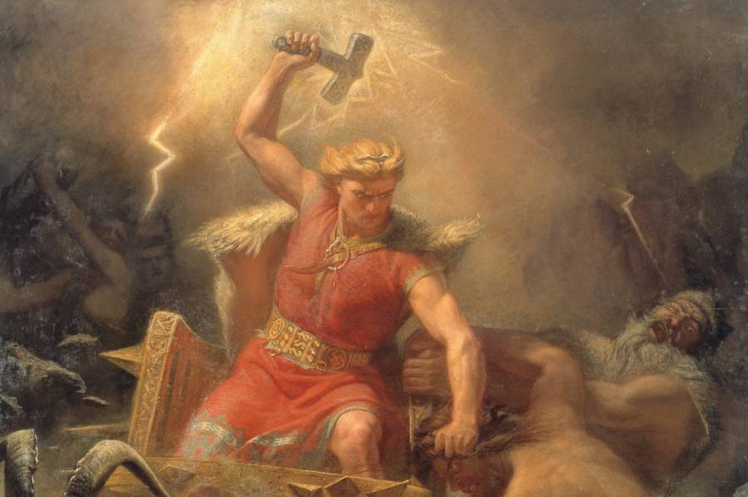
Thor
Thor is the god of thunder and lightning
He makes them by using hammer. Thor also protects himself with the hammer.

Slide 5
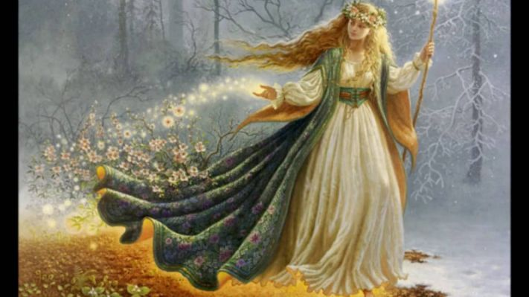
Freya
Freya is the pretty God . She controls the seasons . She decides how much snow, sun, leaves and flowers we get. Freya lost her husband after kissing goblins!

