Slide 1
THE VIKINGS
GODS

Slide 2
Facts!
The Vikings were people from Scandeinavia, and they believed in many Gods. The two main families of Gods were the Aesir family and the Vanir family they were once at war but eventually they made peace.
The Vikings had many myths at stories about creation, Gods and Goddesses. These were taught to children by word of mouth to make sure they were passed on through family generations.
Experts are not sure about how Vikings worshipped their Gods; They believe that they worshipped ‘magic trees’ and built wooden temples although one exist.
Some of the days of the week were named after Viking Gods; Thursday was named after Thor, the God of thunder.
The Vikings told many stories about Gods, Giants, Trolls and Dragons. They describe people living in Midgard (Middle Earth) and Gods and Goddesses living in a sky world called Asgard. They believed a beautiful rainbow bridge linked the two worlds together.

Slide 3
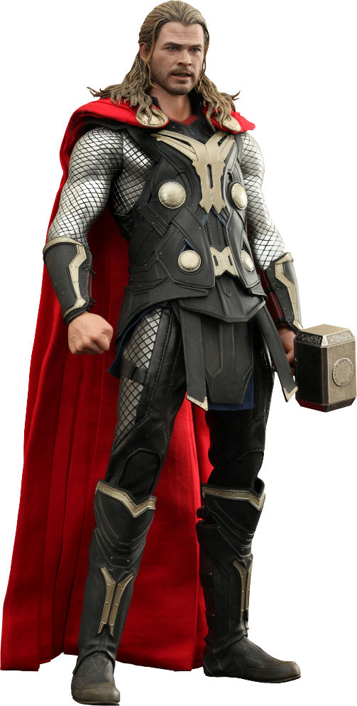
THOR
Thor was the thunder God of the sky, he was brave and strong. Thor protected the home of the Gods with his hammer, it was this hammer that caused the thunder and lightening. The hammer was called Mjolnir. He was much loved and highly respected. Thor represented safety and stability, his symbol was an oak tree. Thor has over 10 different names in Norse mythology, he was married to Goddess Sif. Thor rode a huge chariot pulled by 2 massive goats!! Thor is the son of the ruler of the Gods, Odin.

Slide 4
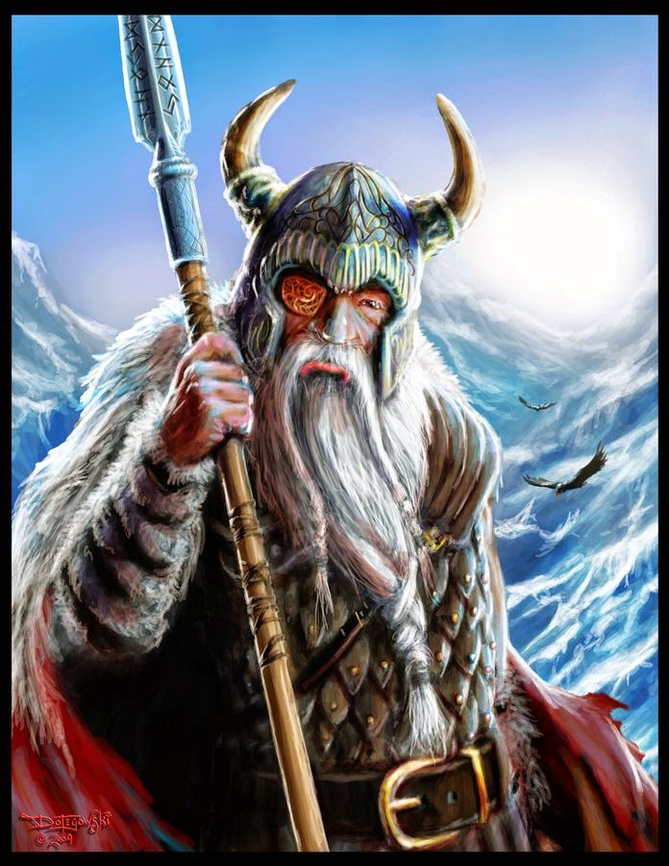
Odin
Odin was one of the most important Viking Gods he was a wise God and lord of the battles; he was feared because he decided between a victory and defeat during battle. Odin sat in a throne above Earth where he could see all. He had 2 ravens who reported to him they were called Hugin and Mugin ( Thought and Memory). In old English, Odin is known as ‘Woden’ and Wednesday is named after him. Odin rode an eight legged horse!!!

Slide 5
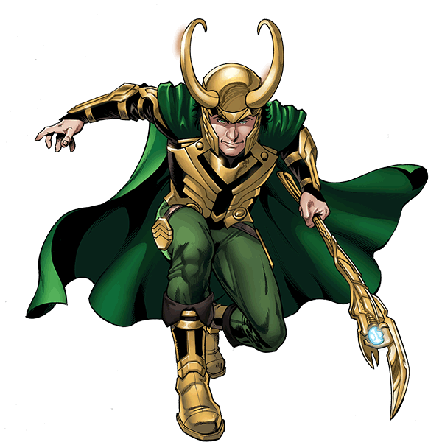
LOKI
Loki was the God of mischief, he liked to play tricks on the other Gods and make trouble Loki was born in Jotunheim, the land of the giants. To help him in his tricks, he could transform himself into lots of different shapes including changing in to a girl! He had also been known to change into a horse, a salmon and an old woman.

Slide 6
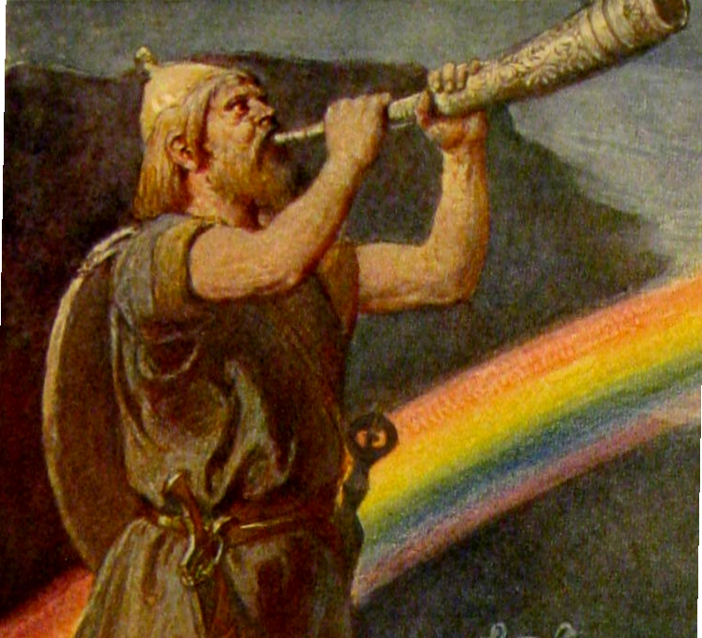
Heimdall
The guardian God. Heimdall watches over the rainbow bridge to Asgard. He has strong hearing and sight and keeps watch for approaching enemies. It is said that he can hear the grass grow and see to the end of the world. He uses a horn to summon the other gods to fight. Heimdall is believed not to need any sleep at all!

Slide 7
HOPE YOU ENJOYED MY PRESENTATION!
Ruby papa
5e

