Slide 1
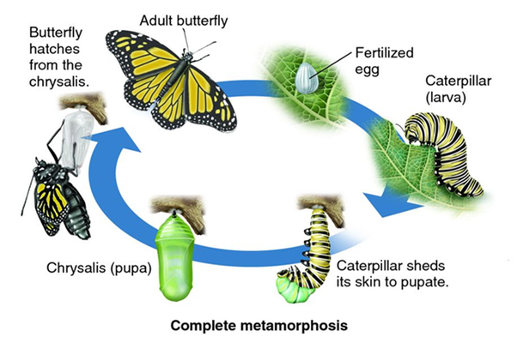
Metamorphosis of a caterpillar to a butterfly
By Alice and Freya

Slide 2
The first stage of metamorphosis is when an adult butterfly lays eggs.

Slide 3
The second stage of metamorphosis is when the egg hatches into a caterpillar.

Slide 4
The caterpillar then eats a lot of food and attaches itself to the underside of a branch.

Slide 5
The chrysalis then starts to grow and the caterpillar’s skin falls off.

Slide 6
The caterpillar’s body dissolves and reforms into a butterfly.

Slide 7
After a while the butterfly hatches slowly from the chrysalis and flies away once its wings have dried out.

