Slide 1
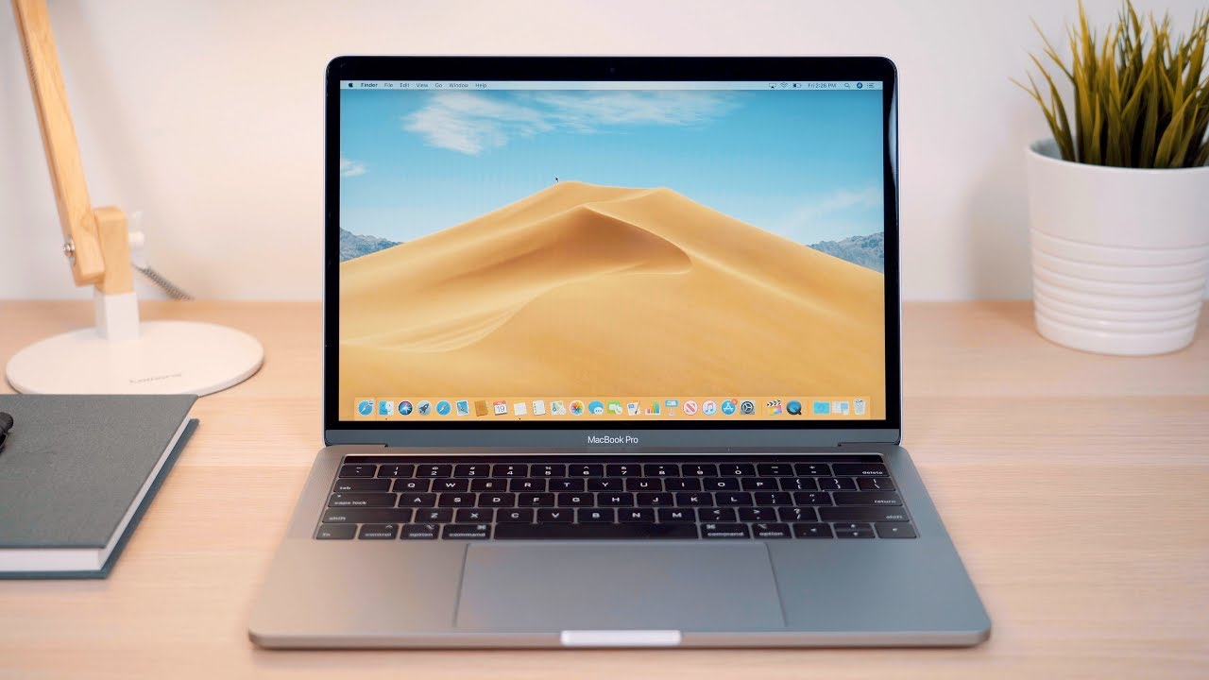
Internet safety PowerPoint
By Alice and Freya ❤

Slide 2
4 tips for staying safe on the internet:

Slide 3
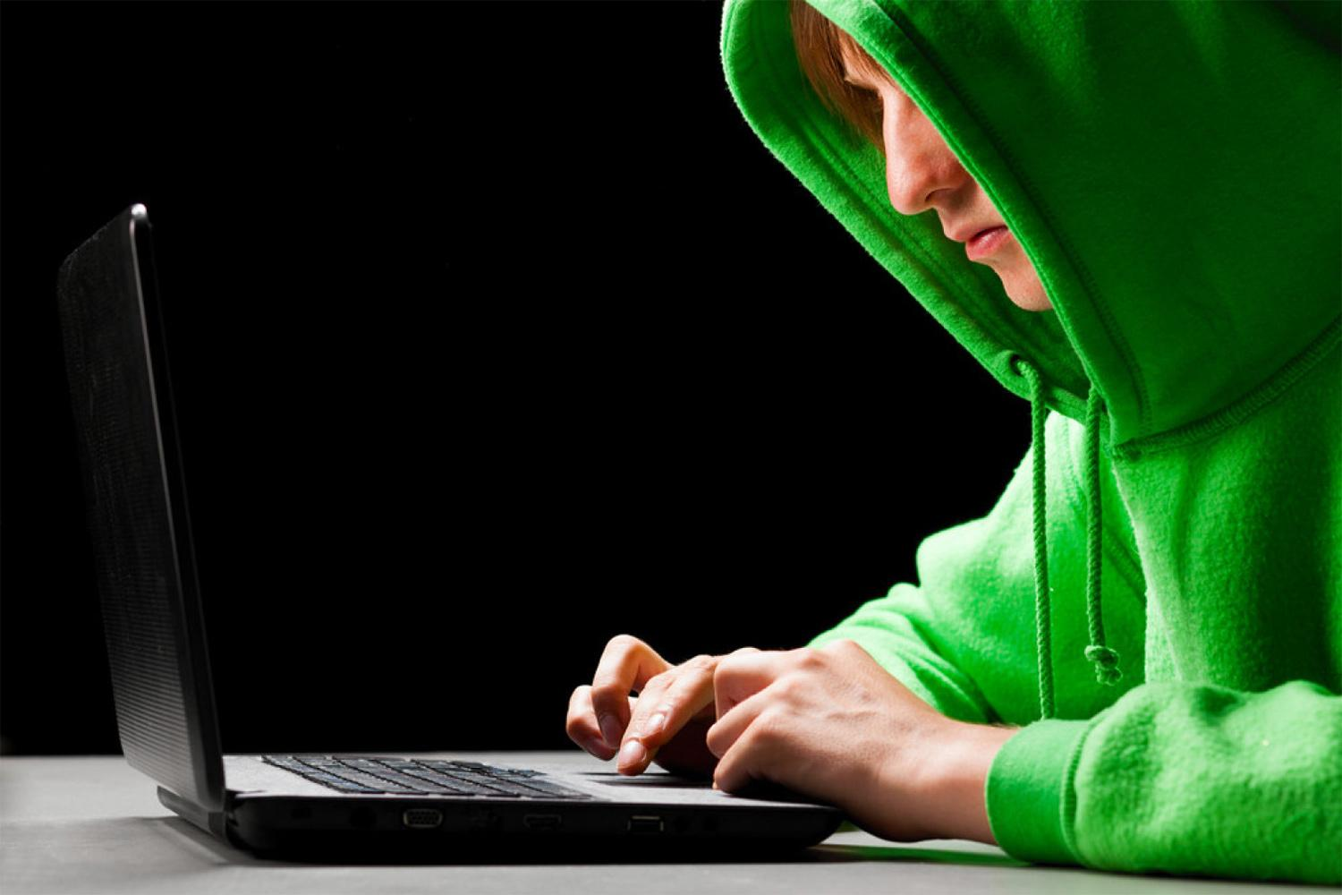
1:
Never give your personal information,because you never know who they will share it with

Slide 4
2:
Never tell people your password on roblox, they could log on to your account and steel your pets on adopt me. They could even steel your robux!!!!!!!!!!
❤❤❤❤❤❤❤❤❤❤❤❤❤

Slide 5
3:
Don’t wear your school uniform on social media unless your account is private.❤

Slide 6
4:
Report people who are being rude to you or bullying you as their account will get taken away from them. This means they will not do it again. Also change your account so they don’t know it is you.❤

