Slide 1
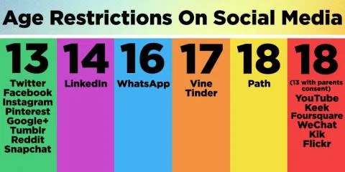
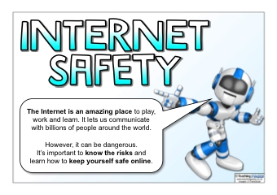
INTERNET SAFETY
LINKS
It is fine to answer some links, but dodgy ones could lead to a bug or even hacking, links which ask for emails are never good, always check the link at the top, say it was Google1
Would like to access your address.
Never put it in.
The internet is much loved by both adults and children, due to popularity and entertainment many forget that even games can be dodgy, and sometimes online someone might have access to all of your details when they ask personal questions. (If you answer them)
PERSONAL QUESTIONS
Well known apps such as Roblox and Facebook all have a chance of getting asked a question like, “Where do you live?” this is called a personal question, if you are asked something similar (especially your email account) never answer and block the person who asked.
BULLYING
In the internet some people can call you names or threaten. If this ever happens ask for help from a trusted adult.

