Slide 1
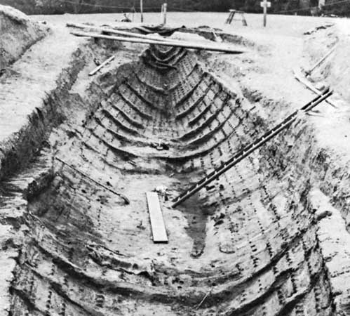
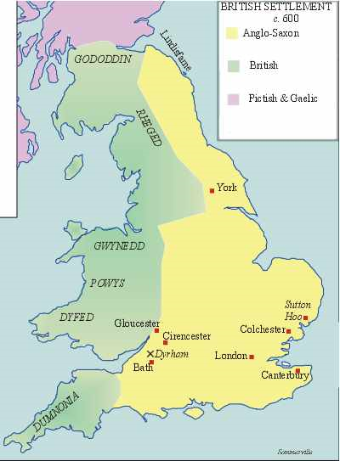
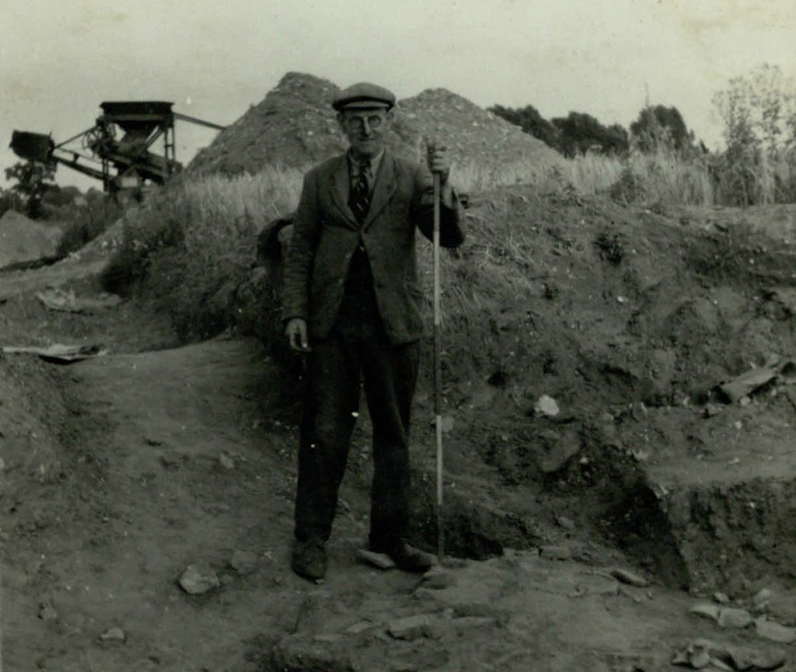
Sutton Hoo
In the summer of 1939, as World War Two loomed bleakly on the horizon, a discovery was made beneath the earth in a quiet corner of Suffolk on the east coast of England.
Archaeologists painstakingly brushed away layers of sandy soil to reveal the shape of a ship beneath a mound, and in the centre of the ship they found a burial chamber full of the most extraordinary treasures.
Although it took some time to understand what these finds were, and what they meant, the discovery would prove to be an Anglo-Saxon royal burial of incomparable richness and it would revolutionise our understanding of early England.
The significance of Sutton Hoo
Sutton Hoo provides one of the richest sources of archaeological evidence for this period of the history of England's development.
The discovery in 1939 changed our understanding of the some of the first chapters of English history and a time seen as backwards was illuminated as cultured and sophisticated.
This story of discovery didn’t end in 1939 though, as our knowledge and understanding of the Anglo-Saxons of Sutton Hoo and their world is still changing and expanding.
Some 1400 years ago, a community came together to haul a ship from the river within which they buried their king along with treasured possessions for his final journey. It was a public spectacle intended to be remembered for all time.
Did You Know?
Sutton Hoo has 18 burial mounds. The bones of the “Sutton Hoo prince” were discovered in Mound 17.
Basil Brown – Archaeologist who found the Anglo-Saxon grave in 1939.
By Joshua Smith 5E

Slide 2
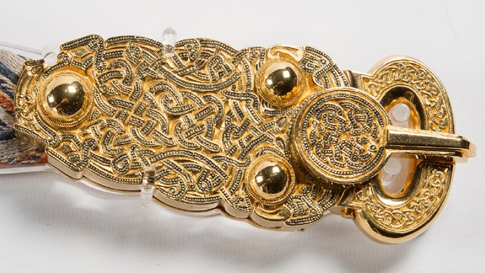
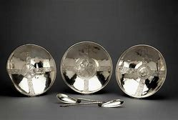
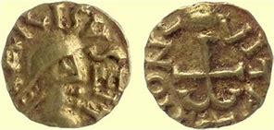
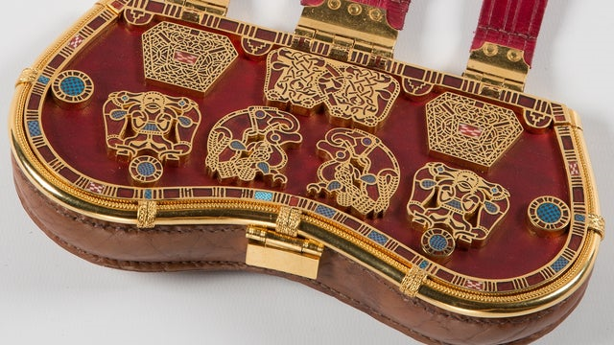
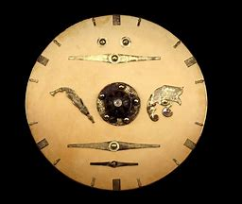
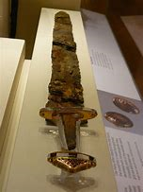
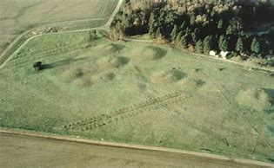
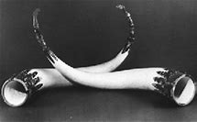
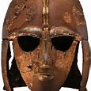
The Treasures
The objects in the burial chamber were designed to signal power on earth and in the hereafter. Each object tells a story and reveals something about the person they accompanied into the afterlife.
Weaponry such as a pattern welded sword suggests a great war leader, a lyre evokes a musician and poet, the exquisite gold and garnet craftsmanship on many items represent a patron of the arts whereas objects like the drinking horns speak of a generous host.
Items such as the shield are thought to have been diplomatic gifts from Scandinavia and speak of someone both well respected and highly connected, whereas the shoulder clasps modelled on those worn by Roman emperors tell us of someone who borrowed from different cultures and power bases to assert their own authority. Together they form a potent piece of power poetry, likely the burial of a king
The dating of the coins help us locate the burial to around the year AD625, a time of political and religious change across England. Some of the silver bowls found in the chamber display cross-shaped decoration, possibly suggesting a Christian origin and a pair of silver spoons bear the names 'Saul's' and 'Paulo's', which would appear to be a reference to the Christian story of the conversion of Saul on the road to Damascus. The King converted to Christianity and then returned back to Pagan roots. The silverware may have been a baptismal gift.
The Belt Buckle was a Germanic design and fashionable during Anglo – Saxon times. It was unique.
Travellers and traders
The people buried at Sutton Hoo were not only closely connected to their Scandinavian neighbours, but clearly engaged in travel and trade across huge distances. Garnets that decorate many of the treasures most likely originated in Sri Lanka and there were also items from the Byzantine Empire, from Egypt and from all across Europe.
The designs on the purse lid may represent his ancestors and his personality.
Round shield showed it was from Anglo-Saxon times.
The helmet was made of iron and was covered in tin bronze foil. There are many different patterns and pictures. It was buried around 625 and is widely believed to have belonged to King Dewald of East Anglia; its elaborate decoration may have given it a secondary function akin to a crown. The helmet was both a functional piece of armour that would have offered considerable protection if ever used in warfare, and a decorative, prestigious piece of extravagant metalwork. It is described as "the most iconic object" from "one of the most spectacular archaeological discoveries ever made," and perhaps the most important known Anglo-Saxon artefact.[1][2]
Sutton Hoo Landscape more recent times.
Feasting Horns.

