Slide 1
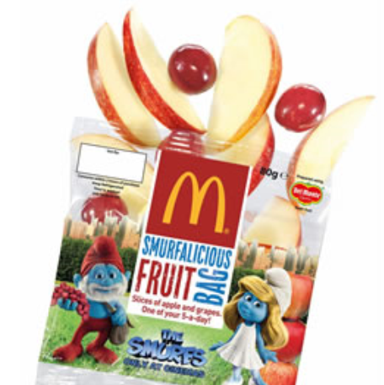
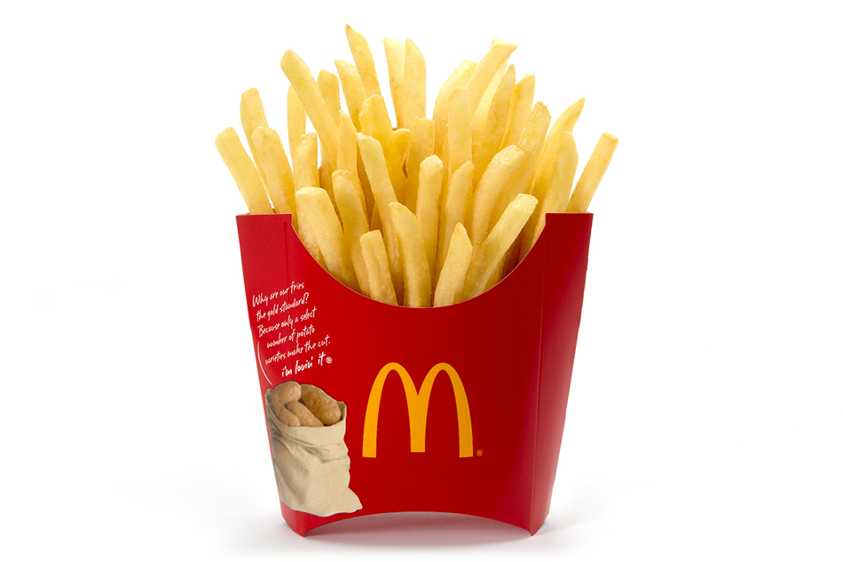
McDonalds burgers are 100% beef
Happy meals come with a choice of healthy salad or fruit!
Delicious, juicy burgers with crunchy lettuce, fresh tomato and creamy cheese
Crunchy, mouth-watering fries are like heaven to your taste buds!
I’m lovin’ it!
No additives or preservatives

