Slide 1
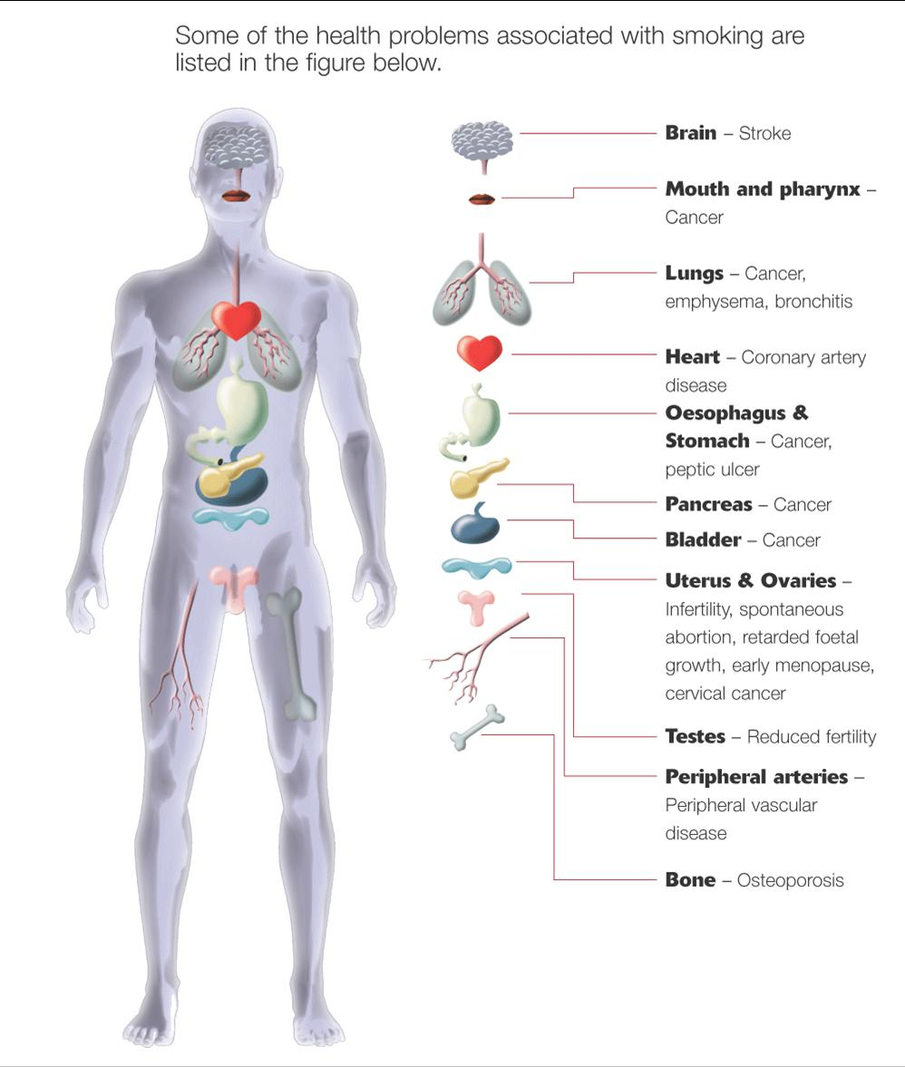
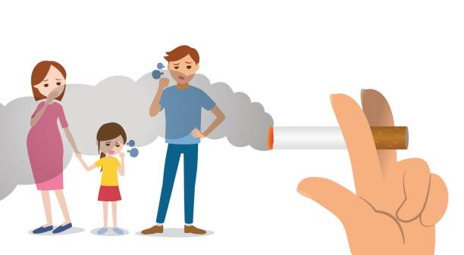
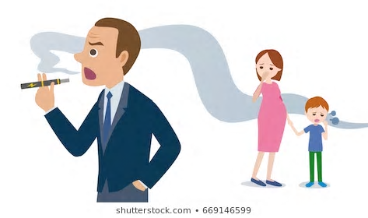
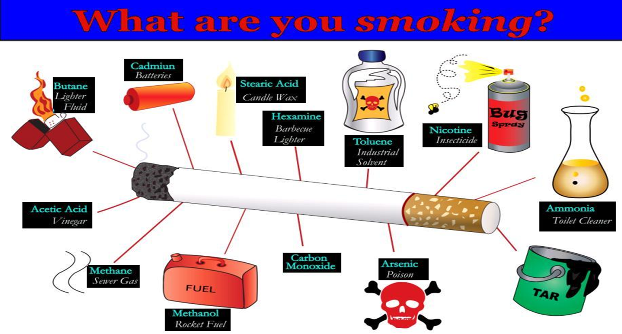
Passive smoking!
Passive smoking is the inhalation of smoke, called second hand smoke, or environmental tobacco smoke, by persons other than the intended "active" smoker. It occurs when tobacco smoke enters an environment, causing its inhalation by people within that environment. Exposure to second hand tobacco smoke causes disease, disability, and death. The health risks of second hand smoke are a matter of scientific consensus. These risks have been a major motivation for smoke-free laws in workplaces and indoor public places, including restaurants, bars and night clubs, as well as some open public spaces.
What is passive smoking?
The evidence is clear that second-hand smoke can cause lung cancer and other health problems like heart disease. It may also increase the risk of some other types of cancer, stroke and the lung disease Chronic Obstructive Pulmonary Disease (COPD).
Tobacco use has predominantly negative effects on human health and concern about health effects of tobacco has a long history. Research has focused primarily on cigarette tobacco smoking. Tobacco smoke contains more than 70 chemicals that cause cancer. Tobacco also contains nicotine, which is a highly addictive psychoactive drug. When tobacco is smoked, nicotine causes physical and psychological dependency. Cigarettes sold in underdeveloped countries tend to have higher tar content, and are less likely to be filtered, potentially increasing vulnerability to tobacco smoking related disease in these regions.
Passive smoking is the inhalation of smoke, called second hand smoke (SHS), or environmental tobacco smoke (ETS), by persons other than the intended "active" smoker. It occurs when tobacco smoke enters an environment, causing its inhalation by people within that environment. Exposure to second hand tobacco smoke causes disease, disability, and death. The health risks of second hand smoke are a matter of scientific consensus. These risks have been
What are the dangers of smoking?
Smoking not only impacts your cardiovascular health, but also the health of those around you who don’t smoke. Exposure to second hand smoke carries the same risk to a non-smoker as someone who does smoke. Risks include stroke, heart attack, and heart disease.
Dangers of smoking that a teenager is more likely to be concerned with are yellowed teeth and more cavities, prematurely wrinkled skin and a longer recovery time from a cold. Teenagers who smoke also commonly suffer from bad breath.
Passive smoking of adults. You have an increased risk of lung cancer and heart disease if you are exposed to other people smoking for long periods of time. For example, the risk of developing lung cancer is increased by about 20-30% in people who are regularly exposed to other people's cigarette smoke.

