Slide 2
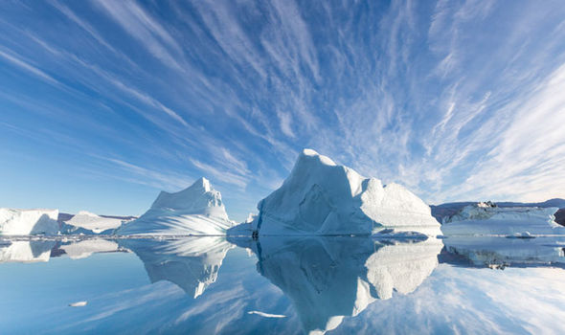
North Pole
The ocean depth at the North Pole has been estimated at just over 4,200 metres. There is little inhabitation there due mainly to the cold temperatures, which on average during the Winter is as low as minus 43 Centigrade.

Slide 3
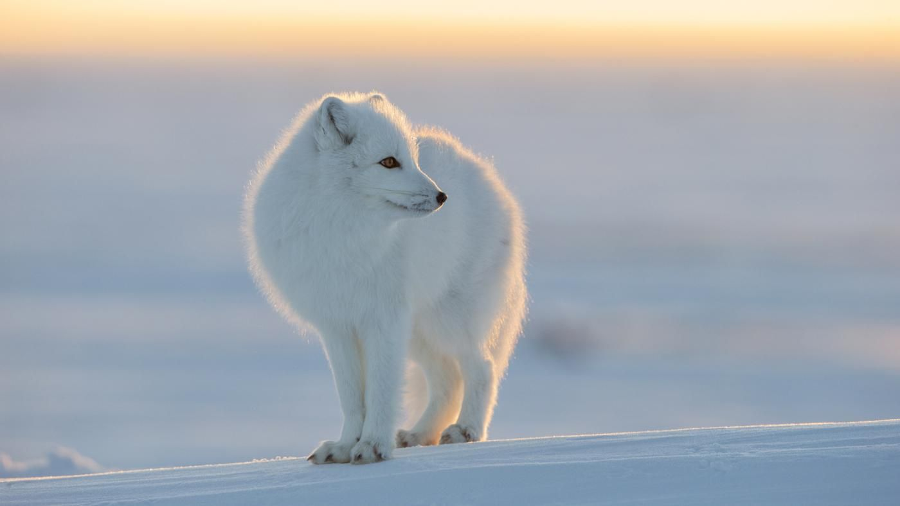
Animals
Many animals live at the North Pole, commonly referred to as the Arctic region, including Arctic Foxes, Arctic Hares, Alaskan Malamutes, Polar Bears, Seals and Beluga Whales. Some animals live closer to the bottom of the Arctic region, like Malamutes, while others live close to the physical North Pole like Polar Bears, Seals and Whales.
Animals that live in the extreme cold of the North Pole are highly adapted to survive the weather conditions. Most have a thick coat of fur that grows thicker and whiter during the coldest and snowiest part of the year. Fur not only provides warmth but also camouflage.

Slide 4
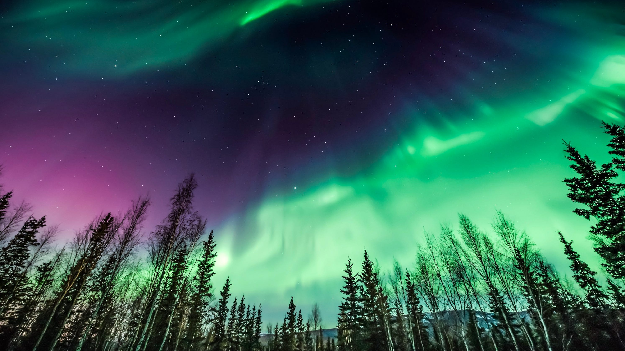
Facts
The North Pole is the most northerly point on earth and lies directly opposite the South Pole. It is the point at which all the lines of longitude meet.
If you stand at the North Pole, whichever direction you go in you are heading south.
The North Pole is located about 725km north of Greenland in the Arctic Ocean. The area is covered by ice most of the time.
In the late 19th century and early 20th century, several expeditions attempted to reach the pole. In 1909 Robert Peary claimed to have reached the North Pole, although this has not been proven.
A Norwegian explorer Roald Amundsen is usually considered to be the first person to reach the Pole. He arrived there on May 12, 1926 and also navigated the Northwest Passage.
The first Polar ice station was built by Russia at the Pole, in 1937. Since then, explorers and adventurers have tried to reach the Pole on a motorbike, by kayak and by parachuting in.
Nobody actually owns the North Pole, although dozens of planes fly over it every day.
It is permanently dark at the North Pole for 6 months of the year, and light for the other 6 months of the year. This is because of the tilt of the earth on its axis.

Slide 5
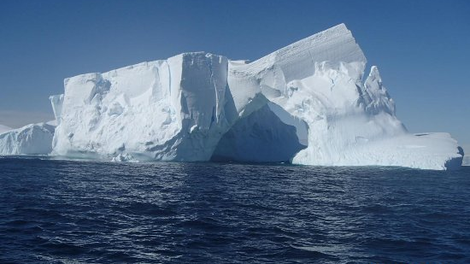
South Pole
From the South Pole, all directions are north. Its latitude is 90 degrees south, and all lines of longitude meet there (as well as at the North Pole, on the opposite end of the Earth). The South Pole is located on Antarctica, one of the Earth's seven continents. Although land at the South Pole is only about a hundred meters above sea level, the ice sheet above it is roughly 2,700 meters (9,000 feet) thick. This elevation makes the South Pole much colder than the North Pole, which sits in the middle of the Arctic Ocean. In fact, the warmest temperature ever recorded at the South Pole was a freezing -12.3 degrees Celsius (9.9 degrees Fahrenheit).

Slide 6
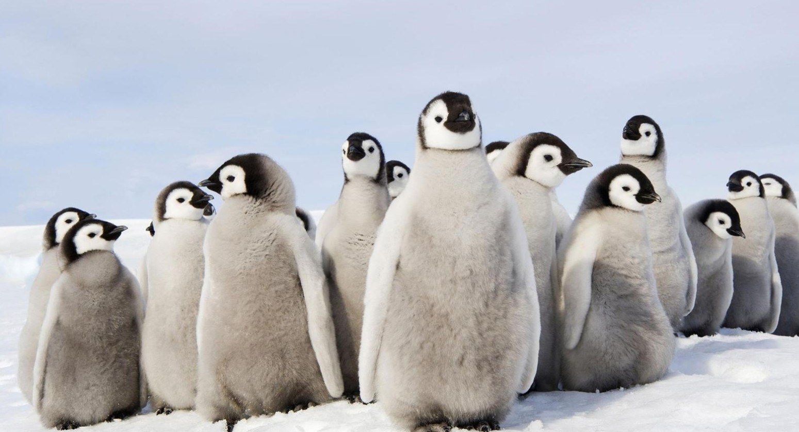
Animals
Antarctica has an abundance of animal life including the charismatic mega fauna that you have seen pictures and videos of, though you may be surprised to find that they live far more interesting and complex lives than you imagine. Almost all of these animals are dependent on the sea, the largest truly land animal is a wingless midge about 13mm / 0.5 of an inch long. As the animal life is dependent on the sea and are mainly warm blooded, they tend to be pretty large as a survival technique against the extreme and relentless cold. That Antarctica can support such an abundance of large animals is a result of the productivity of the southern polar sea.

Slide 7
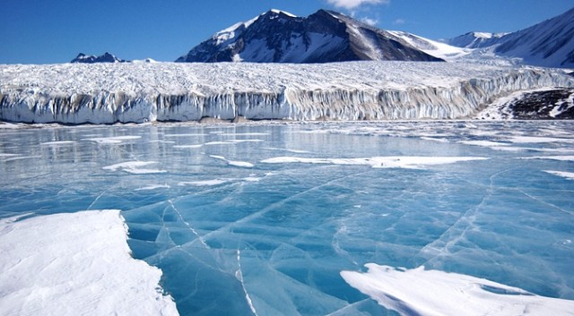
Facts
Antartica is the southernmost continent on Earth.
The South Pole is found in Antarctica.
Antarctica is surrounded by the Southern Ocean.
Antarctica is bigger than Europe and almost double the size of Australia.
Most of Antarctica is covered in ice over 1.6 Kilometres thick (1 Mile).
Because it experiences such little rain, Antarctica is considered a desert.
The coldest recorded temperature on Earth occurred in 1983 at Vostok Station, Antarctica, measuring a rather chilly −89.2 °C (−128.6 °F).
While humans don’t permanently reside in Antarctica, several thousand people live and work at various research facilities found on the continent.

Slide 8
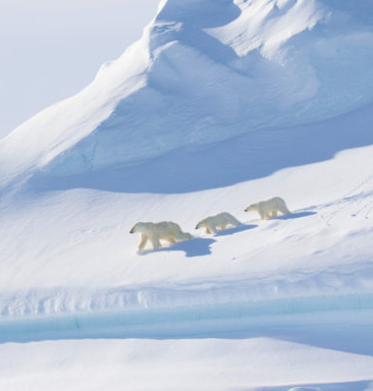
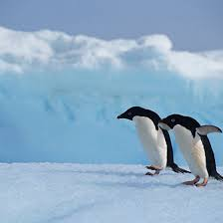
South
North
Sea surrounded by land
Land surrounded by sea
21st June midsummer, light for 24 hours
21st June midwinter, dark for 24 hours
21st December midwinter, dark for 24 hours
21st December midsummer, light for 24 hours
Temperature 13c to -43c
Temperature –12.3c to -62c

