Slide 4
M
R
R
M
R

Slide 6
The relative clause refers to which sundae is Ben’s favourite flavour.

Slide 7
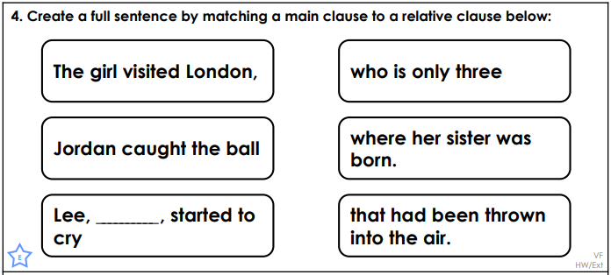

Slide 10
M
M
R
R
R

Slide 12
The relative clause refers to how the taxi driver has not yet been paid which explains why he was unhappy.

Slide 13
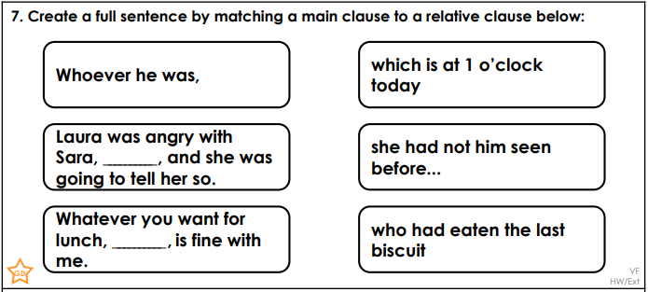

Slide 16
R
M
R
M
R

Slide 18
It explains a little bit about their relationship to each other

