Slide 1
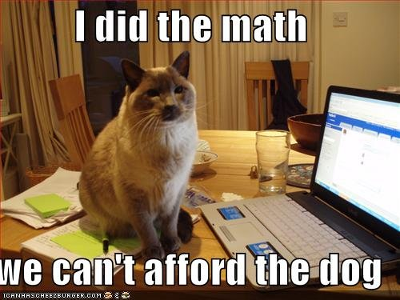
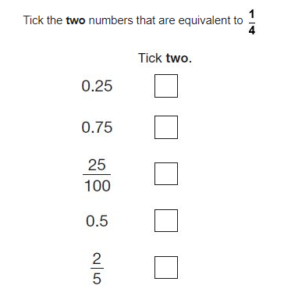
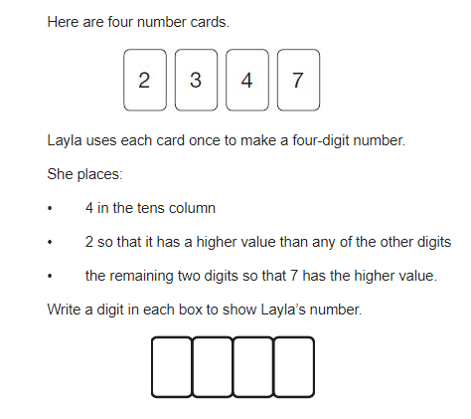
9² + _____ = 87
36 x 21 =
7380 ÷ 5 =
3/8 + ½ =
¾ x ½ =
Write the first five cube numbers
3 x 4 x ____ = 100 – 40
28.372 x 100 =
True or false – 39 is a prime number
10) There are 162 sweets. Tim has 20 more than Tom. How many do they each have?

Slide 2
9² + __6__ = 87
36 x 21 = 756
7380 ÷ 5 = 1476
3/8 + ½ = 7/8
¾ x ½ = 3/8
Write the first five cube numbers
1, 8, 27, 64, 125
7) 3 x 4 x __5__ = 100 – 40
8) 28.372 x 100 = 2837.2
9)True or false – 39 is a prime number
False, it’s in the 3 and 13 times table
10) There are 162 sweets. Tim has 20 more than Tom. How many do they each have? Tim 91, Tom 71

