Slide 1
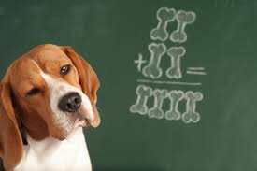
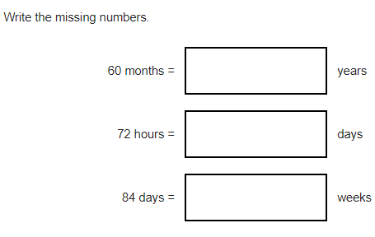
7 x 70 =
1.23 + 1.9 =
4/5 x 4 =
3/5 x 2/5 =
27380 ÷ 5 =
362 ÷ 10 =
5/9 of 36 =
2 x 3 x 4 = ___ ÷ 2
38 x 55 =
10) There are 66 sweets. Tim has 5 times as many as Tom. What is the DIFFERENCE between their amounts?
11) Write the first 12 prime numbers
12) 5² + 2³ =

Slide 2
7 x 70 = 490
1.23 + 1.9 = 3.19
4/5 x 4 = 16/5 or 3 and 1/5
3/5 x 2/5 = 6/25
27380 ÷ 5 = 5476
362 ÷ 10 = 36.2
5/9 of 36 = 20
2 x 3 x 4 = _48_ ÷ 2
38 x 55 = 2090
10) There are 66 sweets. Tim has 5 times as many as Tom. What is the DIFFERENCE between their amounts? Tim 55 Tom 11 DIF 44
11) Write the first 12 prime numbers
2, 3, 5, 7, 11, 13, 17, 19, 23, 29, 31, 37
12) 5² + 2³ = 33

