Slide 1

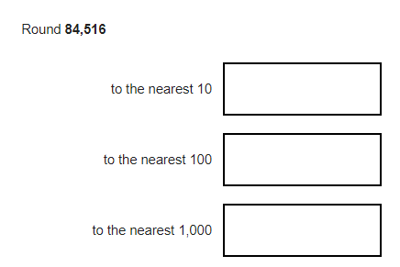
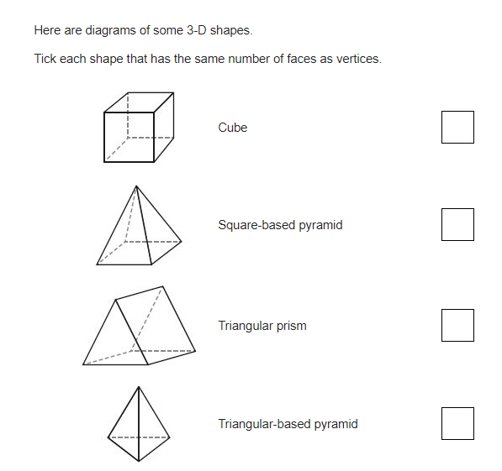
7 x 70 =
30000 – 1829 =
1/5 x 4 =
347 + 392 + 839 =
675 ÷ 5 =
47.9 x 10 =
How many degrees are there in 3 right angles?
3 x 7 = 100 - ____
134 x 65 =

Slide 2
7 x 70 = 490
30000 – 1829 = 28171
1/5 x 4 = 4/5
347 + 392 + 839 = 1578
675 ÷ 5 = 135
47.9 x 10 = 479
How many degrees are there in 3 right angles? 270°
3 x 7 = 100 - _79_
134 x 65 = 8170

