Slide 1

Expanded Noun Phrases
Creating Concise Noun Phrases
An expanded noun phrase is a phrase made up of a noun and at least one adjective. If one or more adjectives are listed to describe the noun, a comma should be added to separate the sentence.
© Classroom Secrets Limited 2019

Slide 2
Introduction
Underline the adjectives in the sentences below.
In winter, I love the cold, dark nights and frosty mornings.
The young, playful dog ran after the ball in the grassy meadow.
Make sure you wash your hands in the small sink.
Adjectives describe the noun (the object).
© Classroom Secrets Limited 2019

Slide 3
Introduction
Underline the adjectives in the sentences below.
In winter, I love the cold, dark nights and frosty mornings.
The young, playful dog ran after the ball in the grassy meadow.
Make sure you wash your hands in the small sink.
© Classroom Secrets Limited 2019

Slide 4
Varied Fluency 1
Underline the adjectives that do not give extra information.
These wet, scaly fish have fins and gills.
B. The cute, hairy chimpanzee jumped off the branch.
© Classroom Secrets Limited 2019

Slide 5
Varied Fluency 1
Underline the adjectives that do not give extra information.
These wet, scaly fish have fins and gills.
B. The cute, hairy chimpanzee jumped off the branch.
We know fish are wet and scaly so this is not new information.
Have you ever seen a chimp that wasn’t hairy? Me neither.
© Classroom Secrets Limited 2019

Slide 6
Varied Fluency 2
True of false? Removing the underlined adjectives below changes the meaning.
The rare, meat-eating carnivore was spotted in the wild.
© Classroom Secrets Limited 2019

Slide 7
Varied Fluency 2
True of false? Removing the underlined adjectives below changes the meaning.
The rare, meat-eating carnivore was spotted in the wild.
False
Carnivore means meat-eating so nothing has changed in the sentence. In the original sentence the same information has been given twice.
© Classroom Secrets Limited 2019

Slide 8
Varied Fluency 3
Which noun phrase below gives you the most information?
A. The delicate, lilac flowers on the plant.
B. The purple, lilac flowers on the plant.
© Classroom Secrets Limited 2019

Slide 9
Varied Fluency 3
Which noun phrase below gives you the most information?
A. The delicate, lilac flowers on the plant.
B. The purple, lilac flowers on the plant.
Purple and lilac are the same (nearly) colour.
© Classroom Secrets Limited 2019

Slide 10
Varied Fluency 4
Use the most useful adjectives from the word bank to fill the blanks in the sentence below.
The _______ gentleman offered his seat to the ________ lady.
rude | polite | frail
tall | old | French
© Classroom Secrets Limited 2019

Slide 11
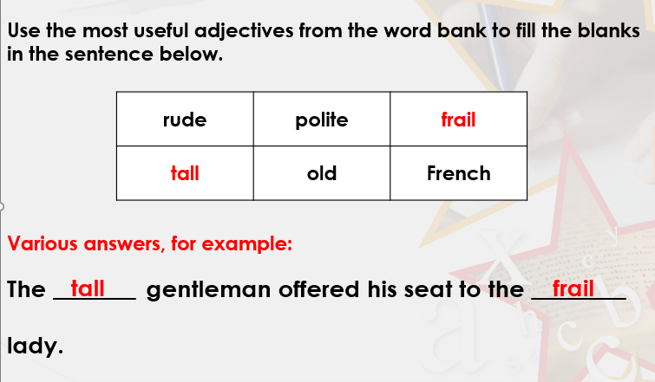
We already know the gentleman is polite because he offered
his seat to the lady, this also means he isn’t rude. Because of this,
he won’t be frail or old either. We have no idea whether he is tall or
French but tall gives us more information than French.
If the lady is being given a seat then she must be frail or old; frail gives us
more information than old.
© Classroom Secrets Limited 2019

Slide 12
Application 1
Change the noun phrases to make them more concise.
They live in a huge, vast mansion in the next village.
The ancient, bony skeleton of the man was found underground.
Concise means- short and to the point (cuts out the waffle).
© Classroom Secrets Limited 2019

Slide 13
Application 1
Change the noun phrases to make them more concise.
Various answers, for example:
They live in a huge, vast mansion in the next village.
They live in a mansion in the next village.
The ancient, bony skeleton of the man was found underground.
The ancient skeleton of the man was found underground.
Huge and vast mean the same thing
Skeletons are bony so bony doesn’t need to be there.
© Classroom Secrets Limited 2019

Slide 14
Application 2
Rewrite the sentence to add more detail to the noun phrase.
Some people like to parachute.
You must include two adjectives, a noun and a preposition.
© Classroom Secrets Limited 2019

Slide 15
Application 2
Rewrite the sentence to add more detail to the noun phrase.
Some people like to parachute.
You must include two adjectives, a noun and a preposition.
Various answers, for example:
Some young, adventurous people like to parachute over land and sea.
© Classroom Secrets Limited 2019

Slide 16
Reasoning 1
Which sentence gives you the most information?
A. The main character in the book was an evil, mean villain.
B. The main character in the book was a hostile, misunderstood villain.
Explain how you know.
© Classroom Secrets Limited 2019

Slide 17
Reasoning 1
Which sentence gives you the most information?
A. The main character in the book was an evil, mean villain.
B. The main character in the book was a hostile, misunderstood villain.
Explain how you know.
Sentence B because…
© Classroom Secrets Limited 2019

Slide 18
Reasoning 1
Which sentence gives you the most information?
A. The main character in the book was an evil, mean villain.
B. The main character in the book was a hostile, misunderstood villain.
Explain how you know.
Sentence B because the adjectives reveal more about this particular character. In sentence A, the adjectives ‘evil’ and ‘mean’ are unnecessary as the word ‘villain’ already tells us these things.
© Classroom Secrets Limited 2019

