Slide 1
LO: I can plan a recount
I can write in chronological order
I can use my knowledge about the daily lives of Roman children to infer my planning

Slide 2
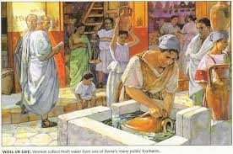
Recap
What facts do you remember from last lesson about these aspects of daily life in the Ancient Roman period?
Food
Clothing
School
Leisure time
Let’s make a fact bank on the whiteboard.

Slide 3
Main Task
Create a visual timetable for a Roman child’s day which you will write about in tomorrow’s lesson. Underneath each picture, write information about each aspect. Remember to keep it in chronological order!

