Slide 2
Aim
Recognise and write decimal equivalents of any number of tenths or hundredths.

Slide 3
Tenths on a Place Value Grid
Diving
Complete the table.
Place Value Grid
Stem Sentence
Decimal
Ones | tenths
There is one and tenths.
1
1.2
2
Ones | tenths
There are 4 ones and 0 tenths.
4

Slide 4
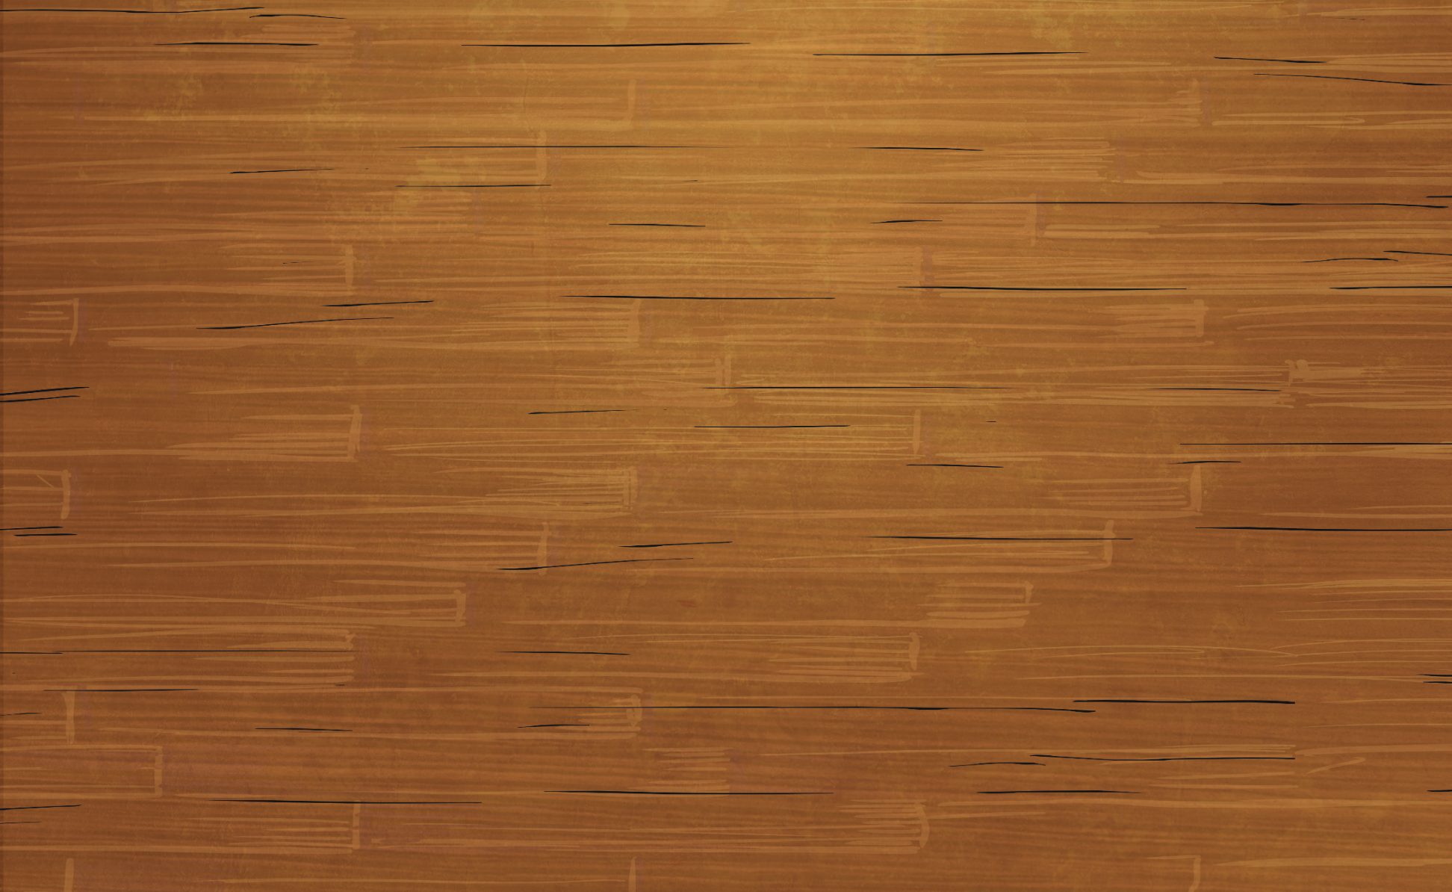
Tenths on a Place Value Grid
Diving
Look at the place value grid.
a)
What number do the orange
buttons represent?
0.7
b)
What number do the blue
Ones | tenths
buttons represent?
1.3
c)
What number do they
make altogether?
2
ten tenths = 1

Slide 5
Tenths on a Place Value Grid
Diving
Look at the place value grid.
Jamil wants to make the
a)
What number do the orange
number 5.1 on a place value
buttons represent?
0.7
chart. How many counters
will he need to use? Prove it
b)
What number do the blue
Ones | tenths
Ones | tenths
buttons represent?
1.3
There are five ones and
one tenth.
c)
What number do they
5 + 1 = 6
make altogether?
2
Jamil needs 6 counters.
ten tenths = 1

Slide 6
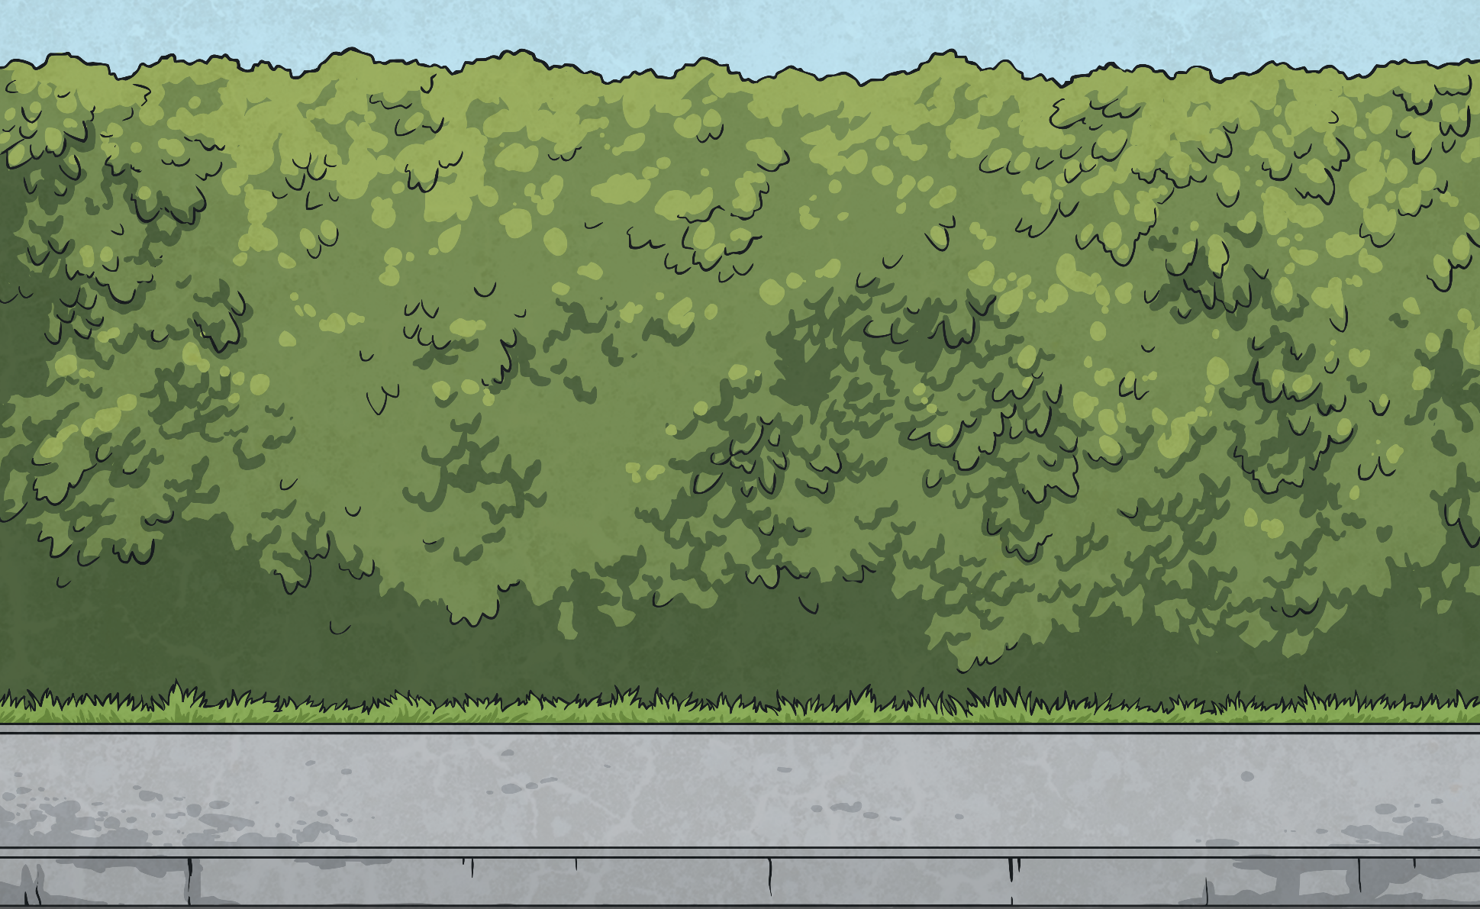
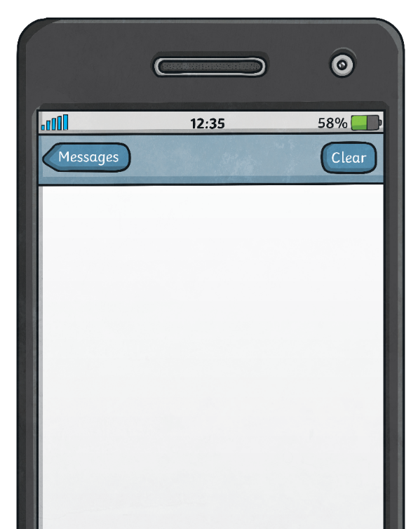
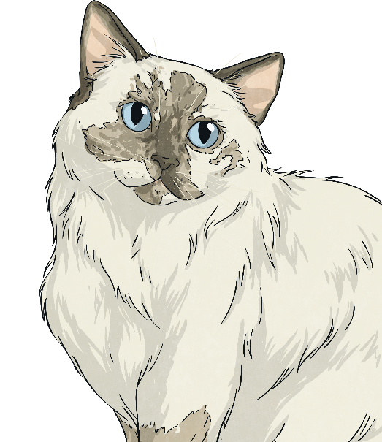
Tenths on a Place Value Grid
Diving
Draw the counters on the place value chart to match Fern’s description.
There are 4 counters on the left of the decimal point and 3 more counters than this on the right of the decimal point.
What is Fern’s number?
4.7
Ones | tenths
Fern
11:58

Slide 7
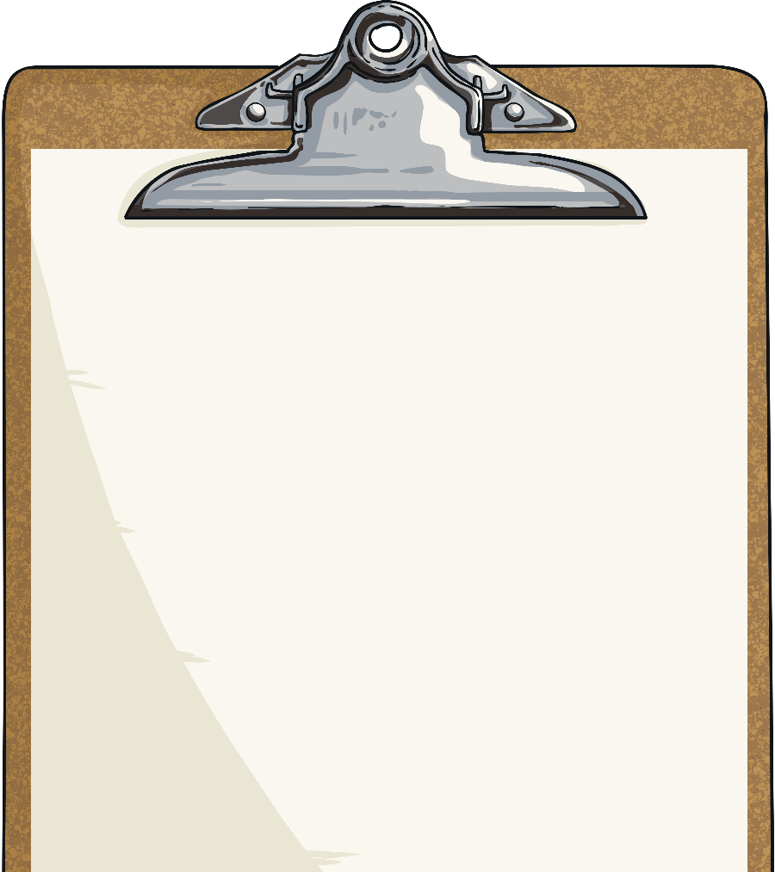
Tenths on a Place Value Grid
Deeper
The mistake is that they have mixed up the digits in the number. The place value chart shows 4 ones and 1 tenth, rather than 1 one and 4 tenths. The statement should say:
The place value grid shows the decimal number 4.1.
The place value grid shows the decimal number 1.4.
Explain and correct the mistake.
Ones | tenths

Slide 8
Tenths on a Place Value Grid
Deeper
Which is the odd one out and why?
A
B
C
D
1
0.1
0.1
Ones | tenths
2 ones and 0 tenths
2.1
0.1
0.1
0.1
0.1
0.1
0.1
0.1
0.1
C is the odd one out because it represents 2.1, while the rest of the images represent 2.

Slide 9
Tenths on a Place Value Grid
Deeper
You would need to add 1 more counter into the tenths column because 9 tenths add another 1 tenth makes 10 tenths. 10 tenths is equivalent to 1 whole.
0.9 + 0.1 = 1
Ones | tenths
What do you need to add so that the place grid represents a value of 1?
Explain how you solved this.
ten tenths = 1

Slide 10
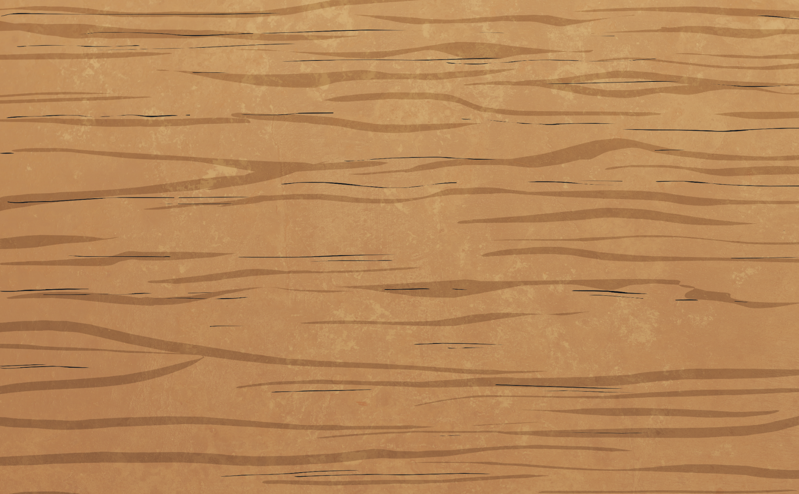
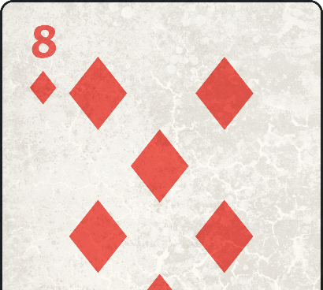
Tenths on a Place Value Grid
Deepest
What decimal numbers can you make using all four counters on this place value grid. Find all 5 possibilities.
4
3.1
2.2
1.3
0.4
Ones | tenths

Slide 11
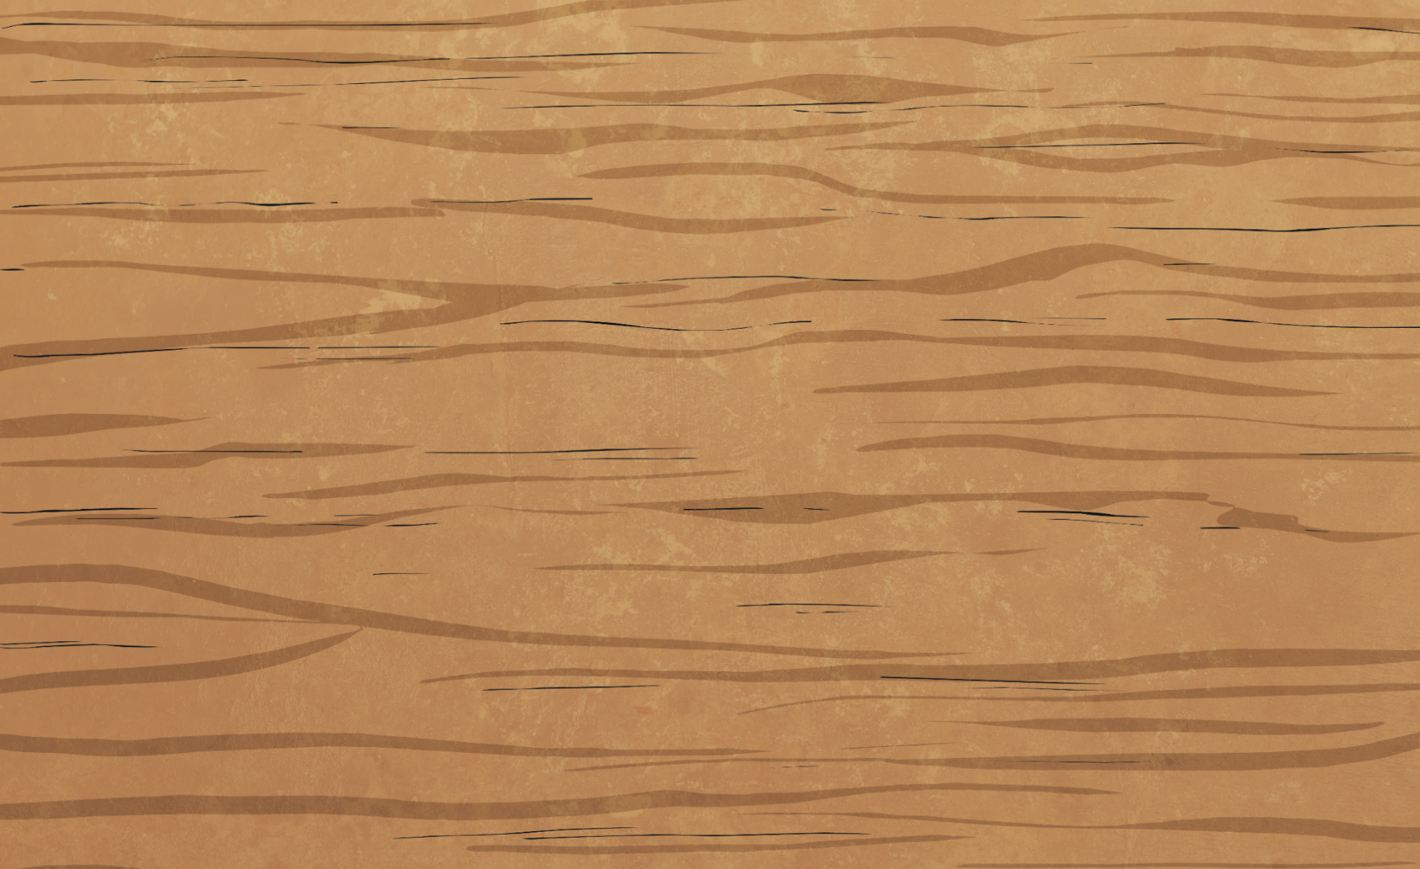
Tenths on a Place Value Grid
Deepest
Look at Niamh’s place value chart. She was making a decimal number using 6 counters but 2 have slipped off her place value grid on to the floor. What number could she have been making?
Find all 3 possible answers.
Ones | tenths
3.3
2.4
1.5

Slide 12
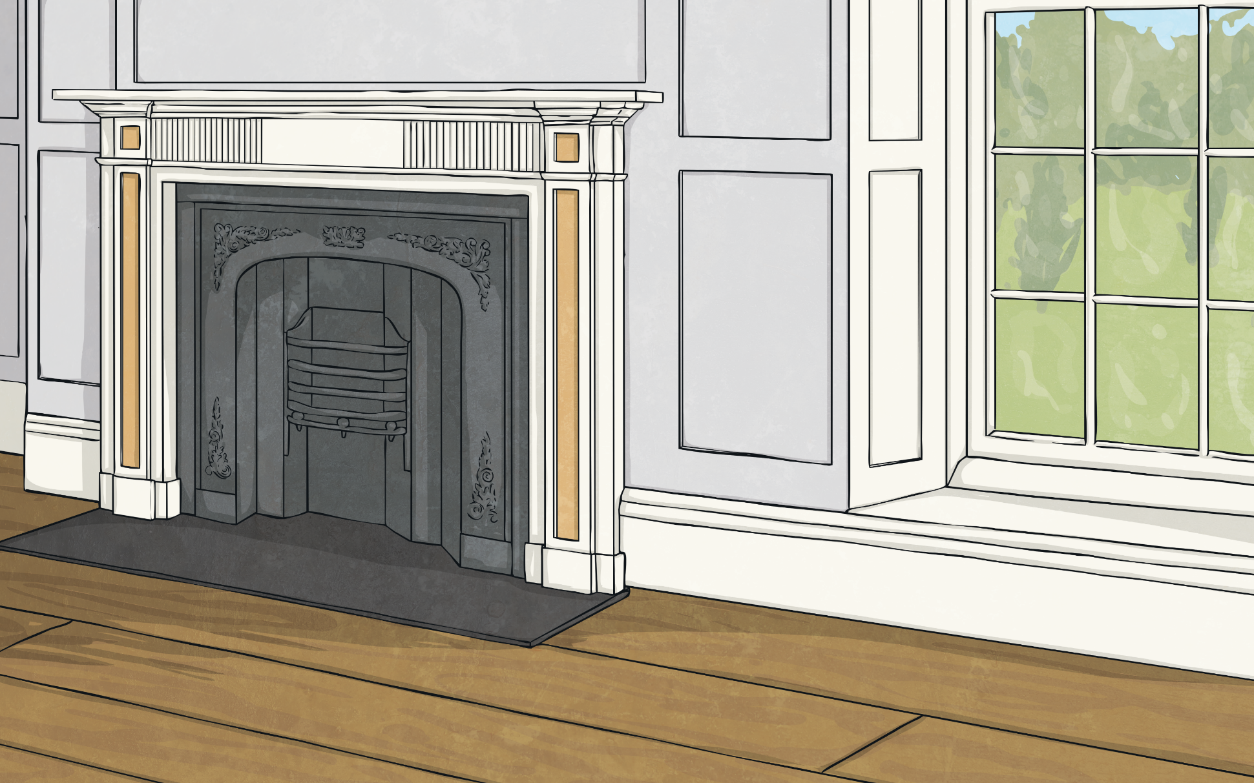
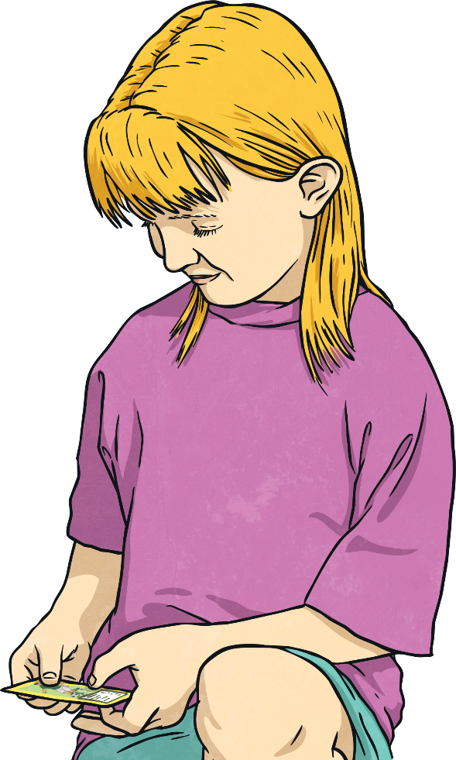
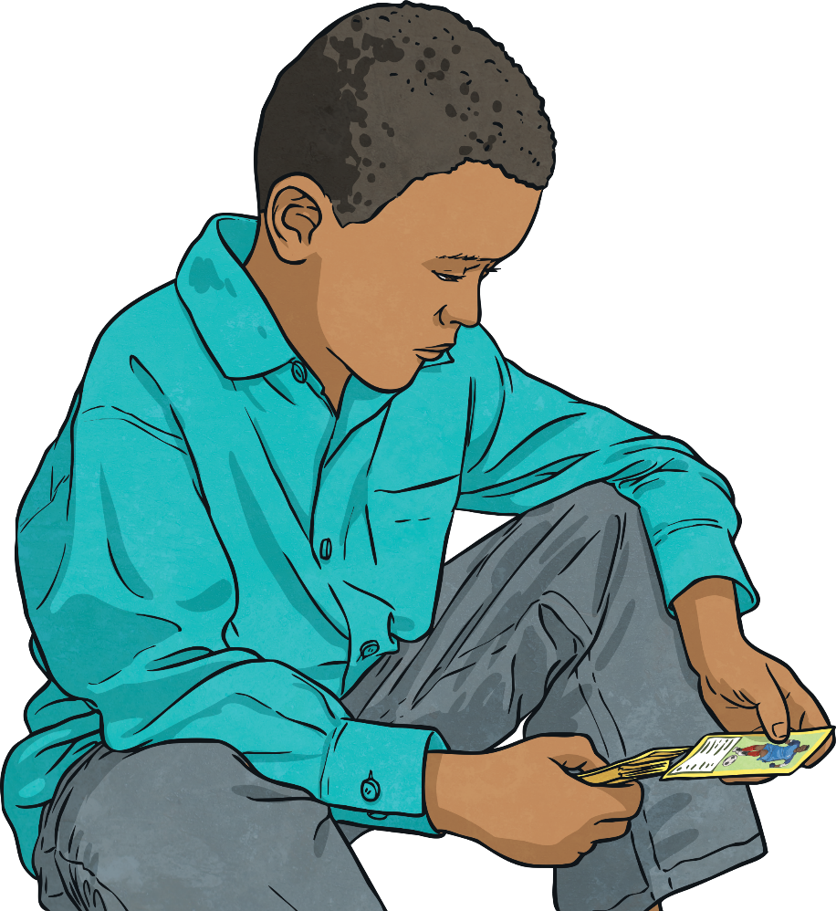
Tenths on a Place Value Grid
Deepest
Use the clues to help workout Tabatha’s number.
I’m thinking of a decimal number. First, I added 2 ones. Next, I subtracted 8 tenths. Then, I doubled it and my answer is 4.6. What was my original number?
Half of 4.6 = 2.3
2.3 + 0.8 = 3.1
3.1 – 2 = 1.1
Tabatha’s number is 1.1.

Slide 13
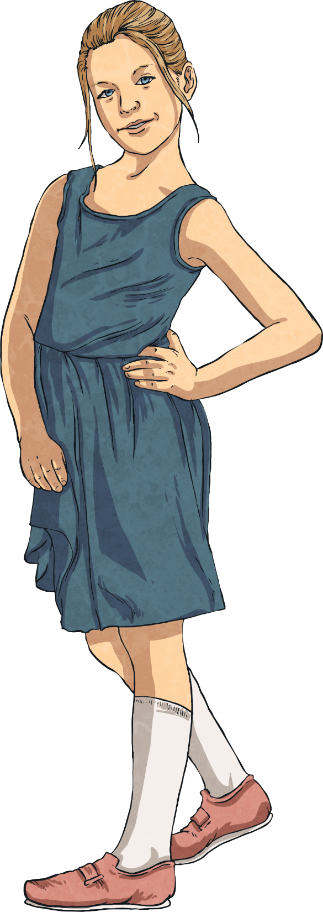
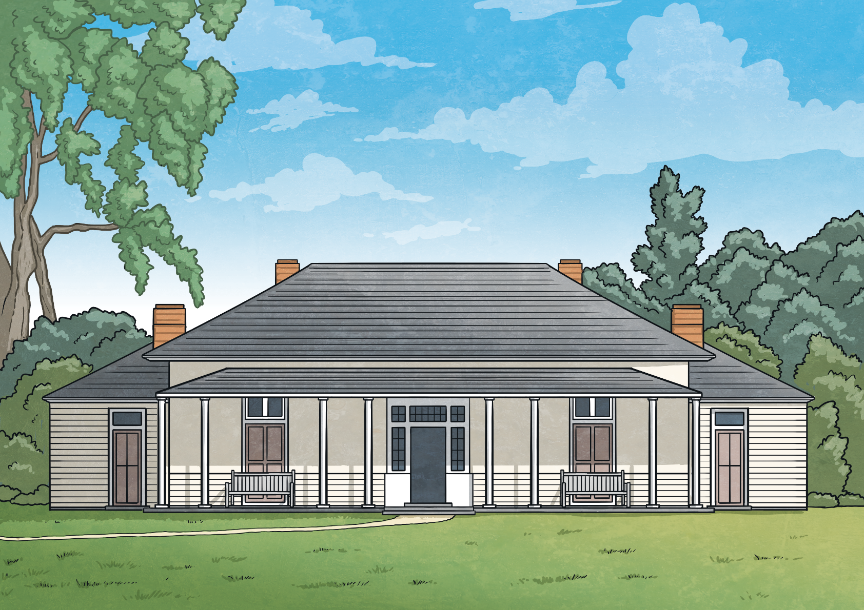
Tenths on a Place Value Grid
Deepest
True or False? Explain how you know.
3.1 is greater than
False. The place value grid represents the greater decimal number because is has 2 ones and 12 tenths. If you regroup 10 of these 12 tenths into 1 whole, you actually have 3 ones and 2 tenths, which is 3.2.
Ones | tenths
ten tenths = 1

