Slide 2
Aim
Recognise and show, using diagrams, families of common equivalent fractions.

Slide 3
Tenths and Hundredths
Diving
Look at this grid. Complete the sentences to match the grid.
Each little square is 1 out of ____ and represents the fraction .
1
100
100
Each column is out of and represents the fraction .
1
10
1
10
The columns and rows can also be
represented as out of 100 or .
10
10
100

Slide 4
Tenths and Hundredths
Diving
Look at this grid. Complete the sentences to match the grid.
There are squares shaded out of 100.
40
40
This represents .
100
There are rows shaded out of 10.
4
4
This represents .
10

Slide 5
Tenths and Hundredths
Diving
Look at this grid. Complete the sentences to match the grid.
There are squares shaded out of 100.
26
26
This represents .
100

Slide 6
Tenths and Hundredths
Diving
Choose the correct fraction to match the statement.
How do you know you have chosen the correct one?
On my hundred square, 5 rows have been shaded plus 4 extra squares.
45
45
54
54
10
100
100
10
It has be this one as 5 rows of 10 is 50. If you add on the 4 extra, that gives you 54 out of 100.

Slide 7
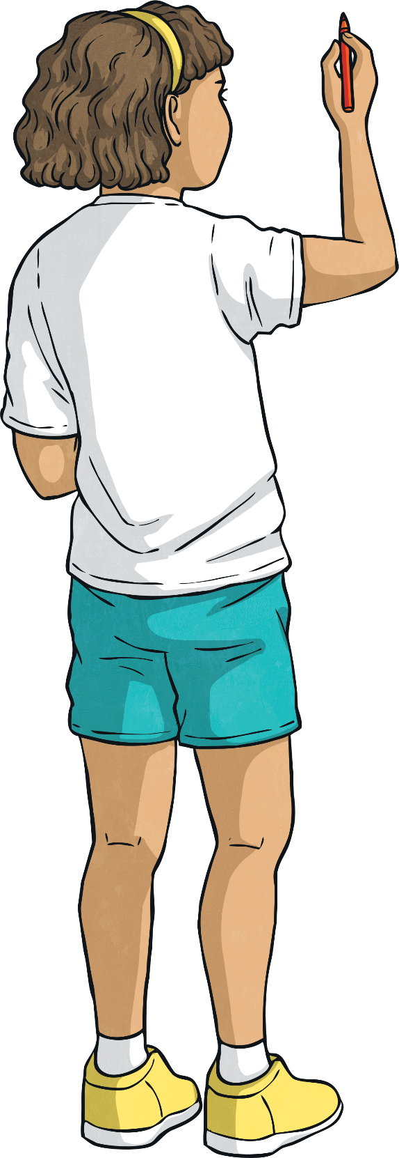
Tenths and Hundredths
Diving
Complete the part-whole model.
3
10
39
100
9
100

Slide 8
Tenths and Hundredths
Diving
Use the part–whole model to partition the fractions.
a) 60 hundredths
6
0
10
10
60
60
100
100
0
60
100
100
b) 41 hundredths
4
10
41
100
1
100

Slide 9
Tenths and Hundredths
Deeper
There are two rows and 3 extra squares shaded which represents .
Mandeep is explaining what this grid shows. Is she correct? Explain your answer.
23
10
Mandeep is incorrect. There are 23 shaded squares but it does not represent , it represents 23 hundredths. This would be written as .
23
10
23
100

Slide 10
Tenths and Hundredths
Deeper
What is missing? Explain your reasoning.
6
10
67
100
7
100
6
10
67
100
7
100
is missing because represents 6 rows of 10 squares shaded, which makes 60 squares, and represents 7 individual squares shaded. 60 + 7 = 67.
67
100
6
10
7
100

Slide 11
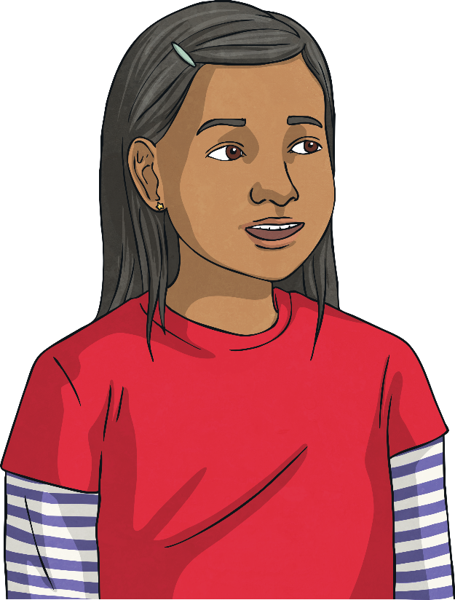
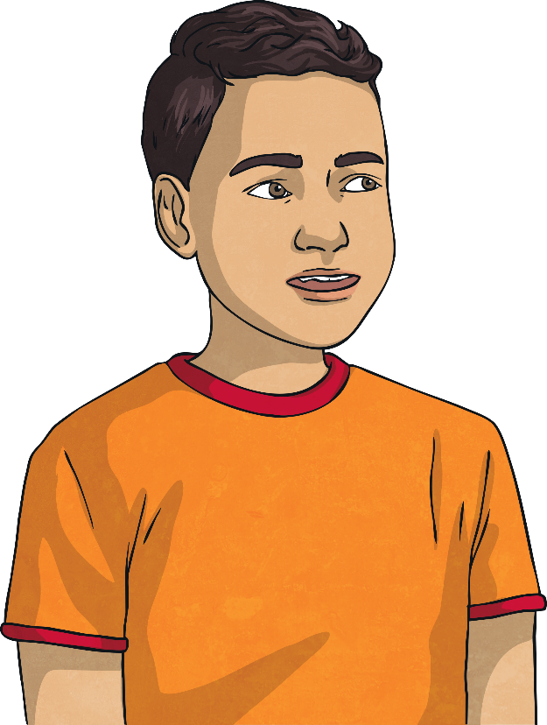
Tenths and Hundredths
Deeper
Who has the least? Explain your answer.
I have 5 hundredths and 3 tenths.
3
I have fifty three hundredths.
10
35
100
5
100
Jenny has the least because
she has .
35
100
Dhruv has .
Jenny
53
100
Dhruv

Slide 12
Tenths and Hundredths
Deepest
Find 5 different ways to partition fourteen-hundredths using this part-whole model.
1
11
12
10
100
100
14
14
14
100
100
100
4
3
2
100
100
100
13
9
100
100
14
14
100
100
1
5
100
100

Slide 13
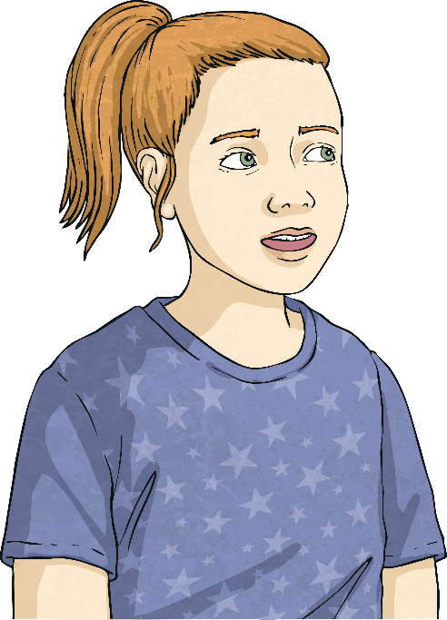
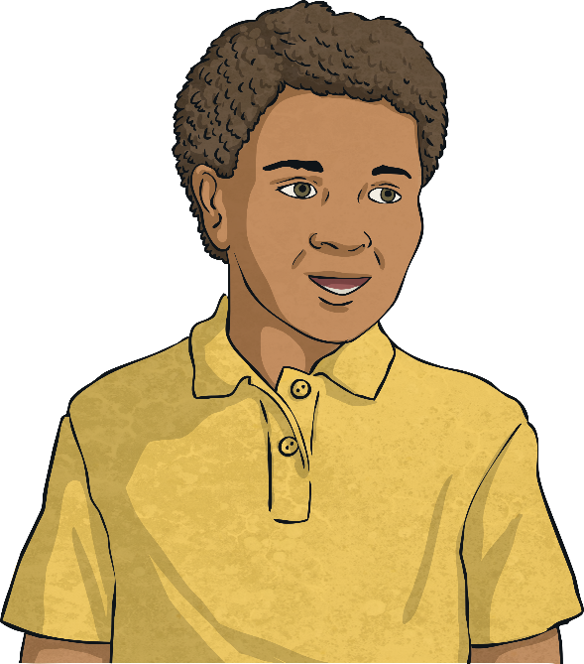
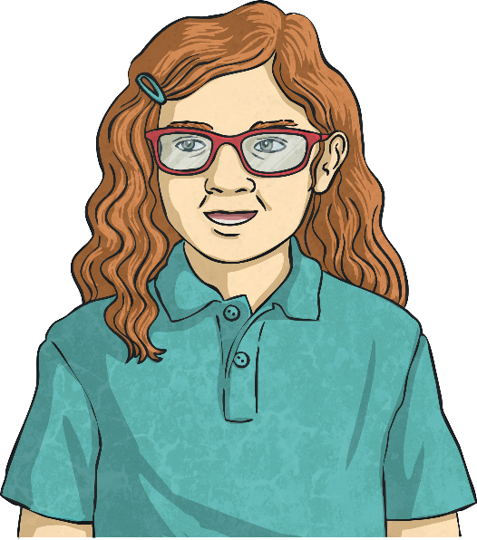
Tenths and Hundredths
Deepest
Read each child’s statement and match them to the correct fraction.
8
68
78
78
68
8
100
100
100
100
100
100
Gabby
My fraction has some tenths and eight hundredths.
Mateus
Zia
My fraction has no tenths.
My fraction has six tenths.

