Slide 2
Aim
Recognise and write decimal equivalents of any number of tenths or hundredths.

Slide 3
Tenths as Decimals
Diving
Complete this table:
Representation
Decimal
Fraction
1.1
11 10
12 10
1.2
18 10
1.8
1.6
16 10

Slide 4
Tenths as Decimals
Diving
Write each of the following as a decimal and a fraction:
0.5
5 10
0
1
0.8
8 10
0.3
3 10

Slide 5
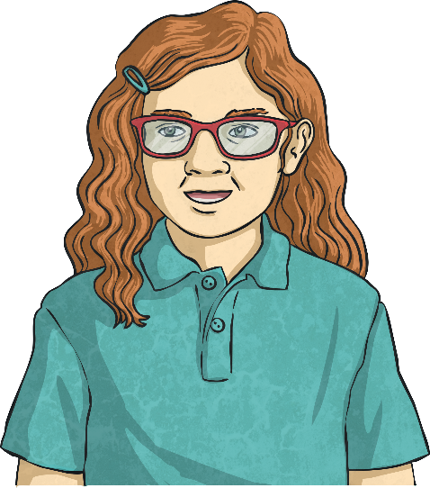
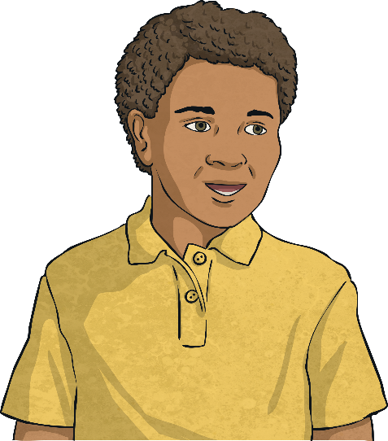
Tenths as Decimals
Deeper
Petra and Leo write this representation in the ways shown:
Are both children correct? If not, can you explain what mistake they have made and what they should have written.
4 10
Leo is correct as the representation shows one whole and three-tenths (which is equal to 1.3).
1.3
Petra is incorrect. She has counted the one whole as but it should have been .
1 10
Petra
Leo
10 10
10 10
3 10
13 10
So it would be and which is .

Slide 6
Tenths as Decimals
Deeper
Mandeep is converting decimals into fraction representations.
This is her first conversion.
1.4 =
What mistake did she make?
The 1 whole is correct but 0.4 has been represented incorrectly. Mandeep has represented 0.4 as a whole divided into 4 equal parts. Instead, as 0.4 is equal to , a whole should be divided into 10 equal parts with 4 parts shaded.
4
10
What should it look like?

Slide 7
Tenths as Decimals
Deepest
In a centimetre (cm), there are 10 millimetres (mm).
1mm = cm
Use this information to complete this table:
1 10
Centimetres and Millimetres | Millimetres | Fraction | Decimal
1cm 8mm | 18mm | 1 cm ( ) | 1.8cm
 | 13mm
 |  | cm
 |  |  | 1.1cm
8 10
18 10
3 10
13 10
1cm 3mm
1 cm ( )
1.3cm
0cm 6mm
6mm
6 10
1.6cm
1cm 1mm
11mm
1 10
11 10
1 cm ( )

Slide 8
Tenths as Decimals
Deepest
Which representations are equal to this representation?
Tick the correct representations:
1
0.9
ten-ninths
0
9 10

