Slide 2
Aim
Recognise and write decimal equivalents of any number of tenths or hundredths.

Slide 3
Hundredths as Decimals
Diving
Complete the grid.
Model | Words | Fraction | Decimal
25 100
twenty-five hundredths
0.25

Slide 4
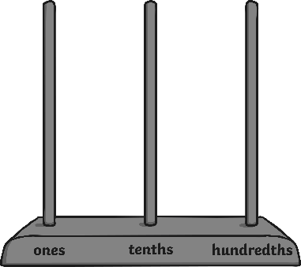
Hundredths as Decimals
Diving
Identify the models and images that do not represent 31 hundredths.
A | B | C | D
0.1
0.01
31 100
0.31
0.01
0.01
0.13
13 hundredths
0.31
31 hundredths
3.1
310 hundredths
0.31
31 hundredths
A and C do not represent 31 hundredths.

Slide 5
Hundredths as Decimals
Diving
Complete the calculation.
7
9 100
=
0.7
9

Slide 6
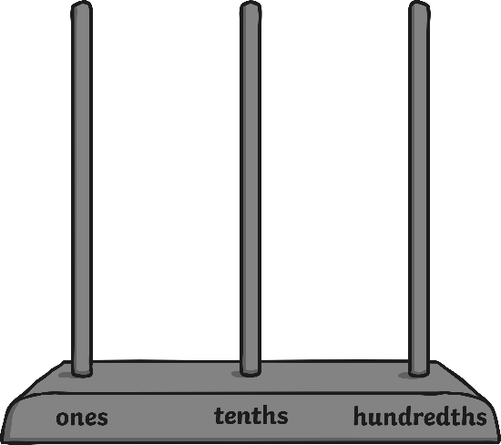
Hundredths as Decimals
Deeper
Which is the odd one out? Explain why.
A
B
C
0.1
0.01
17 100
0.01
0.01
0.01
0.01
0.01
0.01
A represents 1.4 and B and C both represent 0.17 so A is the odd one out.

Slide 7
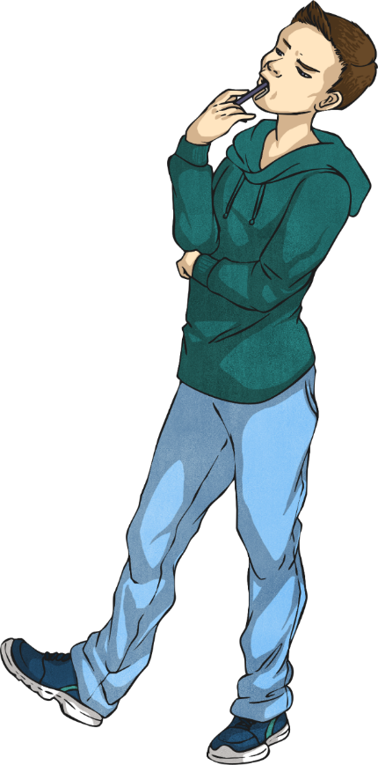
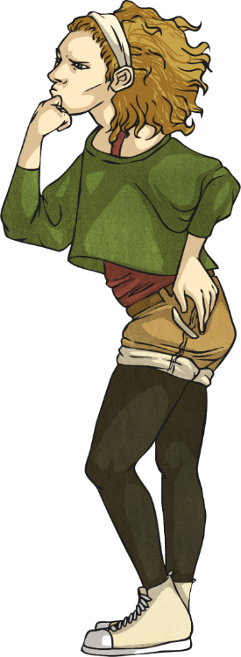
Hundredths as Decimals
Deeper
What is the same and what is different about this fraction and decimal number? Explain your reasoning.
0.1
0.1
2.2
0.01
0.01
They are shown differently because one number is represented with place value counters and the other is represented as a number. They are also different because they represent different values. The place value counters represent 0.22, which is 22 hundredths and the decimal number is 2.2, which is 220 hundredths.
The similarity is that they both have 2 tenths.

Slide 8
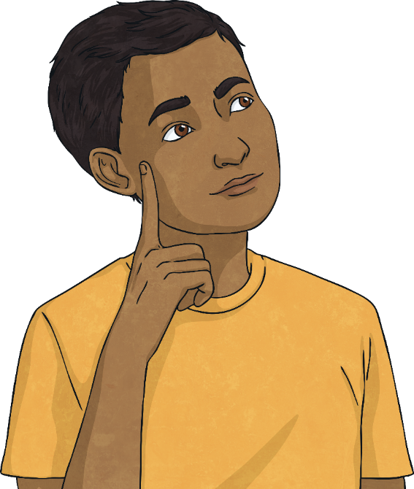
Hundredths as Decimals
Deeper
True or false? Explain your answer.
15 hundredths is the same as 1500.
False. 15 hundredths = 0.15 not 1500.
The 15 hundredths have been confused with 15 hundreds.

Slide 9
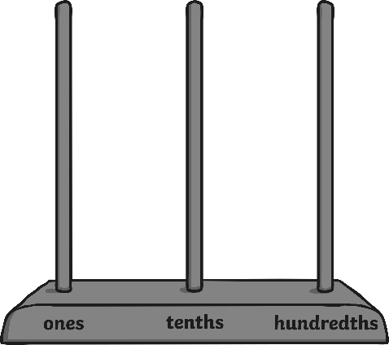
Hundredths as Decimals
Deepest
Put the models and images in descending order.
A
B
C
D
92 100
2.9
0.29
2.9
0.92
1.29
B, D, C and A.

