Slide 2
Aim
Find the effect of dividing a one- or two-digit number by 10 and 100, identifying the value of the digits in the answer as ones, tenths and hundredths.

Slide 3
Divide 1 Digit by 10
Diving
Complete the place value grid to solve the calculation.
Ones | tenths
0.5
5 ÷ 10 =
right
When dividing by 10, we move the counters one place to the .

Slide 4
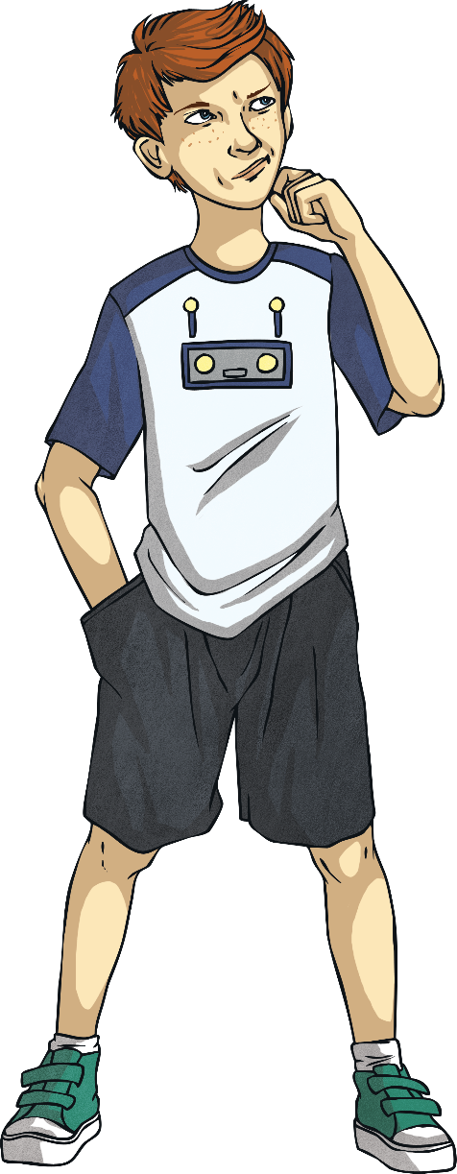
Divide 1 Digit by 10
Diving
Move the digit on the place value grid to answer the calculation.
Ones | tenths
0.3
3 ÷ 10 =
3

Slide 5
Divide 1 Digit by 10
Diving
Solve these calculations.
7 ÷ 10 =
0.7
0.9
= 9 ÷ 10
8
÷ 10 = 0.8
0.1 = ÷ 10
1

Slide 6
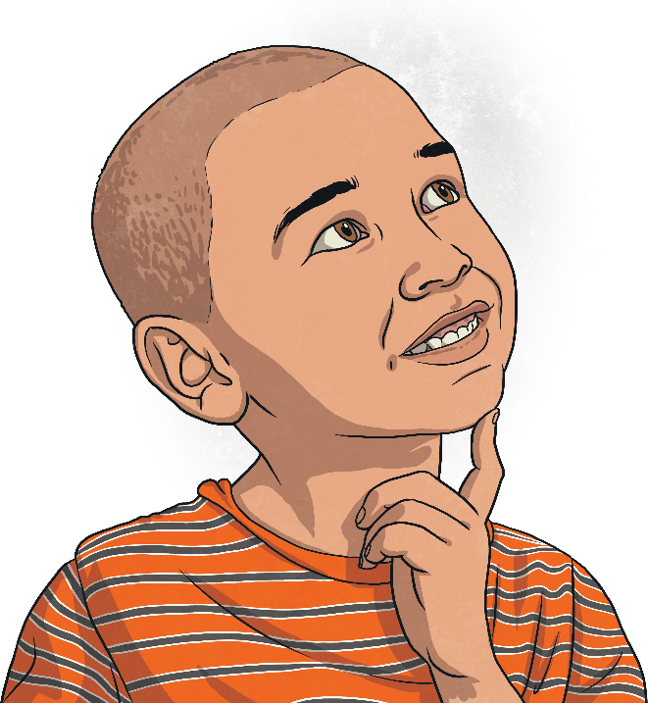
Divide 1 Digit by 10
Deeper
Explain and correct the mistake that Anton has made.
Ones | tenths
4 ÷ 10 = 4
Anton has forgotten to move the 4 counters in the ones column into the tenths column.
If he moved the counters correctly in this way, it would show that 4 has been divided by 10 to make 0.4.

Slide 7
Divide 1 Digit by 10
Deeper
Mario’s number is 10 times smaller than Ivy’s number.
0.1
0.1
0.1
0.1
Mario
0.1
0.1
0.1
0.1
Ivy
True or false?
Explain your answer.
False. Mario’s image represents 0.8 and Ivy’s image represents the number 7.
0.8 is not 10 times smaller than 7.

Slide 8
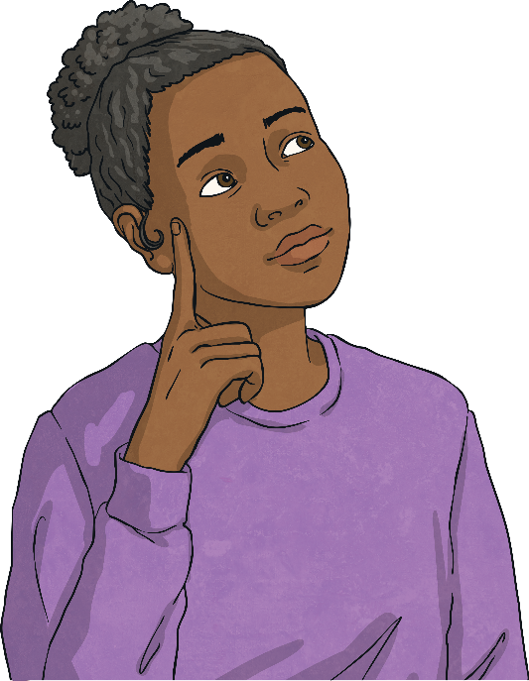
Divide 1 Digit by 10
Deeper
The place value grid shows the answer to the calculation ‘9 shared equally between 10’.
Ones | tenths
Do you agree or disagree? Why?
Agree. This place value grid represents the number 0.9. When you divide 9 by 10, the 9 ones counters move 1 column to the right into the tenths column. This makes 0.9 so 9 ÷ 10 = 0.9.

Slide 9
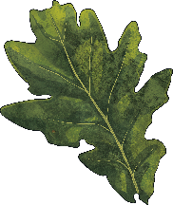
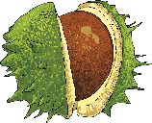
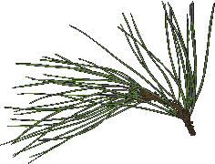
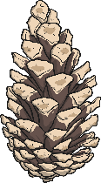
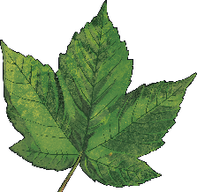
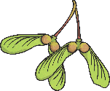
Divide 1 Digit by 10
Deepest
Complete the table.
Type of Tree | Average Growth in 10 Years | Average Growth in 1 Year
oak | 3m
chestnut | 5m
pine |  | 0.8m
sycamore |  | 0.6m
0.3m
0.5m
8m
6m

Slide 10
Divide 1 Digit by 10
Deepest
Use the digit cards to complete these number sentences. Each card may only be used once.
4
5
7
7
42 ÷ ÷ 10 = 6 ÷ 10
5
16 ÷ ÷ 10 < ÷ 10
4

