Slide 1
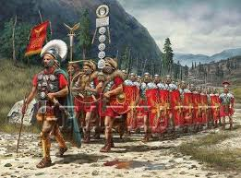
Write a super sentence about this picture on your whiteboard.
Challenge: Can you include a:
Simile
Fronted adverbial
Complex sentence
3 ed sentence
Ad same ad

Slide 2
Home School Task LO: To write using imaginative description
Discuss descriptive words and phrases that capture the imagination.
I can use techniques used by authors to create characters and settings.
I can use high level vocabulary

Slide 3
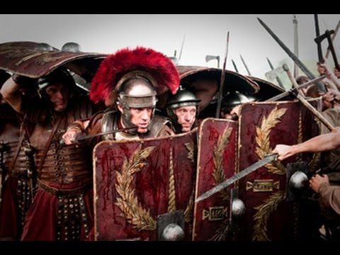
What formation are the soldiers stood in?
How might the soldiers be feeling? How do you know?
How are the soldiers showing suspense?

Slide 4
Today we are going to describe a legion of Roman soldiers marching and preparing for battle.

Slide 5
WAGOLL
Day after day the soldiers continued, heading ever eastwards, across the bleak mountains. Up there, the winds were sharp and cold the whole year round, and blew the few trees that grew there so hard they looked strange and twisted and bent. Despite this, the Roman soldiers marched energetically along the freshly dug road. The metal hobs in the soles of their leather boots pounded against the hard earth like hooves of a galloping horse. Gladius’ hanging in their scabbards, the Romans felt smug with the power that this gave them. The rhythmic sound of, “Dextra, Sinistra!” echoed in their hearts. The strong, protective lorica weighed heavily upon their shoulders. Each soldier locked in their metal safe.
Barely three miles from the protection of the fort they had just built, the soldiers felt a sea of eyes upon them. On the horizon the sun cast sinister silhouettes of the Brigantes wielding axes. The Roman soldiers stood unnerved, efficiently moving into a tortoise formation, shields raised. A single cry from the Brigantes, as they began their assault…

Slide 6
Main Task
Paragraph 1- Set the scene of where the soldiers are
Paragraph 2- Describe how the soldiers are feeling and what they are wearing
Paragraph 3- Describe the Brigantes attacking the Romans
Features to include
5 senses
Adjectives
Fronted adverbials
Chronological order
Third person
Yellow: DE:DE sentence
Brigantes lorica dextra sinistra gladius attack march soldiers legion scabbard mountain tortoise shield

