Slide 1
LO: To compare the daily lives of children today and in Ancient Roman time
To use retrieval and interpretation skills
To identify differences and similarities between the daily life of Ancient Roman children and ourselves
To give opinions as to which aspects of Ancient Roman life you prefer

Slide 2
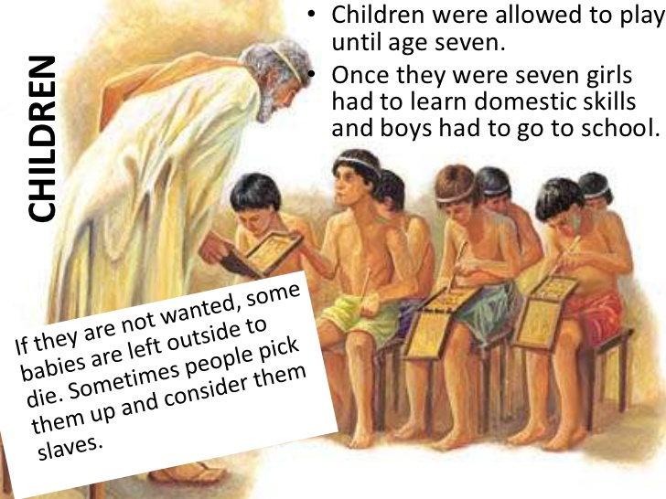
R- What happened to unwanted babies?
I- Who is the man in the picture? How do you know?
C- Why did the Romans not let girls go to school?

Slide 3
https://www.bbc.com/teach/class-clips-video/children-in-roman-britain/zkdy47h

Slide 4
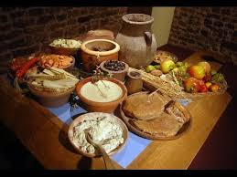
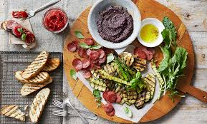
Breakfast
Daily life in Ancient Rome often began with a light breakfast. Bread and water (or wine) would be served at home, or a wheat pancake could have been purchased on the way to work or school. Sometimes meat, fish, fruit, and other items may have been served, but not each day.

Slide 5
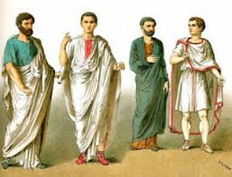
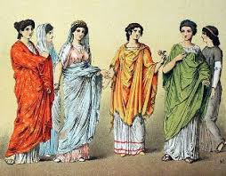
Ancient Roman Clothing
Men and boys wore togas and then later tunics, which were slightly larger than a shirt typically worn today. Women and girls also wore tunics; however, these reached their ankles and tied near the waist.

Slide 6
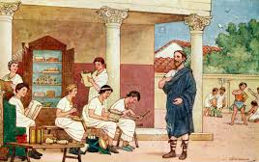
Ancient Roman School
While many girls stayed home with their mothers to take care of the home, some girls were allowed to attend schools with the boys. Schools often consisted of only one room and might have resembled a small Roman shop, like a bakery.

Slide 7
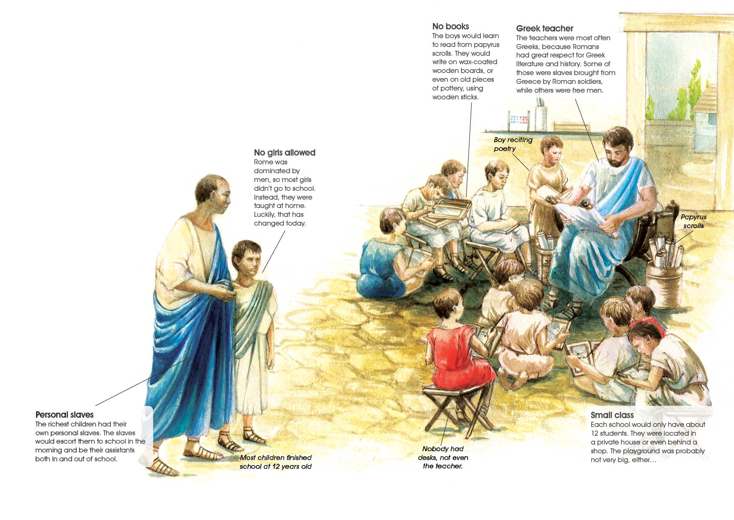

Slide 8
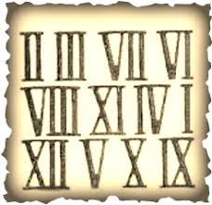
Schoolmasters (or teachers) were often strict, especially those who followed the words of Aristotle, who once said, “Young people are not playing when they are learning.” Education was taken very seriously in these schoolhouses. Students studied many of the same subjects learned in school today. In school, math was difficult, as six Roman letters (I, V, X, L, C, and M) were used to create all numbers. Students also learned how to speak, how to write, how to tell time, how to use and count money, and other lessons designed to help them in everyday life. Weights and measurements, history, philosophy, and public speaking were also taught, among other subjects. This prepared them for jobs like the Roman Army, school teachers, politicians and architects.

Slide 9
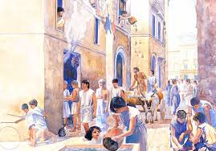
Jobs
While the children were in school and the mothers and daughters tended to the household chores, the fathers spent a few hours working each day. Below are some of the typical jobs:
Farming
Baking
Building
Selling and trading goods
Making clothing
Some became doctors, lawyers, writers, or teachers. Many others joined the military, which provided a decent salary for a man supporting a family. Unlike today, though, most men worked six hours or fewer each day, usually stopping around mid-day.

Slide 10
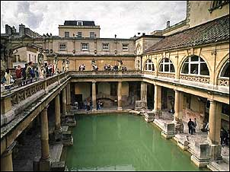
Leisure Time
After work and school ended each day, most men and boys headed to the baths, which required only a very small fee to enter. Here people gathered, not only to wash, but also to sit and talk among friends. The bathhouses usually included gardens, gymnasiums, libraries, and other forms of recreation. A typical cold bath resembled something like a swimming pool, while other rooms were available for hot baths. Many Romans spent their time in gardens and fields, assuring their families of fresh foods. Children helped and would often use this time to learn about both family and Roman history from their parents.

Slide 11
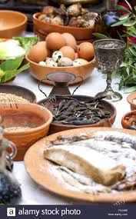
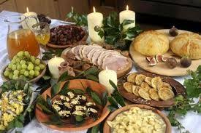
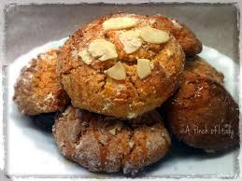
Roman meal time
After spending some time at the baths, most would head home for their biggest meal of the day, eaten somewhere between our lunch time and dinner time. This meal usually consisted of wheatmeal porridge. When hosting a dinner party or celebrating a special occasion, though, a Roman dinner could consist of as many as six or seven courses. In addition to salads, eggs, garden vegetables, and fresh breads, a variety of Mediterranean seafood would have been available, including: mackerel, mullets, eels, and oysters. Meat dishes consisted of lambs, pigs, chickens, geese, ducks, and even peacocks, among others. For dessert, they ate fruit and honey-sweetened cakes.

Slide 12
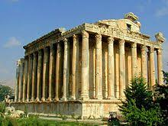
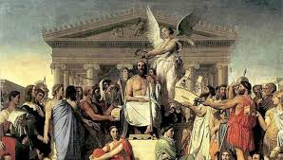
Religion
Religion was a big part of daily Roman life. Although some families did not visit temples often, many had small shrines in the home dedicated to specific gods and goddesses. Like the Greeks, early Romans believed the gods and goddesses lived on top of Mount Olympus. Families would pray to these gods to ask for protection and guidance.

Slide 13
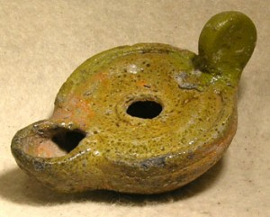
Evening Time
At night, Romans used lamps that burned olive oil. Most families could afford to burn just one lamp, which provided only a fraction of the light from one of our electric bulbs.
Most Romans went to bed early, leaving them able to rise easily in the morning to begin a new day.
https://www.bbc.com/bitesize/articles/ztqg4wx

Slide 14
Main Task
To complete the table showing differences and similarities between you and an Ancient Roman child’s day.

